Slide 1
2012-2013
College of Marine Science
Awards

Slide 2
Points of Pride:
Success after Graduation Out of 8 recent PhDs: 5 hired as post-docs 2 hired as new faculty 1 hired at state research agency

Slide 4
Undergraduate Opportunities offered by CMS:
2 advanced oceanography classes in Tampa
4 classes at USFSP
Several Lab Internships
New Marine Biology Emphasis at USFSP

Slide 5
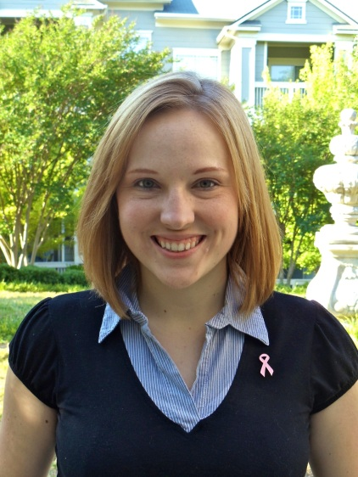
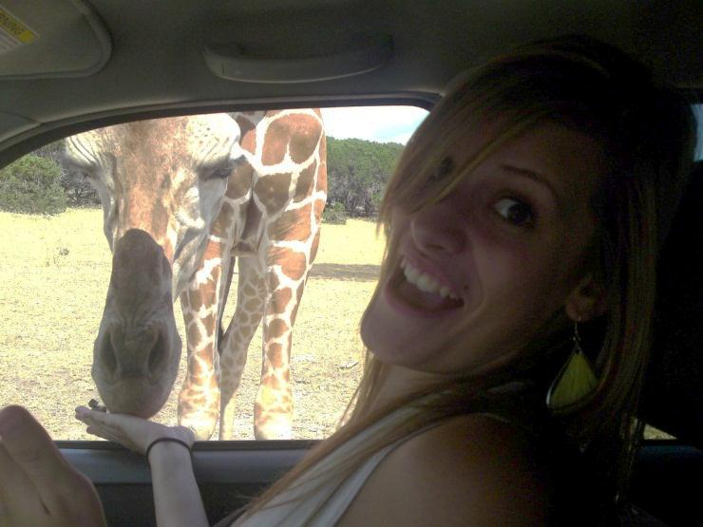
University Funded Fellowships
USF University Graduate Fellowship
Lindsey Dornberger
(Ainsworth)
USF Presidential Doctoral Fellowship
Nora Katie Douglas
(Byrne / Hollander)

Slide 6
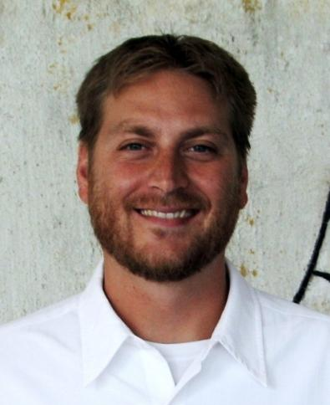
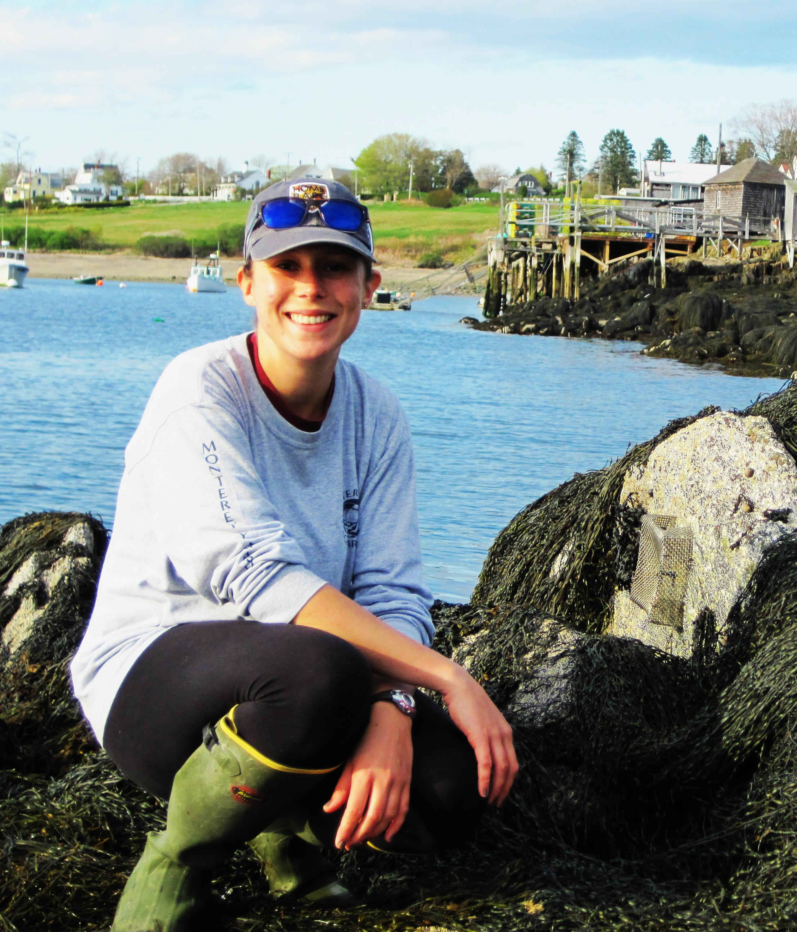
MARINE RESOURCE ASSESSMENT FELLOWSHIPS (NOAA)
Michael Drexler
(Ainsworth)
Orian Tzadik
(Stallings)
Joshua Kilborn
(Naar)
Marcy Cockrell
(Murawski)
Amy Wallace
(Peebles)

Slide 7
Wells Fargo Fellowship in Marine Science
Endowment was originally established by Southeast Bank in 1990
Over the years the bank has changed names from: First Union National Bank, Wachovia Band, and now Wells Fargo
Awarded annually to support one graduate student who has completed their first year of study in marine science

Slide 8
Wells Fargo Fellowship in Marine Science
Dominika E. Wojcieszek
(Byrne)

Slide 9
Dominika E. Wojcieszek
Oceanic uptake of anthropogenic carbon emitted to Earth’s atmosphere results in the acidification of ocean waters.
Decreasing pH causes carbonate and borate ion concentrations to decrease.
Relative abundance of boron in marine calcite (B/Ca) reflects the carbonate ion saturation state (Δ[CO₃²⁻]) and pH of the water in which calcification occurred.
I test the application of B/Ca of epibenthic foraminifera Cibicidoides pachyderma as a shallow water Δ[CO₃²⁻] proxy of past climate and atmospheric CO₂ change.
Cibicidoides pachyderma
Gulf of Mexico

Slide 10
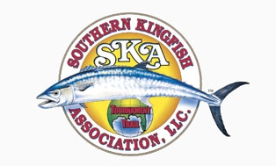
SOUTHERN KINGFISH FELLOWSHIP
The Southern Kingfish Association was founded in 1991 and is one of America’s largest offshore saltwater tournament trials
Fellowship was initiated in 2005 and is awarded annually to an exceptional Marine Science graduate student who has recently completed an undergraduate or Master’s science degree

Slide 11
Southern Kingfish Association’s Fellowship
Alisha Gray
(Ainsworth)
Notes:
The Anne and Werner Von Rosenstiel Fellowship in Marine Science was formerly established in 1992. The primary purpose of the Von Rosenstiel Fellowship is to attract the most talented and most deserving graduate students in marine science. Awards are made to first year students in each of the four major oceanographic disciplines (biological, chemical, geological, and physical).
Pam Hallock Muller is her major professor
Ted Van Vleet will introduce her as a Von Rosenstiel fellow
She also received the USF Presidential Fellowship.

Slide 12
Alisha Gray
I am an ecosystem and fisheries modeller.
For my master’s degree, I am using ECOPATH with ECOSIM to model how Florida red tides affect the West Florida Shelf.
Notes:
The Anne and Werner Von Rosenstiel Fellowship in Marine Science was formerly established in 1992. The primary purpose of the Von Rosenstiel Fellowship is to attract the most talented and most deserving graduate students in marine science. Awards are made to first year students in each of the four major oceanographic disciplines (biological, chemical, geological, and physical).
Pam Hallock Muller is her major professor
Ted Van Vleet will introduce her as a Von Rosenstiel fellow
She also received the USF Presidential Fellowship.

Slide 13
Mahaffey Family Graduate Fellowship
Established December 2010 by M. Thomas Mahaffey, Jr., Chairman, Mahaffey Family Foundation to benefit the College of Marine Science.
To support a full time graduate student in the College of Marine Science.
The first fellowship was awarded in 2012
Mark Mahaffey

Slide 14
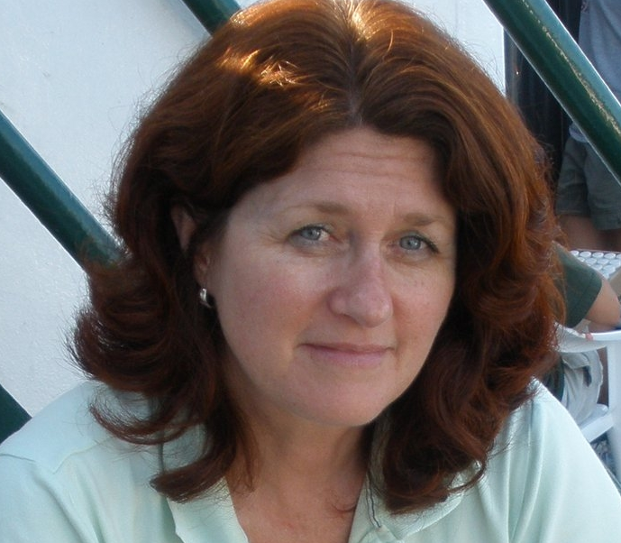
Mahaffey Family Graduate Fellowship
Mary I. Abercrombie
(Coble)
Notes:
The Anne and Werner Von Rosenstiel Fellowship in Marine Science was formerly established in 1992. The primary purpose of the Von Rosenstiel Fellowship is to attract the most talented and most deserving graduate students in marine science. Awards are made to first year students in each of the four major oceanographic disciplines (biological, chemical, geological, and physical).
Pam Hallock Muller is her major professor
Ted Van Vleet will introduce her as a Von Rosenstiel fellow
She also received the USF Presidential Fellowship.

Slide 15
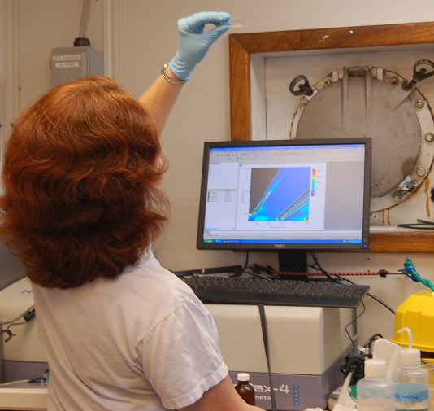
Mary I. Abercrombie
My research is focused on detection of petroleum in the marine environment.
My goal is to validate spectrofluorometry as a fast, efficient and reliable way to track petroleum spills.
Notes:
The Anne and Werner Von Rosenstiel Fellowship in Marine Science was formerly established in 1992. The primary purpose of the Von Rosenstiel Fellowship is to attract the most talented and most deserving graduate students in marine science. Awards are made to first year students in each of the four major oceanographic disciplines (biological, chemical, geological, and physical).
Pam Hallock Muller is her major professor
Ted Van Vleet will introduce her as a Von Rosenstiel fellow
She also received the USF Presidential Fellowship.

Slide 16
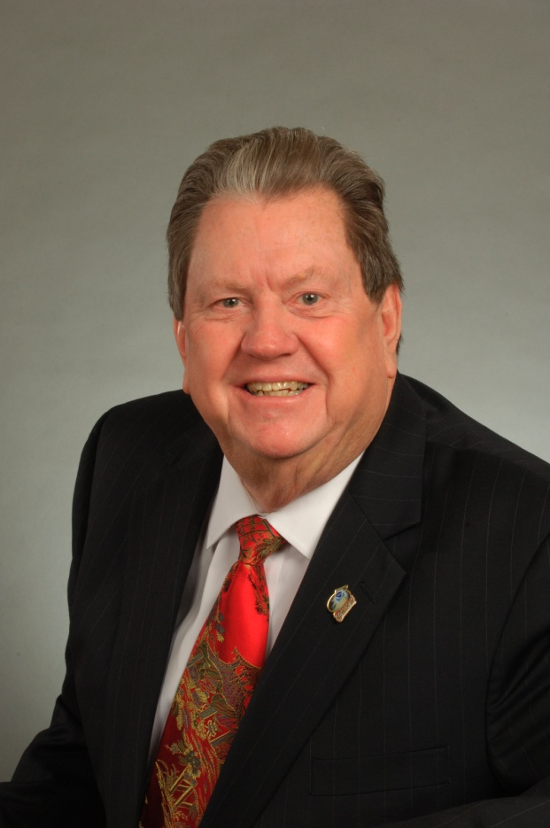
W. HOGARTH FELLOWSHIP IN MARINE MAMMALS
Former Dean of the College of Marine Science and United States Commissioner of the International Whaling Commission
Created in 2008 through a generous donation from the International Whaling Commission
Awarded annually to an especially accomplished biological oceanography graduate student
Special consideration is given to students enrolled in the Marine Resource Assessment program and whose research is focused on fisheries or marine mammals
Bill Hogarth

Slide 17
W. HOGARTH FELLOWSHIP IN MARINE MAMMALS
Erica Hudson Ombres
(Torres)
Notes:
The Anne and Werner Von Rosenstiel Fellowship in Marine Science was formerly established in 1992. The primary purpose of the Von Rosenstiel Fellowship is to attract the most talented and most deserving graduate students in marine science. Awards are made to first year students in each of the four major oceanographic disciplines (biological, chemical, geological, and physical).
Pam Hallock Muller is her major professor
Ted Van Vleet will introduce her as a Von Rosenstiel fellow
She also received the USF Presidential Fellowship.

Slide 18
Erica Hudson Ombres
My research focuses on the overwintering strategy of the Antarctic krill Euphausia superba. I hope to figure out how it survives the winter by investigating these areas:
Metabolism
Individual level: to figure out what the krill are eating during the fall as they transition into winter.
Ecosystem level: to see if there are any differences in diet between summer and winter throughout the food web.

Slide 19
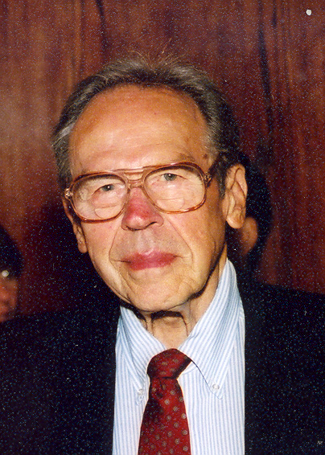
CARL D. RIGGS FELLOWSHIP
Accomplished ichthyologist who served USF in many capacities
Helped develop the Marine Sciences Department’s oceanographic research and education
Fellowship was established in 1992
Student selected to receive fellowship should combine academic excellence and scientific insight with service to either the College of Marine Science, USF, a professional society, some segment of the Tampa Bay community or society at large
Carl Riggs

Slide 20
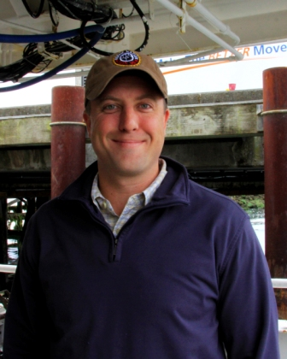
CARL D. RIGGS FELLOWSHIP
Paul Suprenand
(Hallock Muller)

Slide 21
Paul Suprenand
Studying Biological Oceanography
My research focuses on the Ecology, Physiology, Geochemistry, and Modelling of environmental parameters that influence zooplankton

Slide 22
Linton Tibbetts Fellowship
Established in 2011 by Linton N. Tibbetts, O.B.E.
Awarded annually to a full-time marine science graduate student involved in marine science research relevant to the Caribbean region
First awarded in 2012

Slide 23
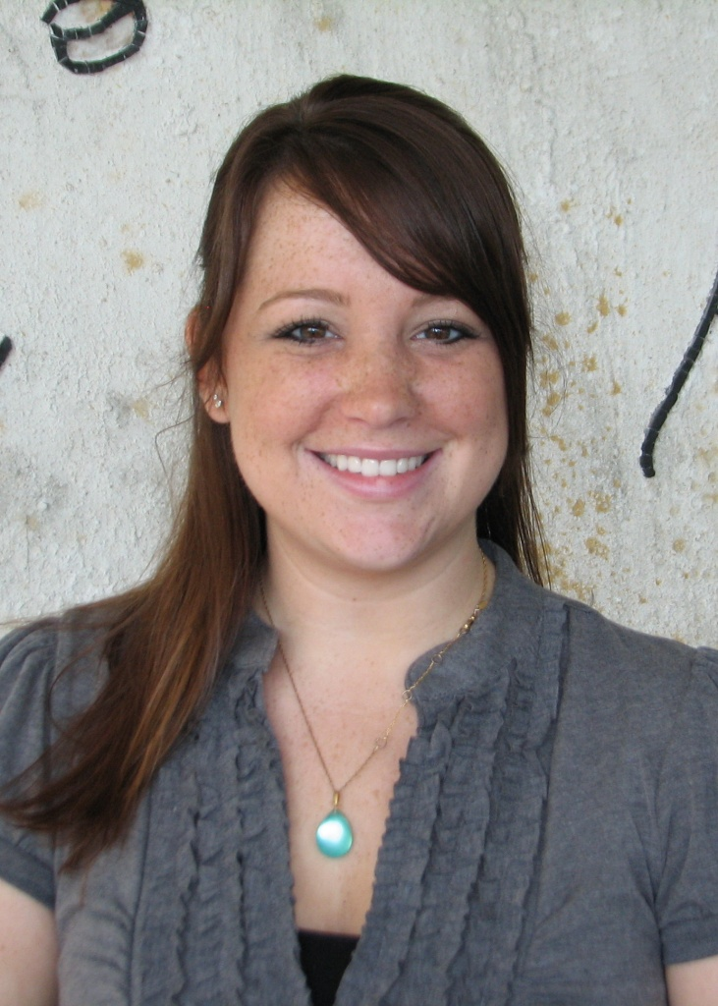
LINTON TIBBETTS FELLOWSHIP
Katie Wirt
(Hallock Muller)

Slide 24
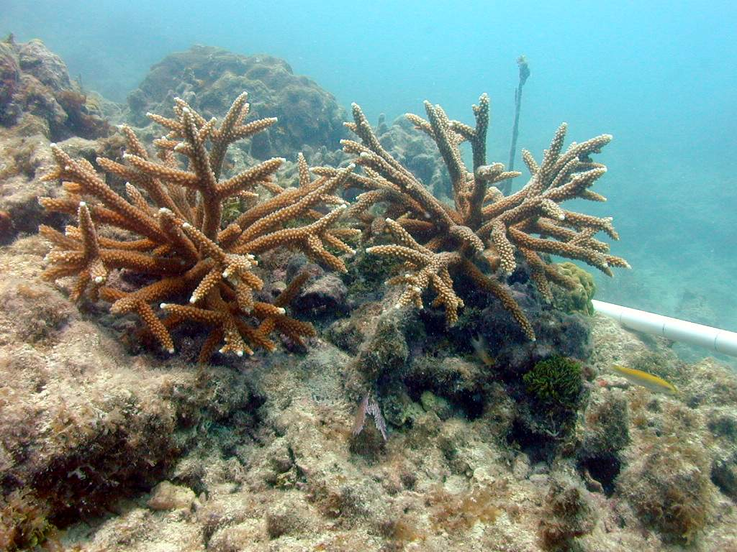
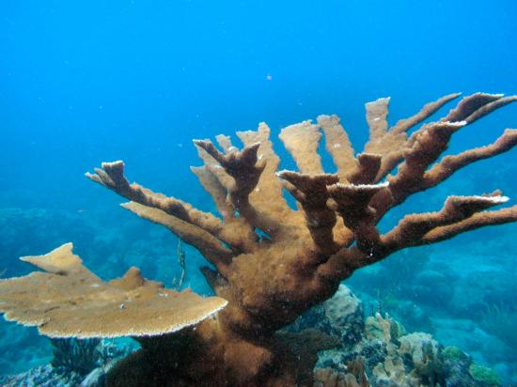
Katie Wirt
Elkhorn and Staghorn Coral Habitat
Historically major reef builders in the western Atlantic and Caribbean
Critically endangered
Refine critical habitat maps in order to better protect the two species

Slide 25
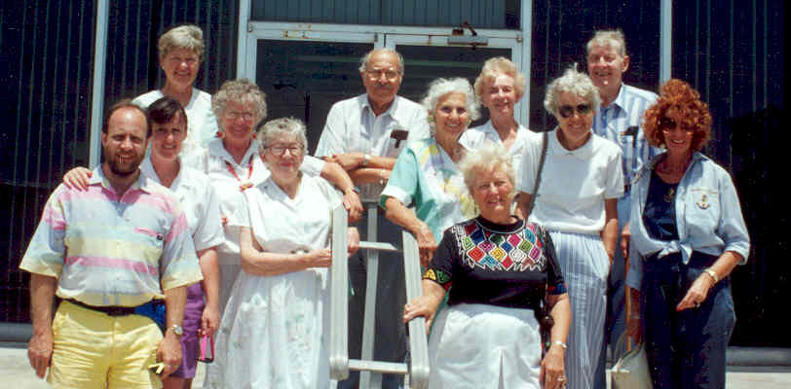
SANIBEL-CAPTIVA/BRIDELL MEMORIAL FELLOWSHIP
In 1982, the Saanibel-Captiva Club made its first contribution to the College’s first Ph.D. student to purchase equipment that was critical to his dissertation
In 1985, they voted to establish an endowed fellowship
Mary and Al Bridell Fellowship was established in 1992 to help graduate students who need financial support to explore new ideas/concepts about all aspects of the ocean/atmosphere system
These two funds where consolidated in 2009 to maximize support available to the Fellowship recipient

Slide 26
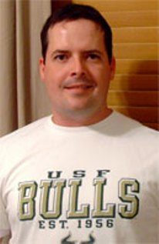
Sanibel Captiva/Bridell Memorial Fellowship
Robert M. Ulrich
(Paul)

Slide 27
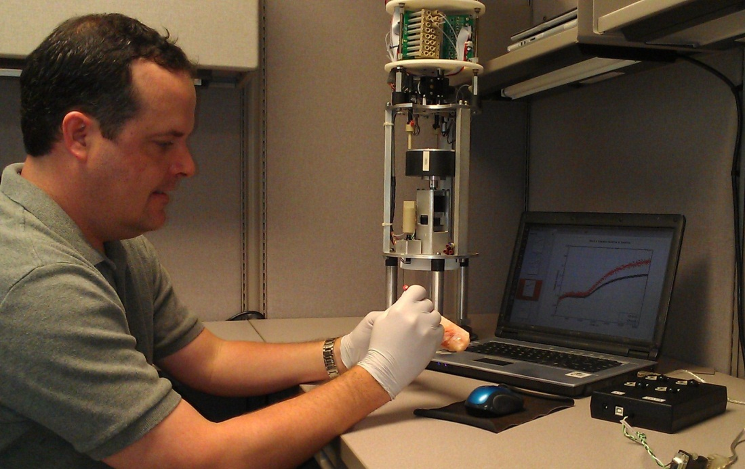
Robert M. Ulrich
My research focuses on the development of gene-based detection assays for the identification of several organisms important to the marine environment and marine resource management.
Such organisms include harmful algal bloom species, bacterial indicators of seawater pollution, and grouper species as they relate to the seafood industry and larval settlement patterns.

Slide 28
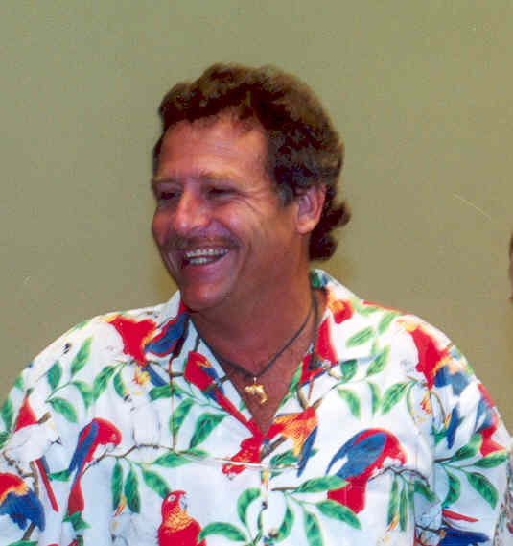
TAMPA BAY PARROT HEAD FELLOWSHIP
Established in 1998 by the Tampa Bay Parrot Heads in Paradise Club
Pays tribute to a USF Marine Science graduate student who is conducting marine research in and around the water of Tampa Bay
Captn” Harry Fink

Slide 29
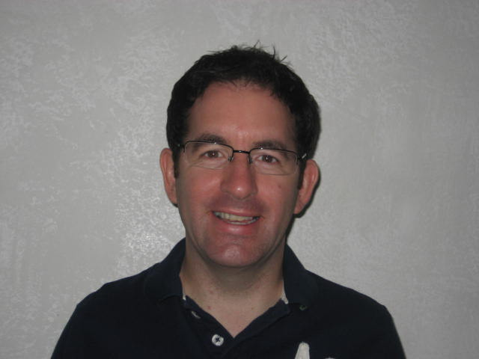
PARROT HEAD FELLOWSHIP
Brendan O’Connor
(Muller-Karger)

Slide 30
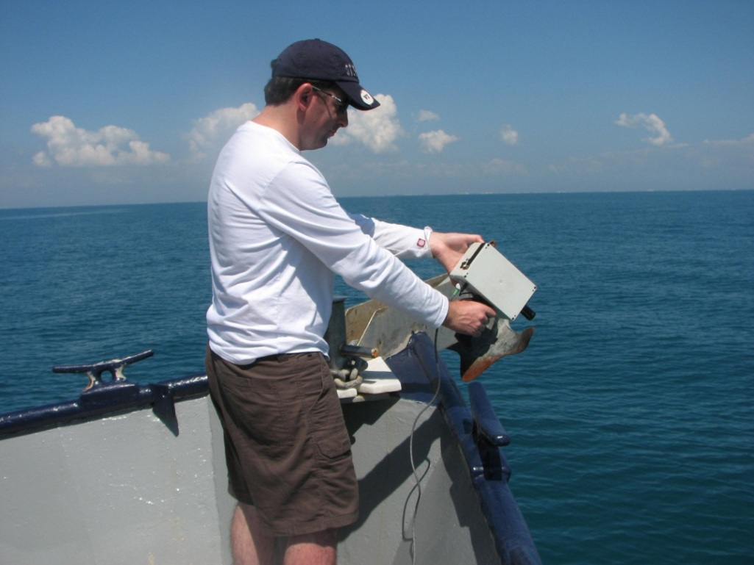
Brendan O’Connor
Analyze the spectral properties of the DWH oil spill using airplane derived imagery
Creating a mapping technique to enhance detection of surface oil

Slide 31
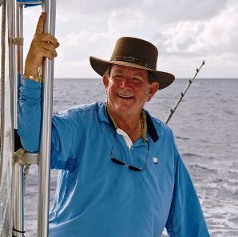
GEORGE LORTON FELLOWSHIP
Established in 2010 by George Harvey Lorton
Awarded annually to a full-time marine science graduate student pursuing a graduate career in one of the four major oceanographic disciplines

Slide 32
George Lorton Fellowship
Danielle Greenhow
(Mann)

Slide 33
Danielle Greenhow
Echolocation Beam Patterns in Freely Swimming Dolphins
Measuring dolphin hearing thresholds using behavioral and psychophysical methods
Comparing hearing ability with echolocation beam pattern to determine if output compensation occurs with high frequency hearing loss
Cross-species comparison of beam pattern and beam steering abilities

Slide 34
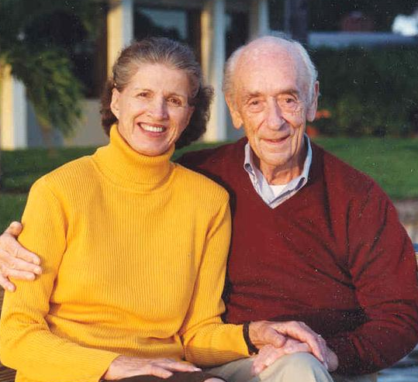
Von Rosenstiel Endowed Fellowships (4 awardees)
Established in 1992 by the Von Rosenstiels
Primary purpose is to attract the most talented and most deserving graduate student in marine science
Awards are made in each of the four major oceanographic disciplines to a new student who is interested in applying an advanced technology to oceanographic science
Anne & Werner Von Rosenstiel

Slide 35
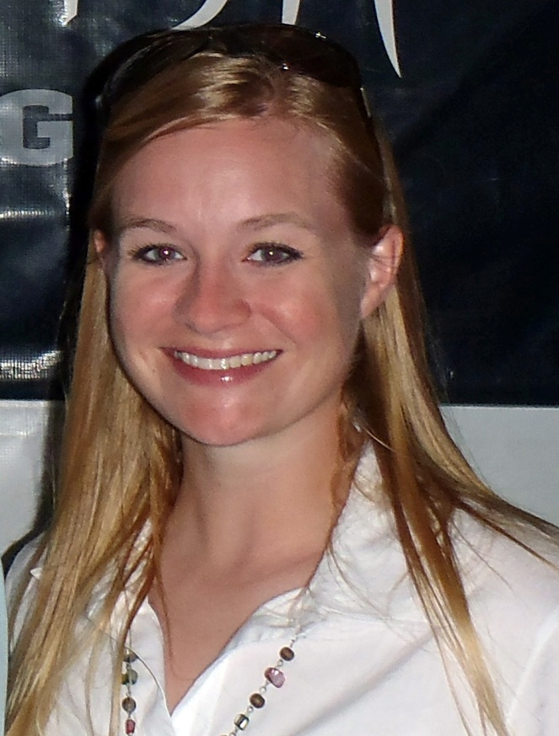
Von Rosenstiel Endowed Fellowship
Jenny Fenton
(Hollander / Peebles)

Slide 36
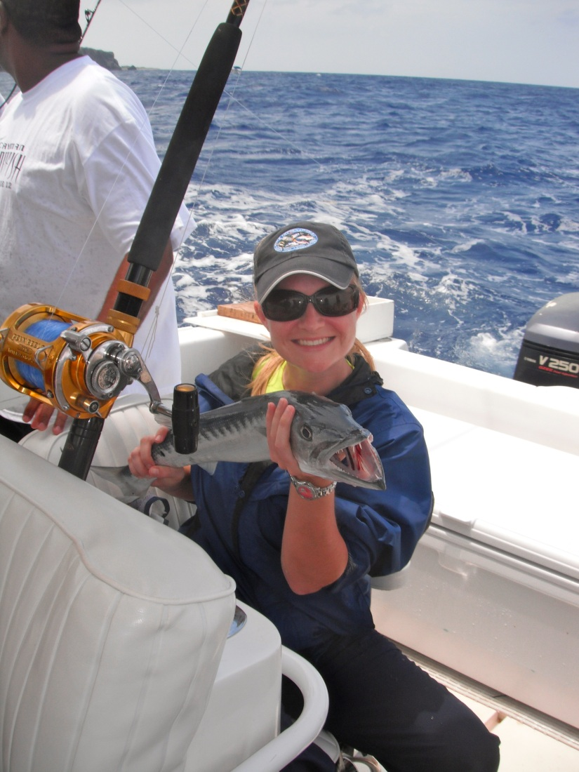
Jenny Fenton
I started my PhD in the Fall of 2012, working with Dr. Hollander and Dr. Peebles, looking at migration and habitat use of fishes through stable isotope analysis and otolith microchemistry.

Slide 37
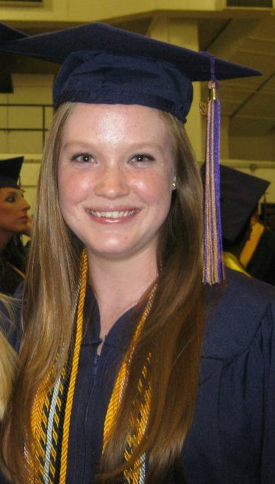
Von Rosenstiel Endowed Fellowship
Jacquelin Hipes
(Murawski)

Slide 38
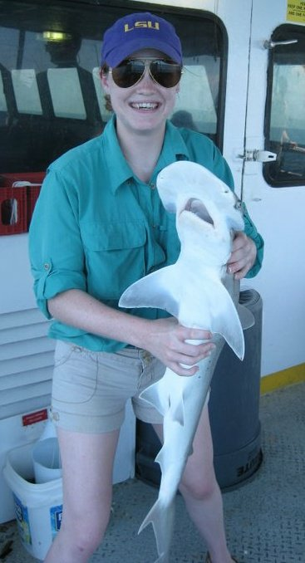
Jacquelin Hipes
I will be pursuing an M.S. in Biological Oceanography with Steve Murawski, looking at fish scale deposition in sediment cores from an anoxic basin in the Gulf of Mexico.

Slide 39
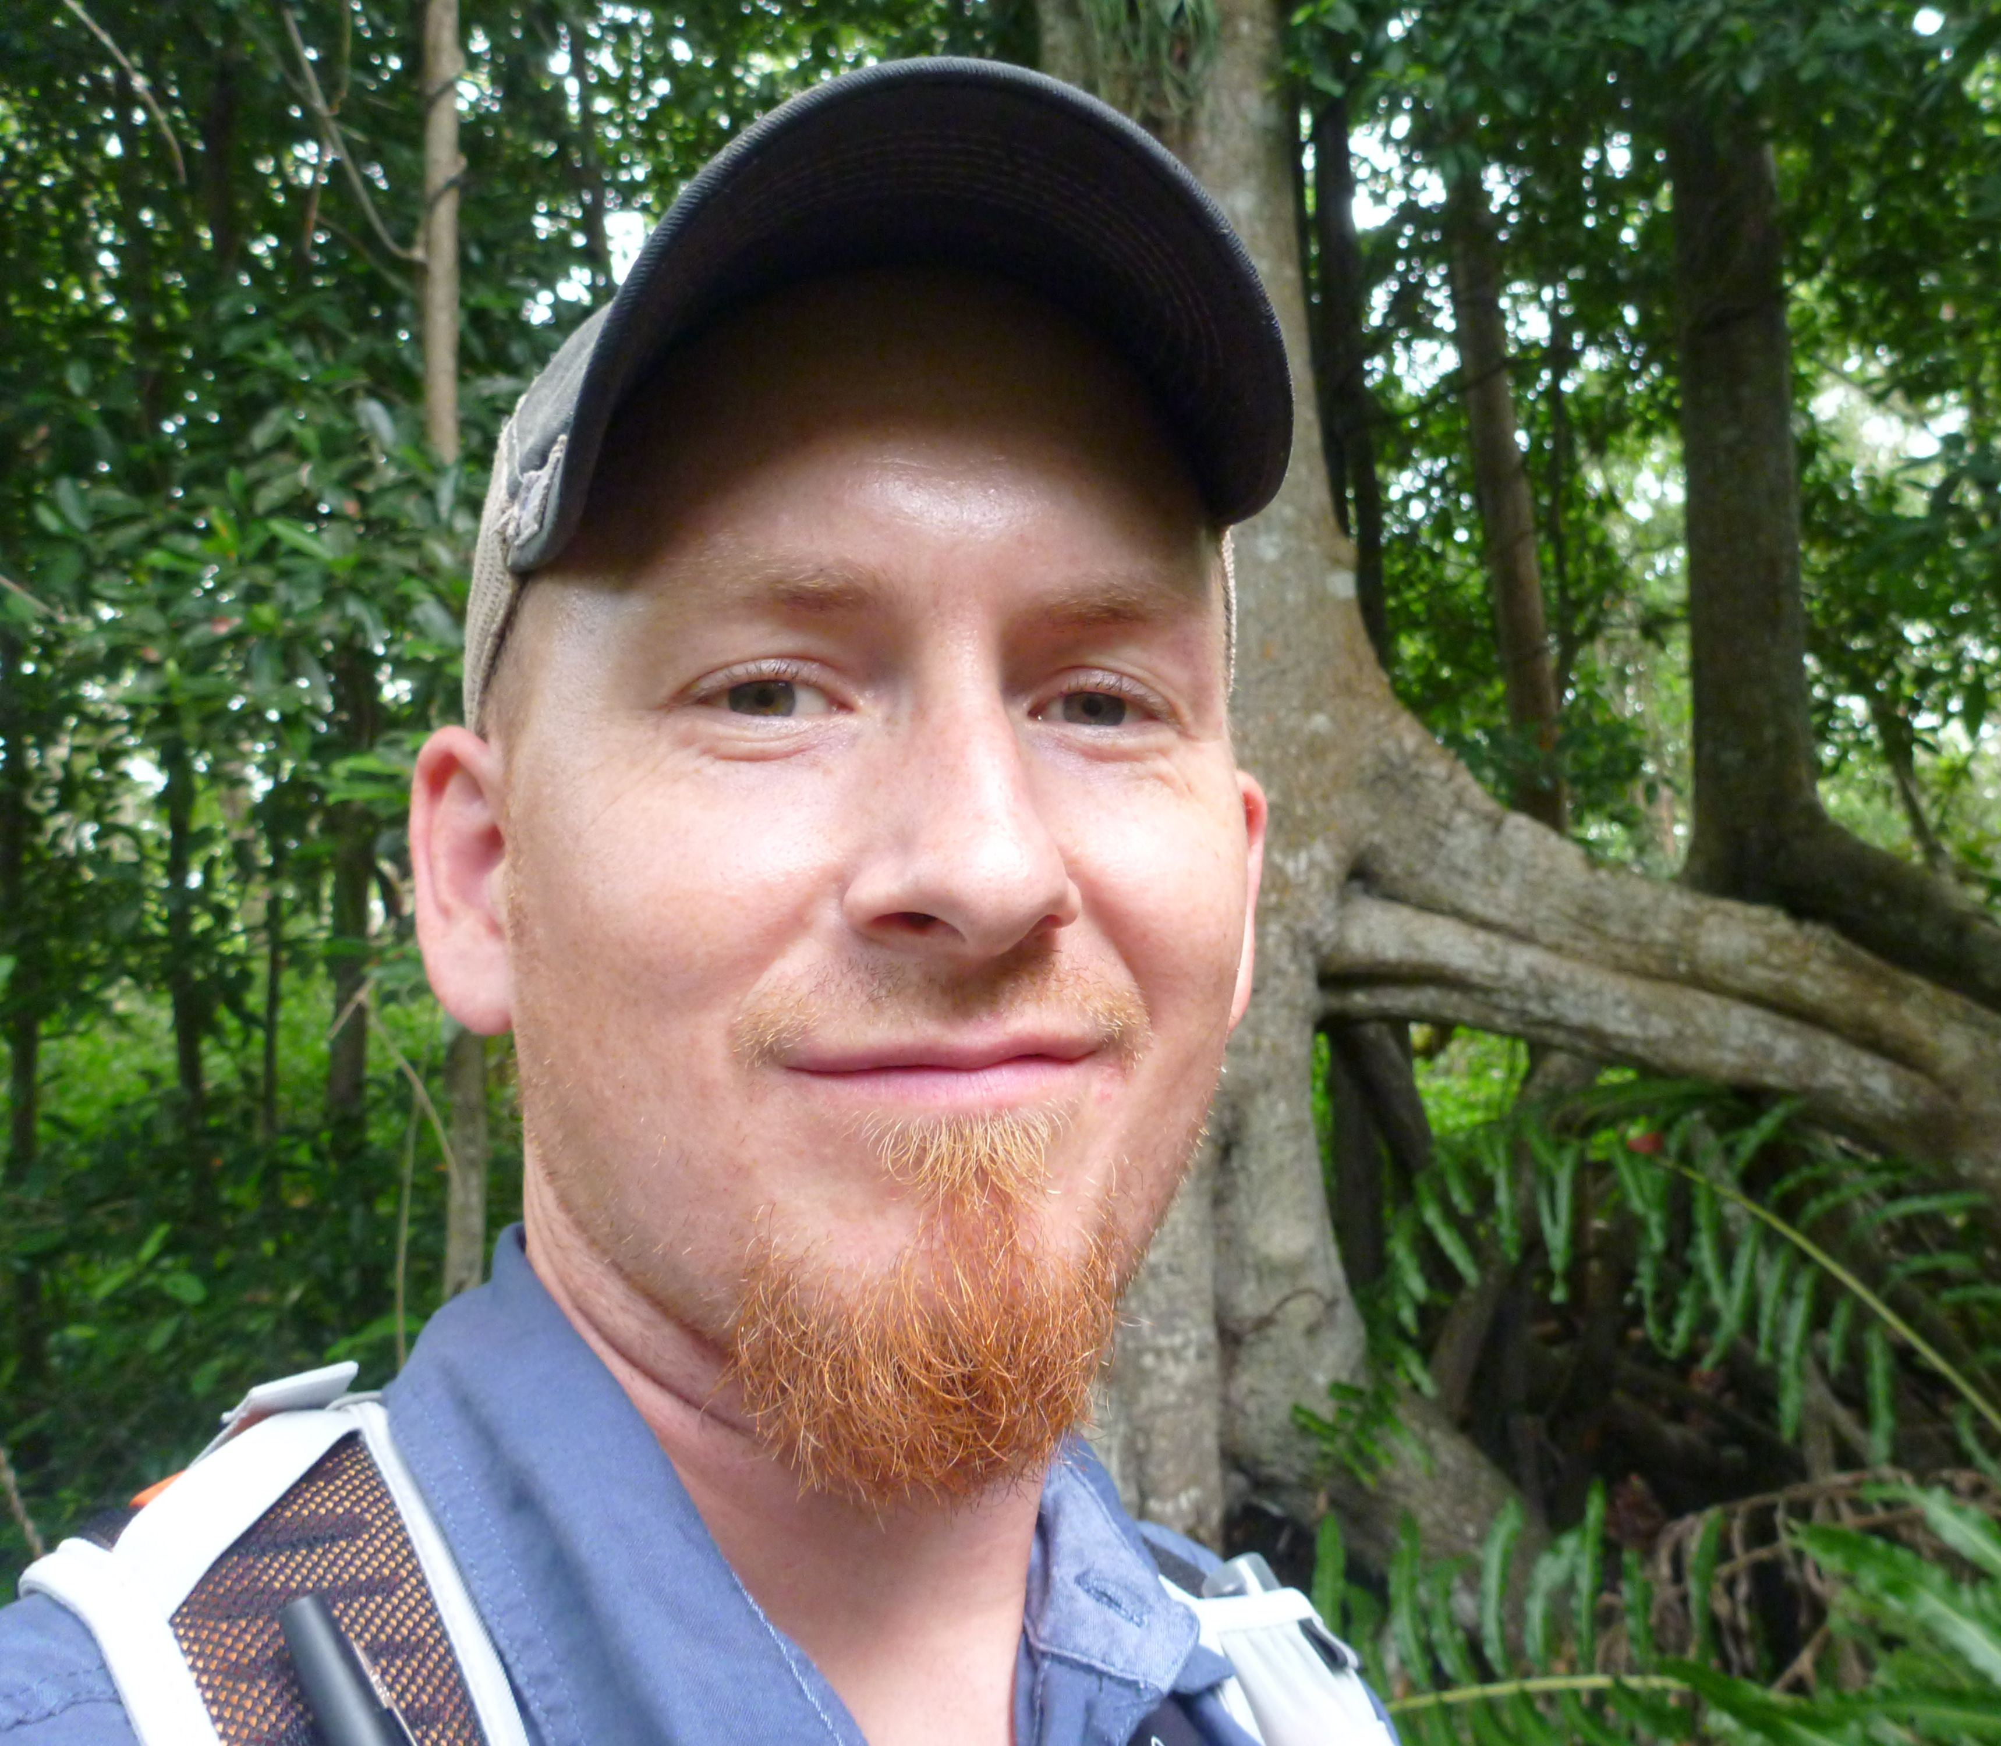
Von Rosenstiel Endowed Fellowship
Joshua Breithaupt
(Byrne / Hallock Muller / Peebles)

Slide 40
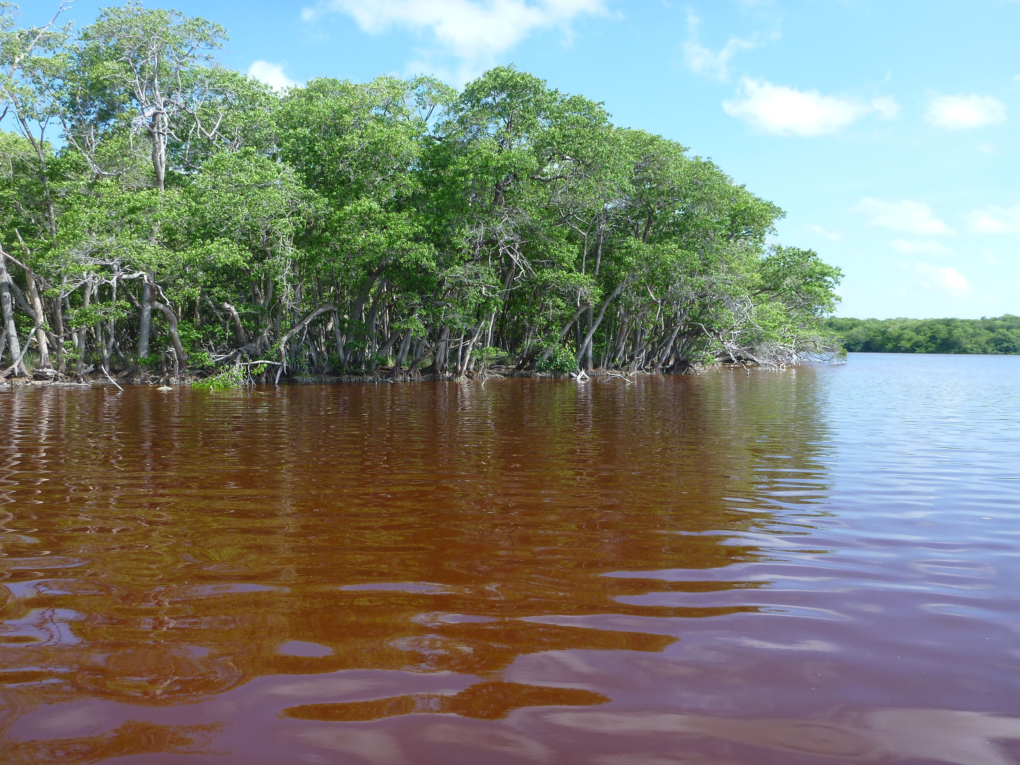
Joshua L. Breithaupt
The cycling of carbon in mangrove environments, particularly the processes that contribute to long-term sequestration of organic carbon in mangrove forest soils.
Notes:
The Anne and Werner Von Rosenstiel Fellowship in Marine Science was formerly established in 1992. The primary purpose of the Von Rosenstiel Fellowship is to attract the most talented and most deserving graduate students in marine science. Awards are made to first year students in each of the four major oceanographic disciplines (biological, chemical, geological, and physical).
Pam Hallock Muller is her major professor
Ted Van Vleet will introduce her as a Von Rosenstiel fellow
She also received the USF Presidential Fellowship.

Slide 41
Von Rosenstiel Fellowship
Sarah Kwon
(Chambers)
Notes:
The Anne and Werner Von Rosenstiel Fellowship in Marine Science was formerly established in 1992. The primary purpose of the Von Rosenstiel Fellowship is to attract the most talented and most deserving graduate students in marine science. Awards are made to first year students in each of the four major oceanographic disciplines (biological, chemical, geological, and physical).
Pam Hallock Muller is her major professor
Ted Van Vleet will introduce her as a Von Rosenstiel fellow
She also received the USF Presidential Fellowship.

Slide 42
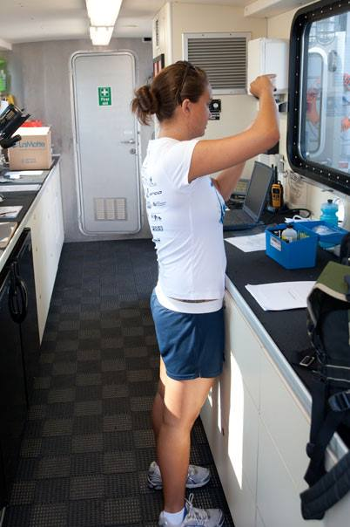
Sarah Kwon
I will be working on multi-decadal oscillations in sea level using tide gauge data.
Notes:
The Anne and Werner Von Rosenstiel Fellowship in Marine Science was formerly established in 1992. The primary purpose of the Von Rosenstiel Fellowship is to attract the most talented and most deserving graduate students in marine science. Awards are made to first year students in each of the four major oceanographic disciplines (biological, chemical, geological, and physical).
Pam Hallock Muller is her major professor
Ted Van Vleet will introduce her as a Von Rosenstiel fellow
She also received the USF Presidential Fellowship.

Slide 43
GULF OCEANOGRAPHIC CHARITABLE TRUST FELLOWSHIP(2 AWARDEES)
Trust was founded in 1967 by the City of St. Petersburg to promote local marine science research
Trust has since become separate from the city and now operates as an independent entity
The Gulf Oceanographic Trust made two contributions to the College in order to create two endowed fellowships
Claude Greene

Slide 44
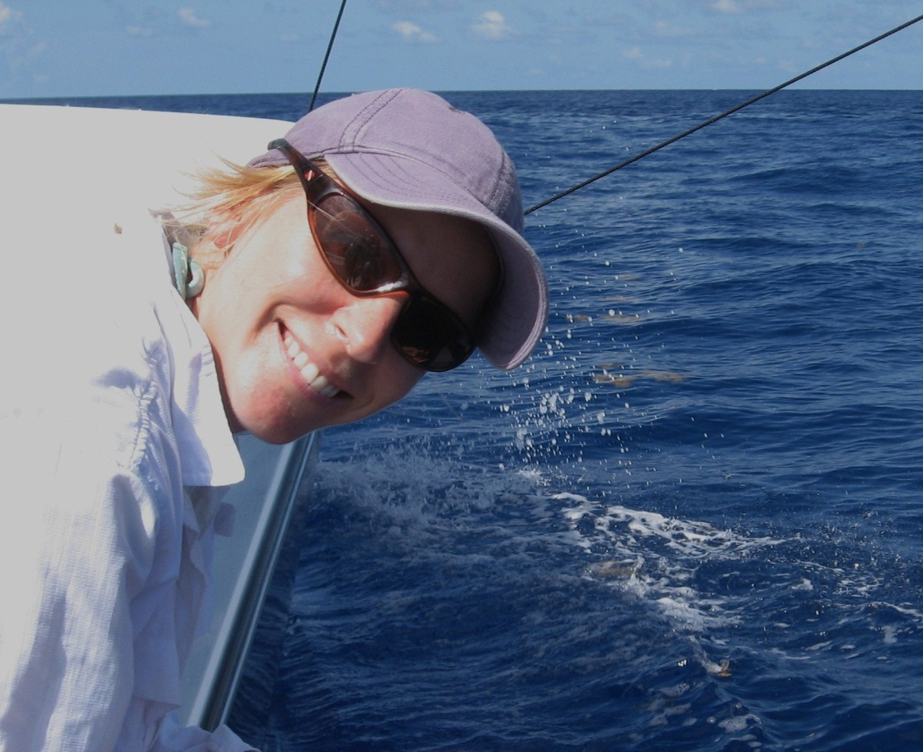
GULF OCEANOGRAPHIC CHARITABLE TRUST FELLOWSHIP
Holly J. Rolls
(Peebles)
Headshot Photo

Slide 45
Holly J. Rolls
Using otolith elemental chemistry to understand the habitat use and life history characteristics of common snook (Centropomus undecimalis) and red drum (Sciaenops ocellatus).
Picture of your research or of you doing research

Slide 46
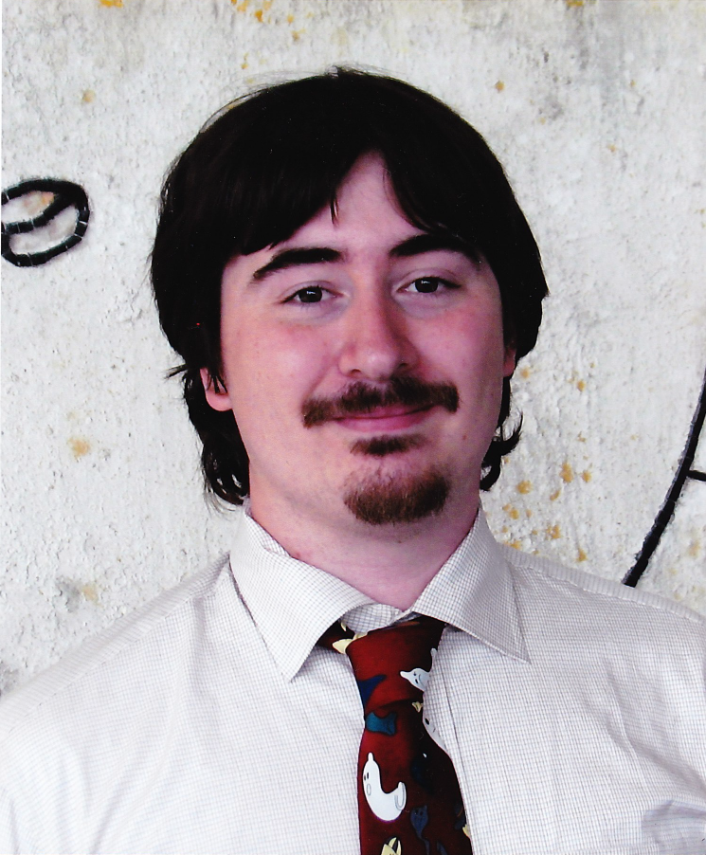
GULF OCEANOGRAPHIC CHARITABLE TRUST FELLOWSHIP
Benjamin Ross
(Hallock Muller)
Headshot Photo

Slide 47
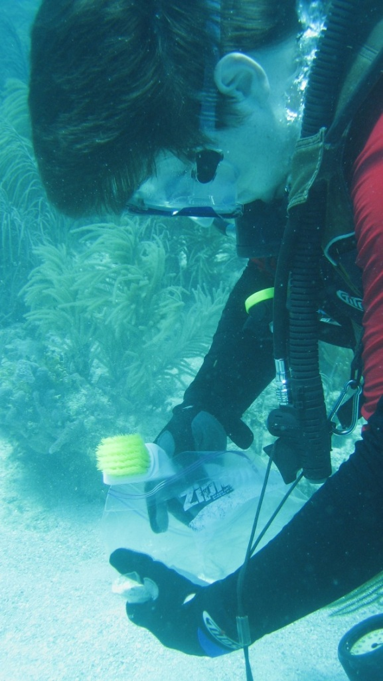
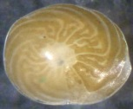
Benjamin Ross
I am studying the effects of environmental stress, especially chemical pollutants, on reef-dwelling foraminifera.
My goals are to better understand their stress responses and to increase their utility as bioindicators

Slide 48
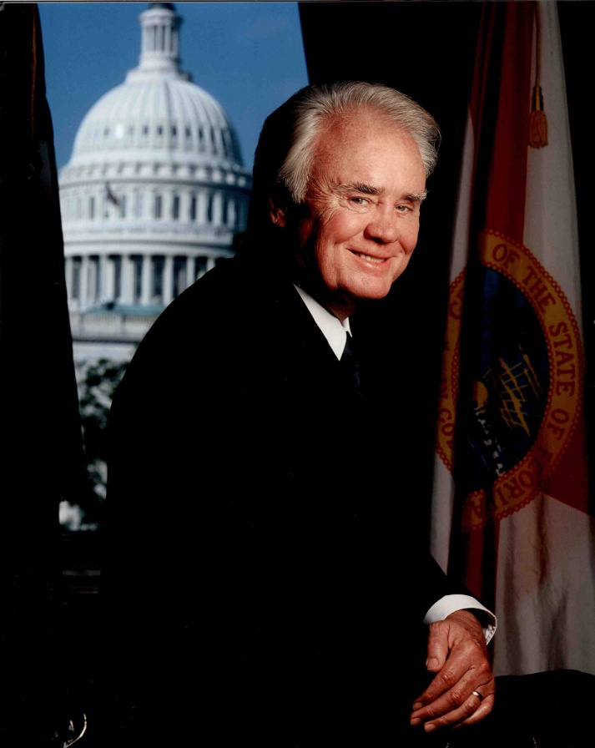
C.W. BILL YOUNG FELLOWSHIP
Fellowship was established in 2000 by the St. Petersburg Business community to honor Congressman Young
His leadership has been essential to the emergence of a major oceanographic research complex at CMS
Designed to support graduate students whose research delves into biological, chemical, geological, or physical processes operating in the oceans, estuaries, fresh water environments, or at the air-sea interface
Congressman Bill Young

Slide 49
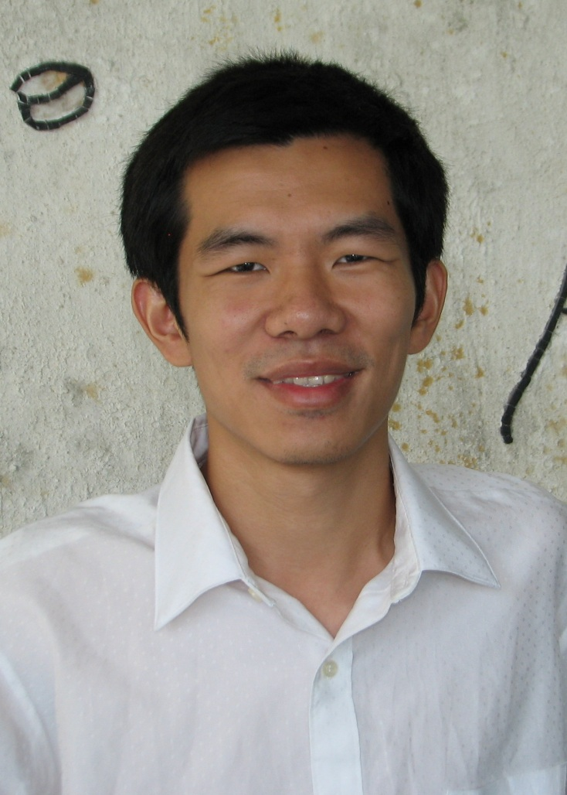
C.W. Bill Young Fellowship
Bo Yang
(Byrne)
Currently in the Arctic Ocean

Slide 50
Bo Yang
CO₂ Sensor Lab
Current Research: Application of Spectrophotometry & Flow Analysis in Marine Environmental Studies

Slide 51
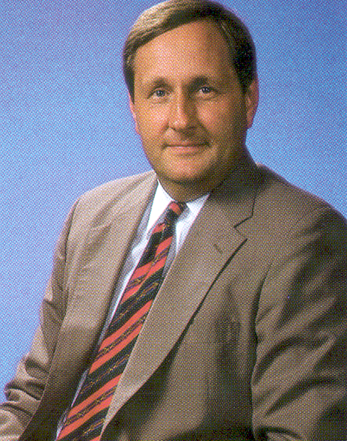
PAUL L. GETTING FELLOWSHIP
Fellowship was established in 1994 to honor the memory of Paul L. Getting, a leader for 22 years in the St. Petersburg’s business community
Getting was instrumental in building of the Knight Oceanographic Research Center
He established the USGS St. Petersburg Coastal and Marine Science Center
The Fellowship is awarded each year who exemplifies some of Mr. Getting’s traits – intelligence, effectiveness, and dedication
Paul L. Getting

Slide 52
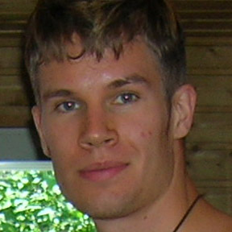
PAUL L. GETTING FELLOWSHIP
Esa-Matti Tastula
(Galperin)

Slide 53
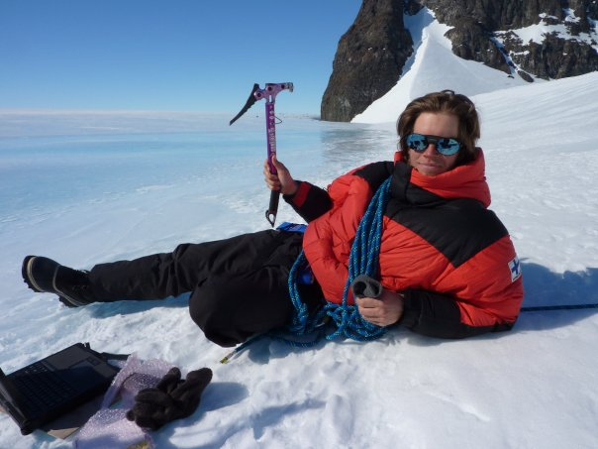
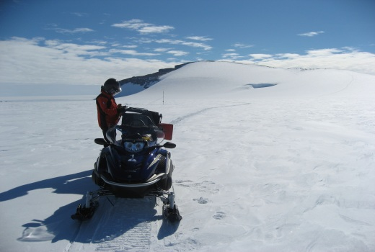
Esa-Matti Tastula
My research concentrates on the representation of turbulence in numerical atmospheric models.
A promising approach is given by hybrid schemes in which ensemble mean second-order closure and mass-flux closure ideas have approximately equal standing.
The objective is, in collaboration with NCAR, to test and evaluate such a parameterization named QNSE-MF in the Weather Research and Forecasting model.

Slide 54
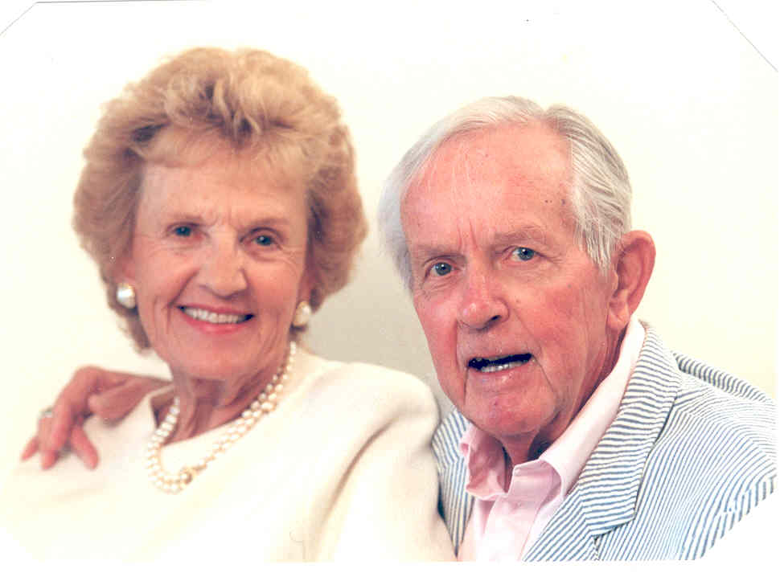
JACK & KATHARINE ANN LAKE FELLOWSHIP
Lake Fellowship was established as part of the Poynter Fund to John B. Lake who retired in 1983 as publisher of the St. Petersburg Times and Evening Independent
Mr. Lake was instrumental in establishing the USF Marine Science Ph.D. program and obtaining critical donations from St. Petersburg Progress
The Lake Fellowship supports one marine science student each year
John & Katharine Ann Lake

Slide 55
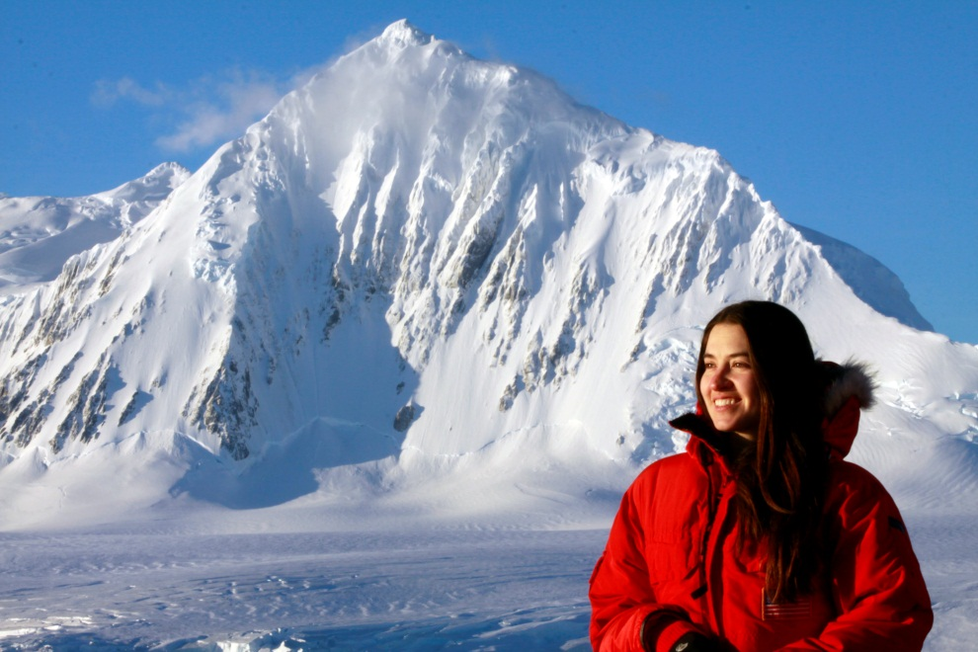
JACK & KATHARINE ANN LAKE FELLOWSHIP
Christin T. Murphy
(Mann)
Currently in California

Slide 56
Christin T. Murphy
Structure and Sensitivity of Pinniped Vibrissae (=Whiskers)
Investigating how the unique structure of the vibrissae of seals and sea lions enables the detection of vibratory and hydrodynamic stimuli.
Picture of your research or of you doing research
NMFS 14535

Slide 57
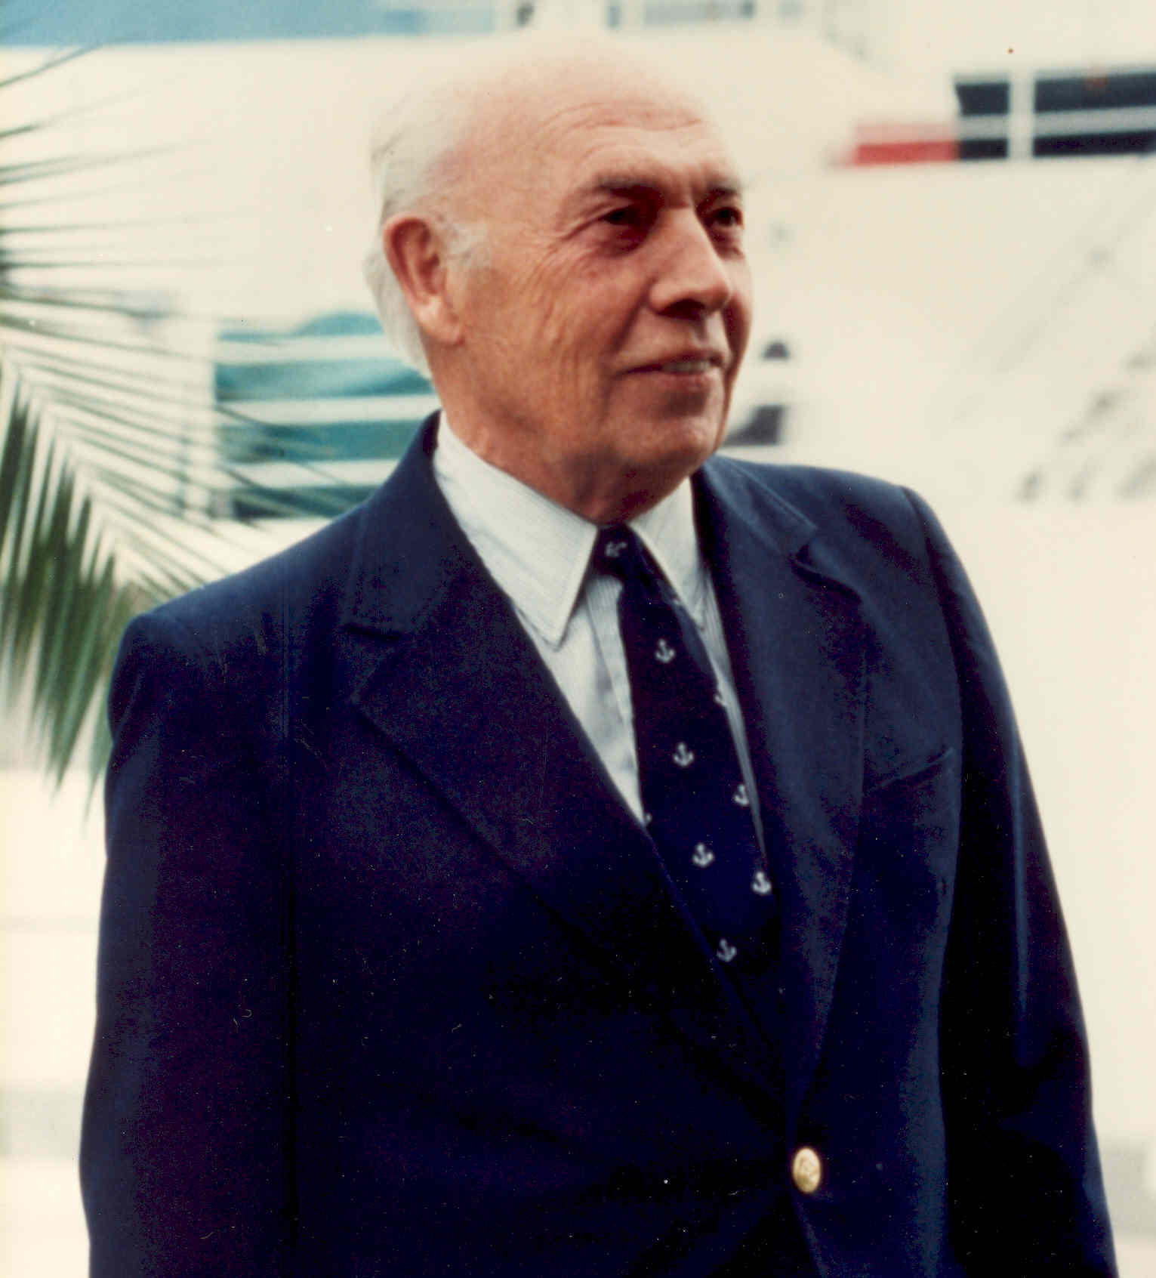
ROBERT M. GARRELS FELLOWSHIP
Established in 1988 to honor the memory of Robert M. Garrels, and eminent geochemist at CMS from 1980 to 1988
The fellowship is awarded annually to an especially accomplished Marine Science graduate student whose research is focused on geochemistry, bio-geochemistry, chemical oceanography or geology
Robert M. Garrels

Slide 58
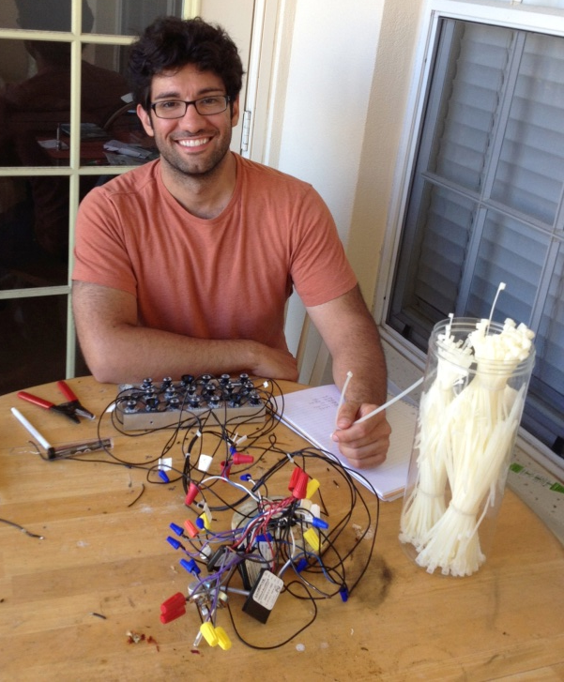
ROBERT M. GARRELS FELLOWSHIP
Mark C. Patsavas
(Byrne)
Currently in the Arctic Ocean

Slide 59
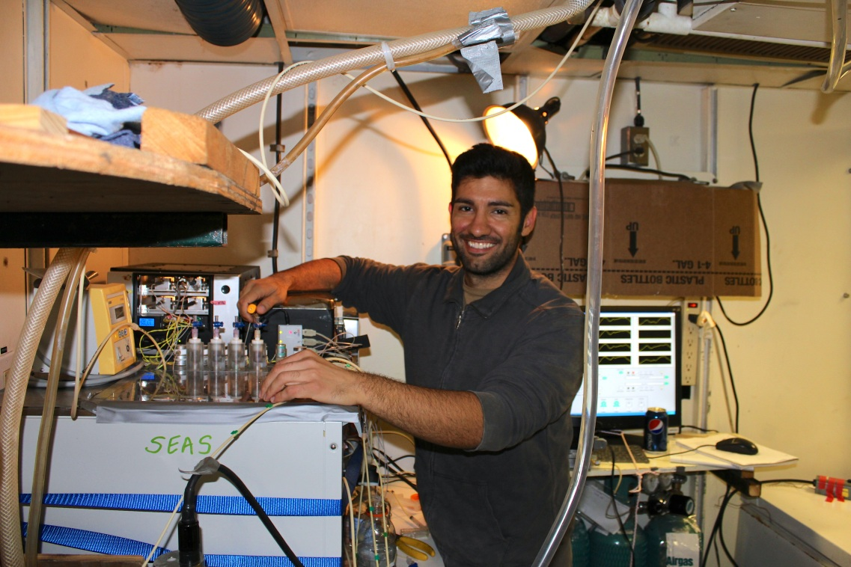
Mark C. Patsavas
Spectrophotometric Carbon System Measurements:
purify indicators used for pH measurements
develop novel in-situ instrumentation
carbon system observations in the Arctic Ocean and Coastal USA

Slide 60
PETER R. BETZER FELLOWSHIP
Established in 2008 by Gordon and Patricia Campbell to recognize Dr. Peter R. Betzer for his long-term leadership
Dr. Betzer served as:
- Chairman of the Department of
Marine Science (1983-2000)
- Founding Dean of the College of
Marine Science (2000-2001)
- Dean of the College of Marine
Science (2001-2007)
Awarded to full-time graduate students during their first year at the College of Marine Science
Peter Betzer

Slide 61
PETER R. BETZER FELLOWSHIP
Timothy Seung-chul Lee
(Daly)

Slide 62
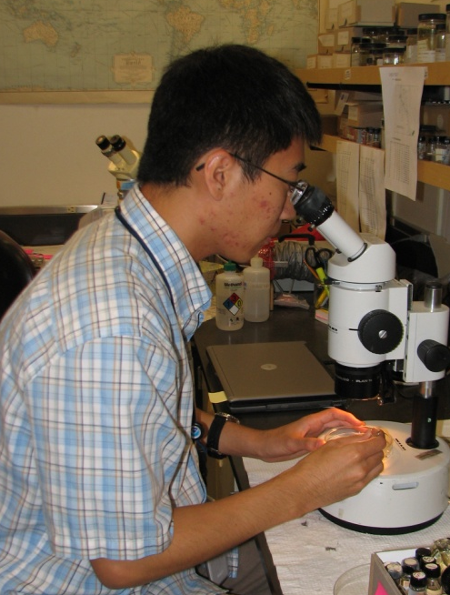
Timothy Seung-chul Lee
ZooScan and SIPPER instruments to identify zooplankton to their lowest possible taxonomic classification, using samples and images from before and after the Deepwater Horizon oil spill.
SIPPER to detect oil droplets and to assess potential impacts that these droplets have on zooplankton survival.
Accurate assessments of zooplankton dynamics can shed light on forecasting the structures of ecologically and recreationally important fish and shellfish communities.

Slide 63
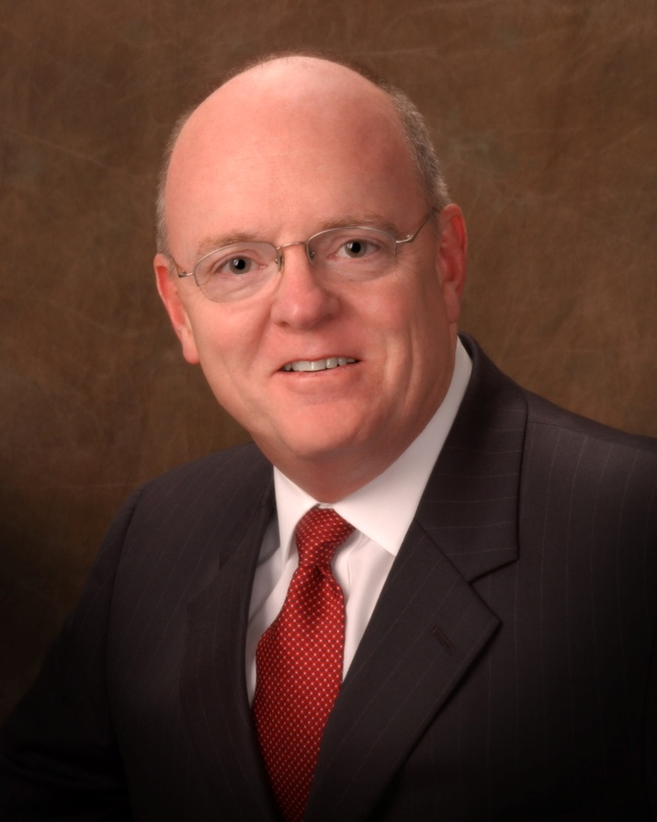
ST. PETERSBURG DOWNTOWN PARTNERSHIP FELLOWSHIP IN COASTAL SCIENCE
St. Petersburg Progress, Inc., now known as the St. Petersburg Downtown Partnership, Inc., was formed in 1962 as a not-for-profit organization, whose purpose is to promote redevelopment and business growth in downtown St. Petersburg
Fellowship was established to support an outstanding Marine Science graduate student whose research focuses on coastal marine studies including any shallow estuarine, marine or continental shelf environment
Don Shea

Slide 64
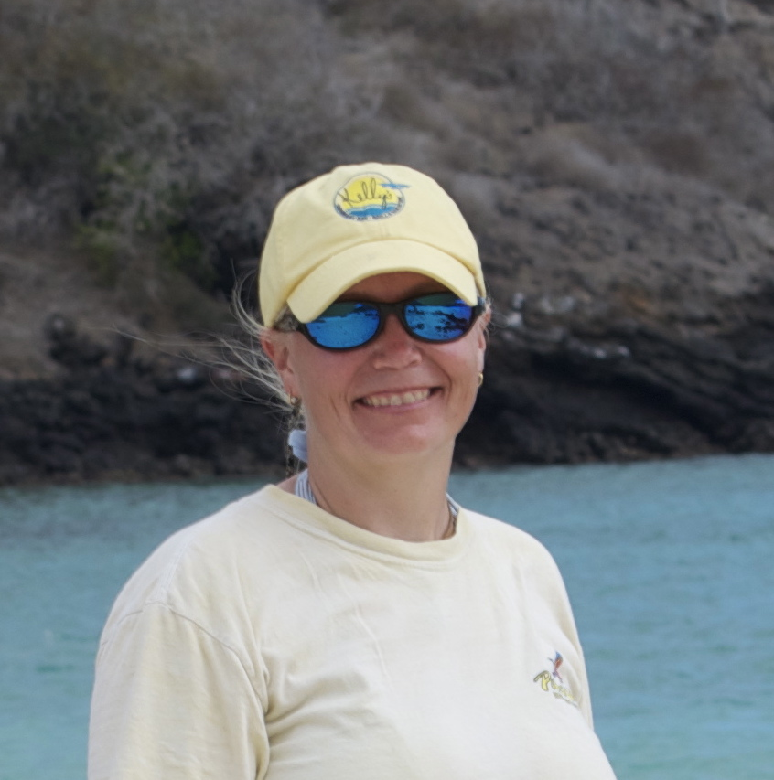
ST. PETERSBURG DOWNTOWN PARTNERSHIP FELLOWSHIP IN COASTAL SCIENCE
Rebekka A. Larson
(Hollander)

Slide 65
Rebekka A. Larson
“Event Stratigraphy”
In the USVI
High-resolution, laminated records of sedimentation events (terrigenous runoff, marine overwash, etc.) over the past ~2,000 years.

Slide 66
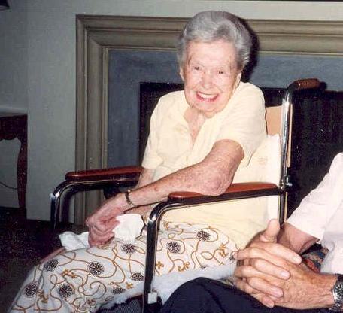
WILLIAM & ELSIE KNIGHT FELLOWSHIP (2 awardees)
Established by Mrs. Knight as a living memorial to her husband
The first gift from the Knight family was made in 1985 to establish the Knight Fellowship
In 1990, the Knight family endowed a total of six fellowships for USF’s Marine Science
The fellowship is awarded annually and Knight scholars are supported for their entire graduate career
Elsie Knight

Slide 67
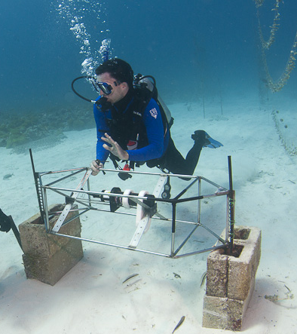
WILLIAM & ELSIE KNIGHT FELLOWSHIP
Brian Barnes
(Hu)
Currently on research cruise in the Keys

Slide 68
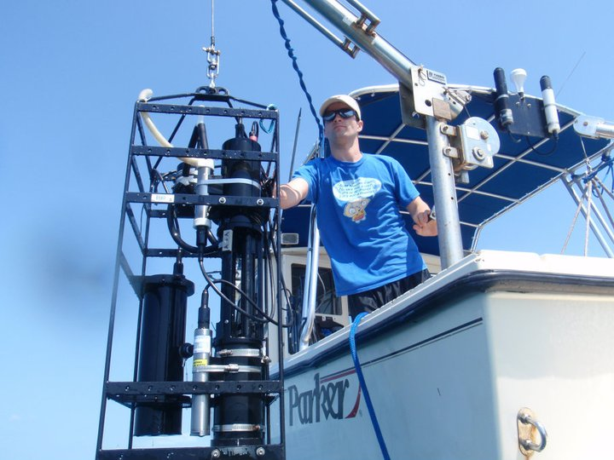
Brian Barnes
Develop and improve satellite algorithms for temperature and light attenuation
Derive these parameters at depth
Clarify the relationship between light, temperature, and coral health

Slide 69
WILLIAM & ELSIE KNIGHT FELLOWSHIP
Carlie Williams
(Shevenell)

Slide 70
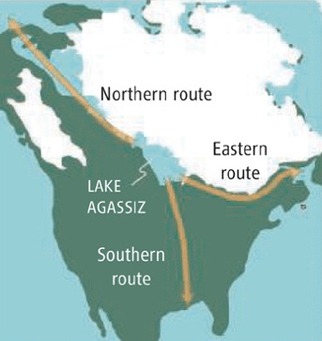
Carlie Williams
Research Interests: Using fossilized foraminifera from deep-sea sediments to reconstruct climate change and ice sheet melting over the last 25,000 years.
Preserved in sediment
Live Foraminifera
Oxygen isotopes and trace metal ratios based on foraminifera from Gulf of Mexico sediments are used to determine the timing of Laurentide Ice Sheet melting.

Slide 71
THANK YOU!
Your generosity has made a difference!

Slide 72
Understanding the Global Ocean

Slide 73
Regionally Relevant

Slide 74
On April 20, 2010
Explosion and Fire on Transocean Ltd’s Drilling Rig - Deepwater Horizon Explosion

Slide 75
Oil Spill from Space—May 24, 2010 A 2-Dimensional Disaster

Slide 76
But it is a 4-D problem
• Model multiphase plume flow
• Coupled to GoM circulation
models
• Improve near-field modeling
w/better constraints behavior
of oil/gas/seawater mixture at
high-pressure
Socolofsky, TAMU; Paris, UM-RSMAS

Slide 77
Impacts of DWH on Fish
Reproduction –
Potentially Significant
To Gulf Fisheries
“Oil Days”
Density Map
from overflight data

Slide 78
BP $500 M over 10 yrs for research
RFP-I: $121 M to fund 8 Centers
80 research institutions involved
77 submitted center proposals
Impact of Physical, Chemical, and Biological Processes on the Fate of Oil Spills – U Texas
GISR – Gulf Integrated Spill Research – TAMU
Deep-C - Deepsea to Coast Connectivity in the Eastern GoM – FSU
Effects of the Macondo Oil Spill on Coastal Ecosystems – LUMCON
C-IMAGE – Center for Integrated Modeling and Analysis of Gulf Ecosystems – USF
CARTHE – Consortium for Advanced Research of Hydrocarbon Transport in the Environment – UMiami
C-MED - The Consortium for Molecularly Engineered Dispersants – Tulane
ECOGIG – Ecosystem Impacts of Oil and Gas Inputs to the Gulf – UMississippi
http://www.gulfresearchinitiative.org/research/awards/year-2-4-rfp-i-consortia-grant-awards

Slide 79
C-IMAGE Consortium Partners: assembling the world’s experts
University of South Florida – Lead, IT, education, various science
Florida Institute of Oceanography – Research vessels
Hamburg Technical University – High-P lab studies, velocity
Texas A&M University – Oil physics and chemistry
University of Calgary – HMW environmental exposure, partitioning
Wageningen University & NHL – Netherlands – Decision support tool
Eckerd College - Benthic stratigraphic studies
University of West Florida - Microbial studies
Pennsylvania State University – Degrading enzymes, ¹³C, ¹⁴C studies
University of Miami – Modeling oil distribution & concentration
University of South Alabama – Fish community analyses
Mote Marine Laboratory - Biomarkers -vertebrate exposure
Scripps Institution of Oceanography – Marine mammals

Slide 80
C-IMAGE: Integrated Understanding of Oil Spill Dynamics
Burning -
Skimming -
Surface dispersants -
Mitigation
Evaporation
Shallow Pelagic & Shelf ecosystems
Ecosystem
Consequences
Spill Scenario
phototoxicity
Surfacing
Use of dispersants
Plankton (phyto-, zoo)
Fish/invert. eggs & larvae
Sargassum community
Adult fishes, o. inverts/verts
Beaches, marshes, estuaries
Dilution
Life history effects
(mortality, productivity)
Nutrient cycling (enrichment?)
Trophic cascades
Economic consequences
Ambient oceanography
Temperature,
Salinity,
Stratification,
Currents,
Turbulence,
Winds
Hydrocarbon
Fractionization,
Initial Emulsification,
Bubble/Droplet Formation,
Size Distribution,
Pressure Dependency
Dispersion
Degradation
Dolphins & whales
“Suspension”
Bubbles/Droplets
Transport/Evolution
Mesopelagic ecosystems
Ecosystem Exposure
concentration X duration
DO/hypoxia?
Deep scatterers
Mesopelagic fishes
Deep foragers
Oil Fate
Marine snow
Secondary
sedimentation
Sedimentation
Benthic ecosystems
Theme 1
Theme 2
Theme 3
Oil/gas jet,
Oil/Gas Ratio (OGR),
composition, T, Pressure, Reservoir Volume, Flow Rate
Re-Deposition
Deep corals
Deep benthos
Biogenic communities
Degradation

Slide 81
Problem: In winter of 2010-2011 many anecdotal reports of fish with skin lesions; no adequate baseline to evaluate if rates had increased in 2011: Conducted Survey of GoM Reef Fishes for Disease Frequency
Objectives
Conduct broad-scale survey from the FL Keys to Central LA to determine frequency ulcers, fin rot and other external lesions
Compare frequency of disease types by region and depth
Determine “background” level of disease incidence by surveying broadly in the Gulf
Provide data on the age, length, weight and internal organ weights of fishes sampled to determine fish condition
Provide fish samples for a broad array of laboratory testing including pathology
Partners: University of South Florida, College of Marine Science, National Marine Fisheries Service (NMFS), Florida Wildlife Research Institute (FWRI), Commercial fishing industry

Slide 82
Partnering with the industry:
commercial longline vessels
F/V Pisces
Panama City, Florida
Owner: John Anderson
F/V Sea Fox
Maderia Beach, Florida
Owner: Robert Spaeth
F/V Brandy
Maderia Beach, Florida
Owner: Jack Golden

Slide 83
84 longline stations, 3,900+ fish examined

Slide 84
Skin Ulcers on Red Snapper →
Southern hake
Conger eel
tilefish

Slide 86
In August 2012:
Stations with high disease rates in 2011 again monitored
Data collected from bile, blood, muscle tissue, livers and other organs
Sediment cores to correlate oil contamination with fish
Rates of growth of key species being assessed (red snapper, groupers, tilefish)
Funded by the GoMRI &
C-IMAGE consortium
R/V Weatherbird II

Slide 88
Example 1: Using Genomics for Species Identification of Individual Eggs
Developing New Technologies
Management of fisheries requires accurate knowledge of timing and location of spawning
Fish eggs can be collected and counted, but species identification difficult because they all look the same
Historically – wait and see what they grow up to be
Test study in Terra Ceia Bay
~1mm
http://www.scielo.org.ar/scielo.php?script=sci_arttext&pid=S0327-95452006000100018
Lauren Van Woudenberg, Camille Daniels, Scott Burghart, Ralph Kitzmiller, Ernst Peebles, Mya Breitbart at University of South Florida, College of Marine Science

Slide 89
14 SPECIES FOUND
LOTS OF HETEROGENEITY
SNOOK
SPOTTED SEA TROUT
STRIPED MOJARRA
PRIONOTUS (sea robin)
SOUTHERN KING CROAKER

Slide 90
Example 2: Grouper Forensics or What’s in your sandwich?? - John Paul, David Fries, David John
Asian catfish
Fla Grouper
?
Grouper Imposter
The Real Deal
?
?
Grouper
Not
Grouper

Slide 91
Example 3: Laser Ablation & ICP-MS analysis of otoliths – Detection of past contamination of fish by oil.
Peebles/USF

Slide 92
Funding Higher Education: A Shifting Paradigm

Slide 93
Moving Forward
Help us promote the value of higher education in Florida
Help us combat reduction in Pell grants at Federal level
Help us demand recognition of the importance of a healthy ocean and Gulf to the state of Florida

