Slide 1
College of Marine Science
February 7, 2013
Dean: Jacqueline Dixon
Associate Dean: Gary Mitchum
Graduate Program Director: David Naar

Slide 2
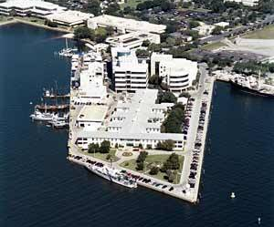
Who are we?
C.W. Young Marine Science Complex:
Knight Oceanographic Research Center, MSL building, COT
27 Tenure-track Faculty
104 graduate students (M.S. and Ph.D.)
~$15 M in research funding ($12.7 M expenditures +
$2 M F&A)

Slide 3
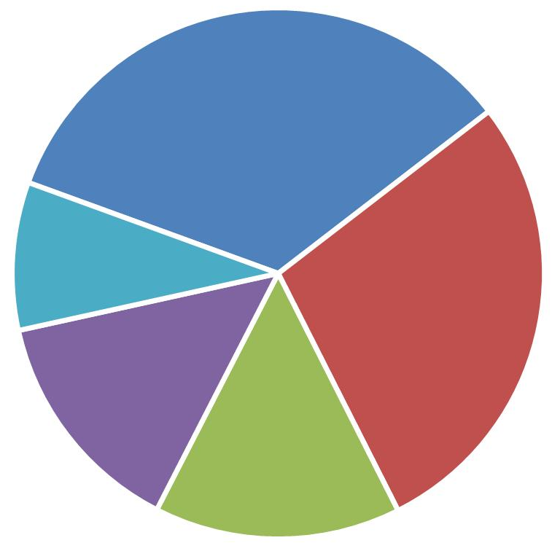
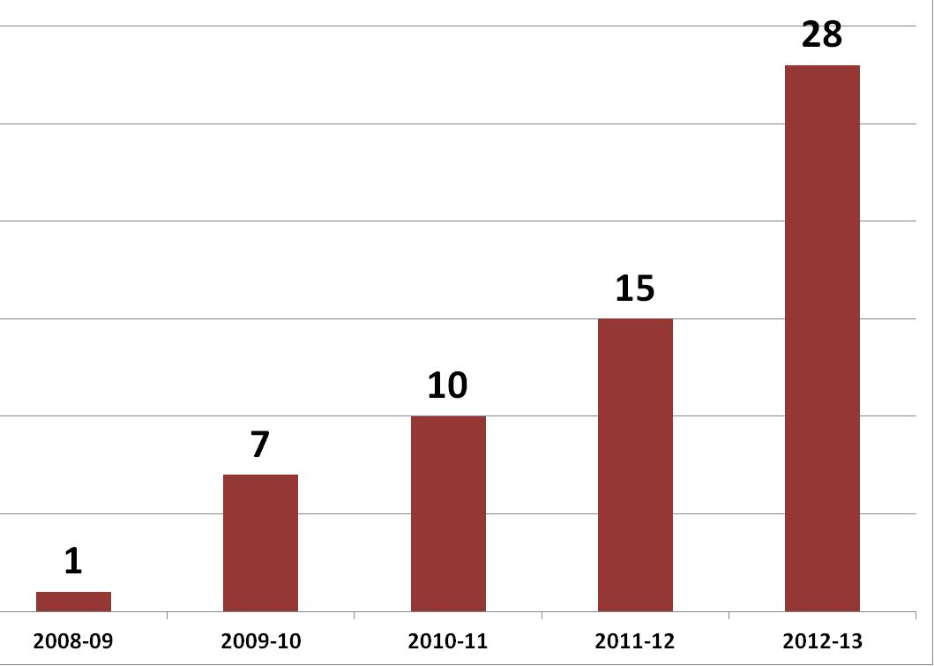
# of Students This Semester:
BIO
34
# of MRA Students over past 5 years
PHY
9
MRA
28
GEOL
14
CHEM
15

Slide 5
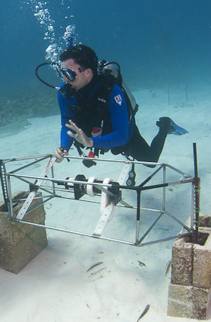
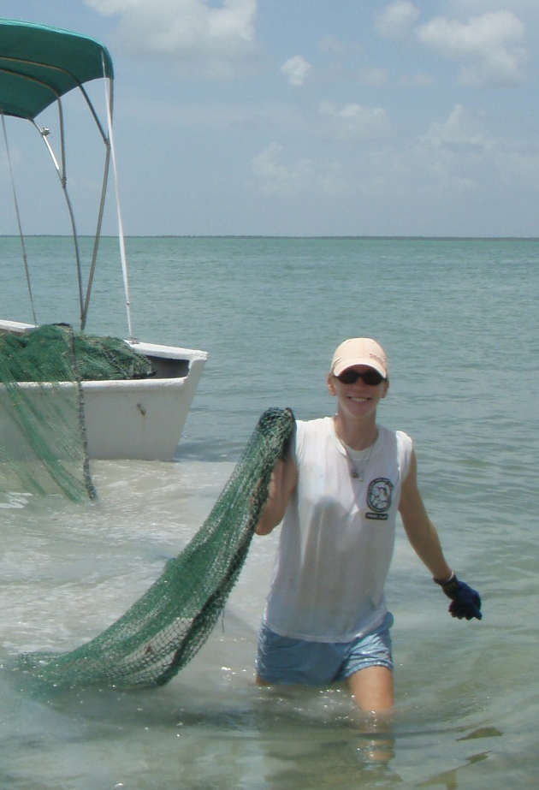
Points of Pride: Student Success
Out of 8 recent Ph.D.s:
  5 hired as post-docs
  2 hired as new faculty
  1 hired at state research
  agency
  3 under-represented
  minority Ph.D.s

Slide 6
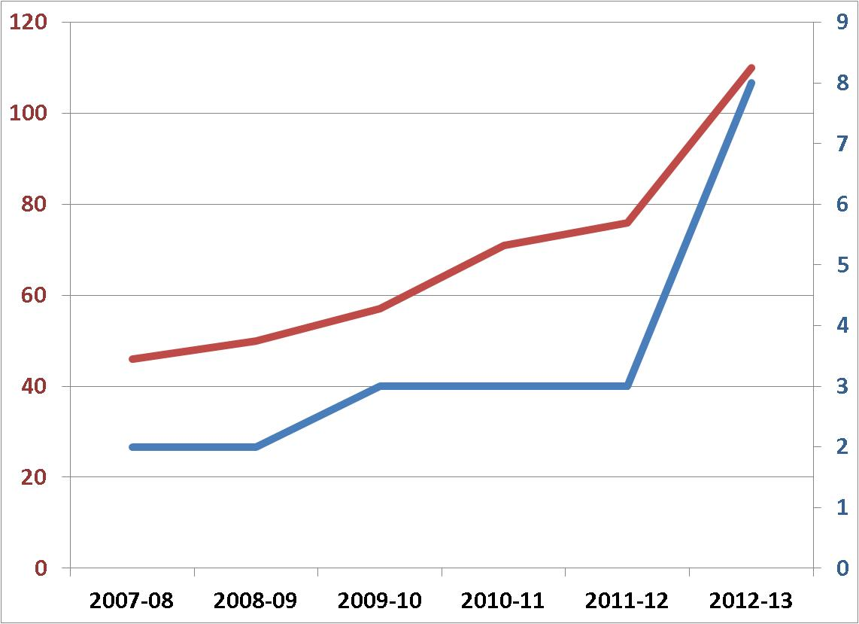
Enrollment
110
Undergraduate Enrollment
8
Course
Sections
Undergraduates in research:
38 Interns during 2011-12
(27 paid interns, 11 volunteer interns)

Slide 7
Points of Pride: Expanded Undergraduate Offerings
2 advanced oceanography classes in Tampa
4 classes at USFSP
New Marine Biology Emphasis at USFSP
Planned expansion of online offerings

Slide 8
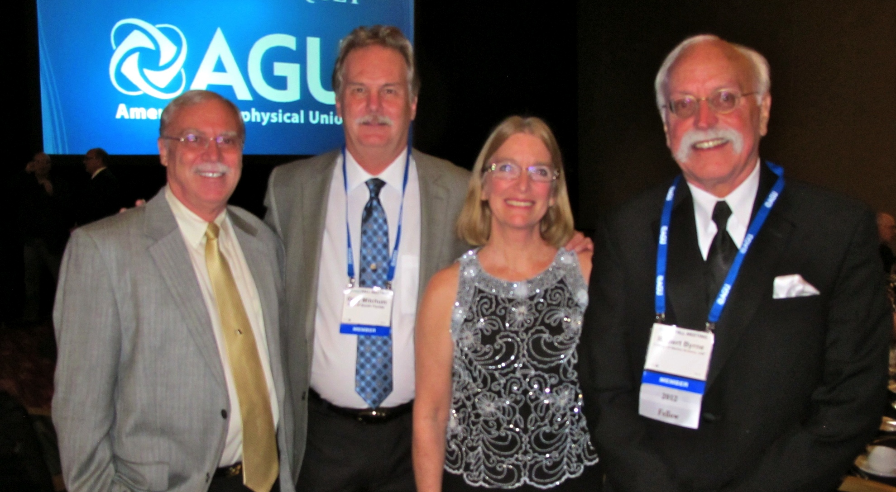
Points of Pride: Faculty Awards
Robert Byrne -2012 AGU Fellow

Slide 9
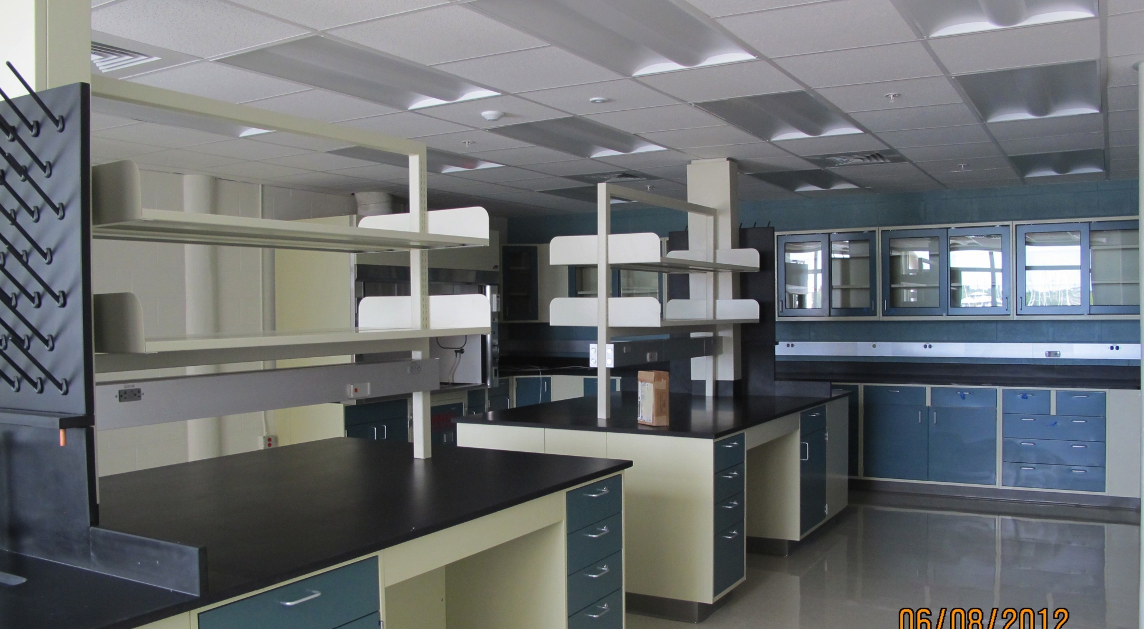
Points of Pride: Renovated MSL Labs
Notes:
~8100 GSF
14 lab spaces renovated
NSF funds expended: $1,898,232
USF CMS funds expended: ~$150,000
All new AC, individual VAV controls for each lab space, occupancy sensors that scale back operation when labs are unoccupied.
All new electrical, separate distribution panels for each lab space, back-up generator for select circuits
All new plumbing, new DI service to each lab,
All new metal casework and fume hoods
Room and hallway lighting on occupancy/motion sensors

Slide 10
Points of Pride:
Research Impact & Productivity
Research Foci are Globally Significant & Regionally Relevant
  Ocean & Human Health
  Ocean Observing & Modeling
  Sensor Development
  Marine Ecosystem & Resource Assessment
  Climate Change – Past, Present, & Future
  C-IMAGE

Slide 11
First some numbers

Slide 12
Research expenditures increasing

Slide 14
Bucking the trends

Slide 15
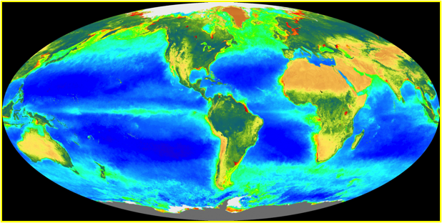
Research: Globally Significant

Slide 16
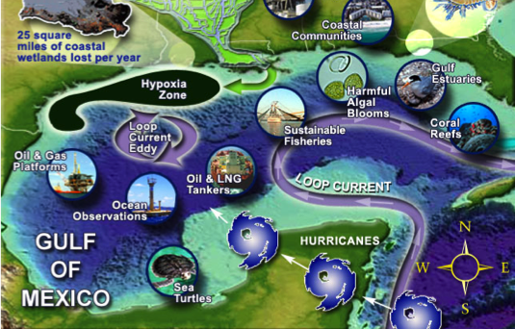
Regionally Relevant

Slide 17
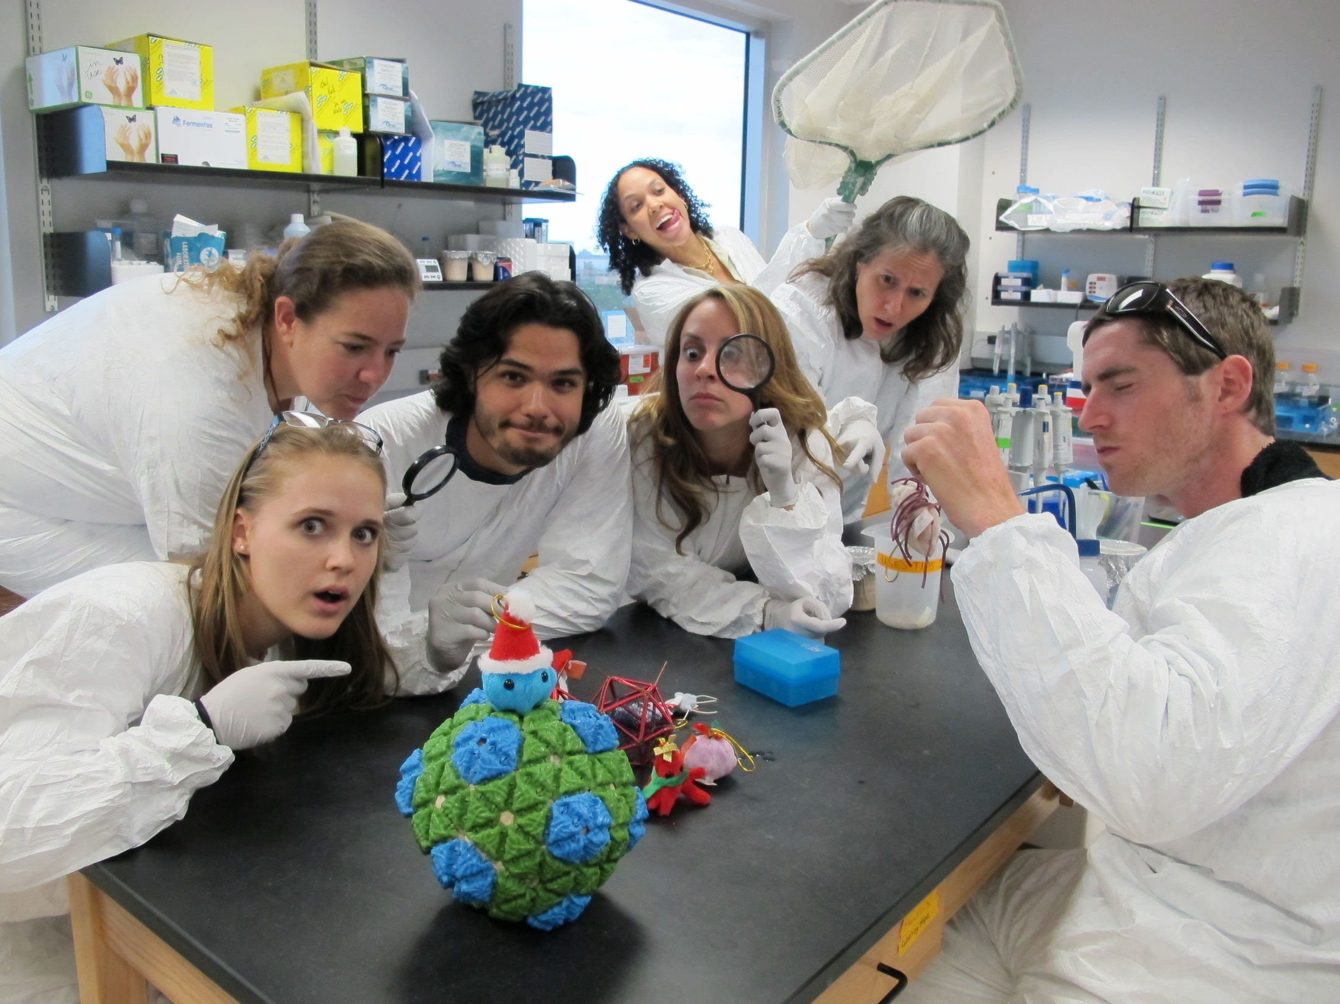
Ocean & Human Health
The Breitbart lab studies microbes (viruses and bacteria)
Notes:
I love this one. I would use it as the first slide in the “research” section of the presentation!

Slide 18


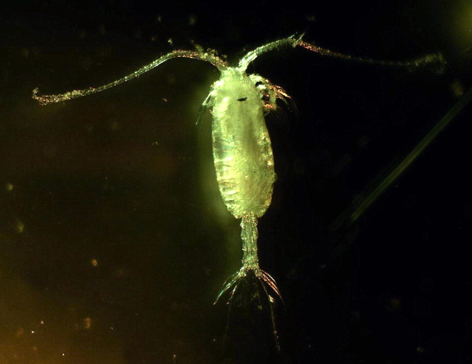
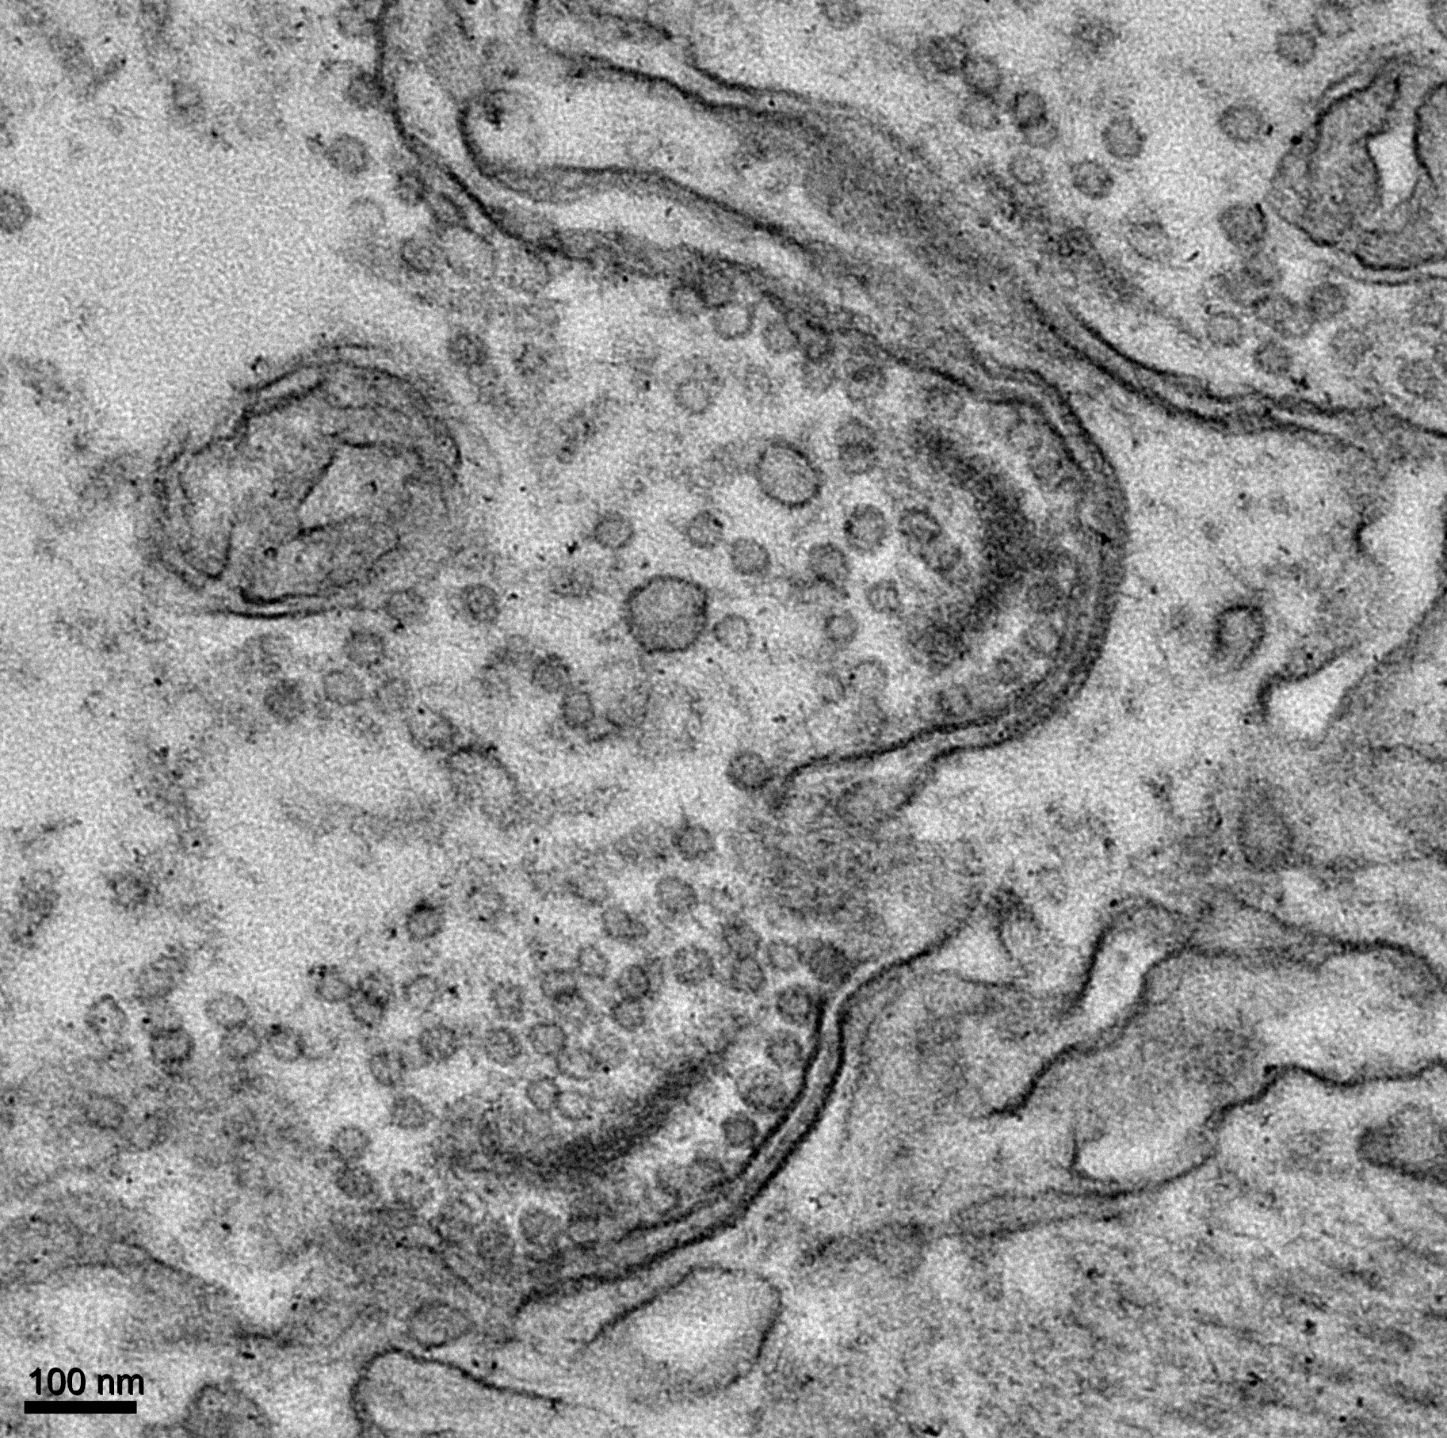
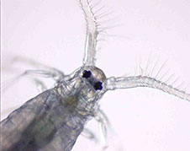
Ocean & Human Health
Breitbart Group: First Discovery of Viruses in Copepods
Copepods are the most abundant animals in the oceans, where they play critical roles in marine food webs and global carbon cycling
Up to 35% of copepod death is of unknown cause (cannot be explained by predation)
Using genomics and microscopy, the Breitbart lab documented the FIRST evidence for viral infection in copepods (Dunlap et al., PNAS 2013)
Copepods
Notes:
From Mya, who says, “Given the audience, Jackie should consider pointing out that "plankton" from Spongebob Squarepants is a copepod (in fact, he's designed after one of the species we found viruses in).”

Slide 19
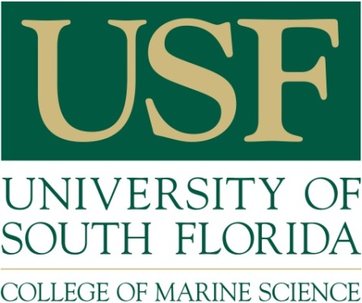
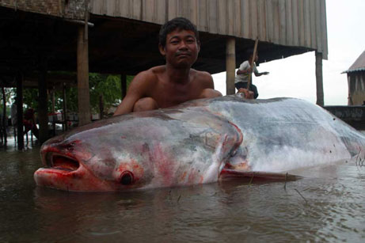
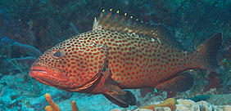

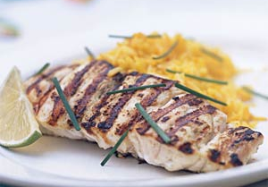
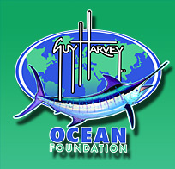
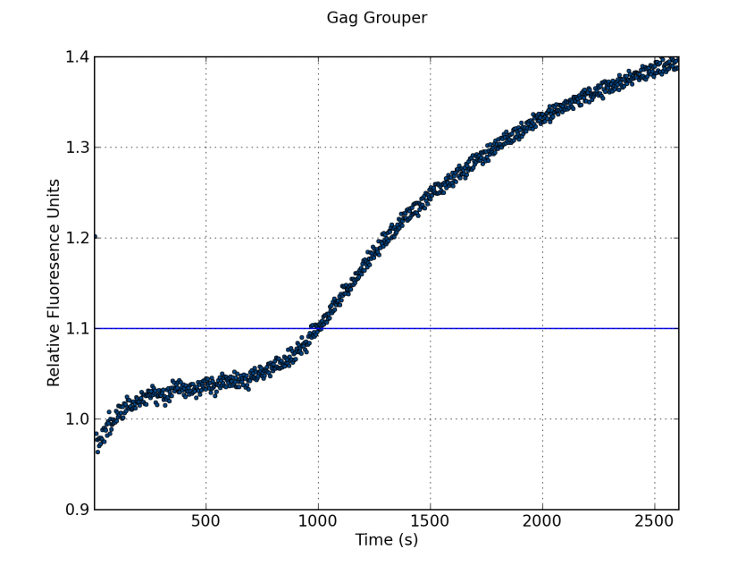
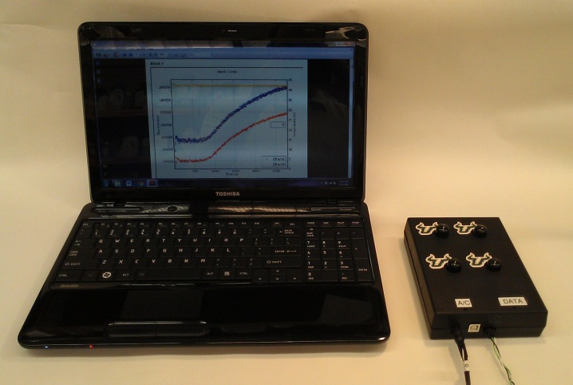
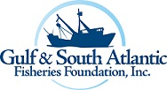
New Sensors:
Paul Group: Grouper Forensics or
What’s in your sandwich??
Asian catfish
Fla Grouper
?
Grouper Imposter
The Real Deal
?
?
Grouper
Not
Grouper

Slide 20
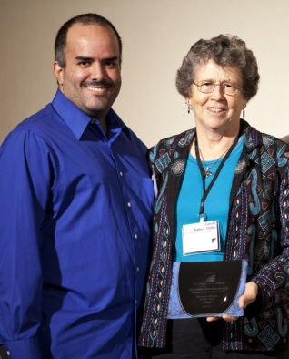
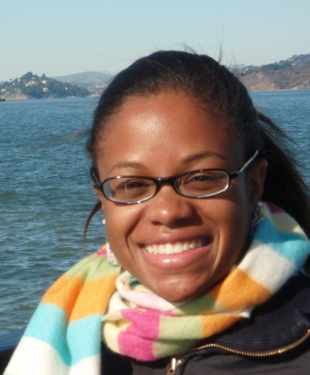
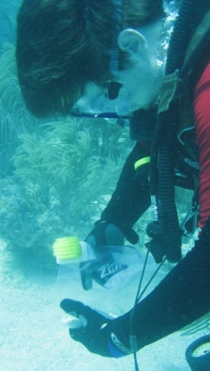
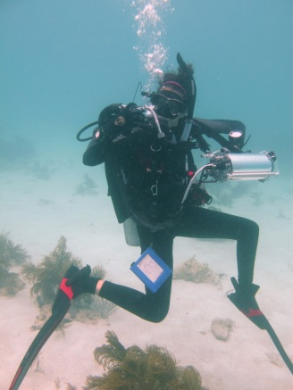
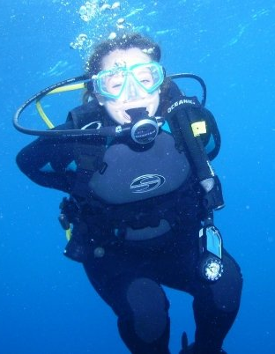

Ecology of carbonate sediment-producing organisms corals & foraminifers to understand algal symbiosis, calcification, and response to environmental changes.
Collaborators at WHOI, USGS, USEPA, EXXON-Mobile, and universities in Brazil, Greece, Italy and Spain.
Funded by NSF, NOAA, USGS, FIO (BP), Florida SeaGrant, NOAA, student fellowships and small private grants to students .
Ocean Health & Climate Change
Hallock Muller Group: Reef Indicators Lab
Adrienne
Ben
Natasha
Katie
P. Hallock Muller, 2012 Sloan Foundation Minority Ph.D. Mentor of the Year, w. Ph.D candidate M. Martinez-Colon,
Some Reefs Lab Ph.D. Students
Adrienne George, M.Sc. 2011, studies coral disease. She earned an NSF EAPSI Fellowship to conduct research in Taiwan in 2012. She is a McKnight Fellow & a Leadership Fellow in the USF Doctoral Student Leadership Institute.
Ben Ross, M.Sc. 2012, discovered that exposing foraminifers to slightly toxic concentrations of dispersant chemicals induced dormancy.
Natasha Mendez-Ferrer is quantifying photic stress in diatom symbionts of large benthic foraminifera. Her proposal was selected for the 2012 Joseph A. Cushman Student Research Award.
Katie Wirt, M.Sc. 2011, is creating critical habitat maps for endangered corals to determine areas where management strategies can be best targeted; thesis results published in Applied Geography.
Notes:
From Pam. Emphasizes students and also nicely demonstrates diversity.

Slide 21
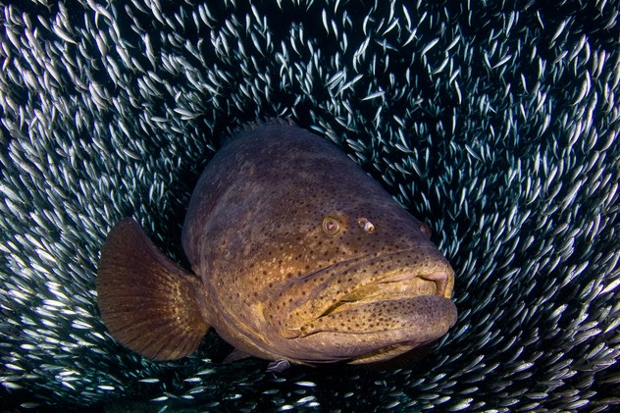
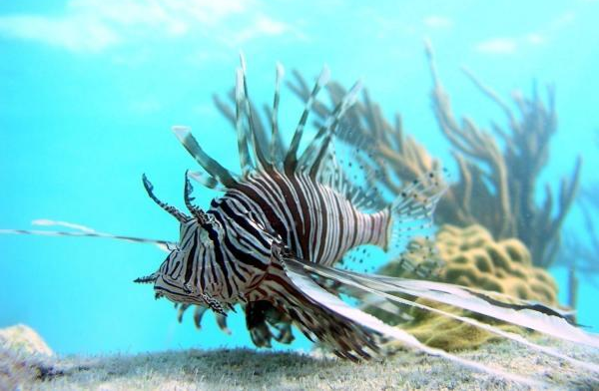
Marine Ecosystem & Resource Assessment
Stallings Group: Overfished Natives & Uninvited Exotics
Research based on first principles to inform management
Goliath grouper (native)
Lionfish (exotic)
Critically endangered but showing signs of recovery in FL waters
NOAA-funded study to examine population status using non-lethal methods
Population “explosion” of Indo-Pacific fish that devours native FL fishes
Sea Grant-funded study to test removal techniques to determine efficacy & costs
Dr. Chris Stallings, Assistant Professor, CMS (stallings@usf.edu)

Slide 22
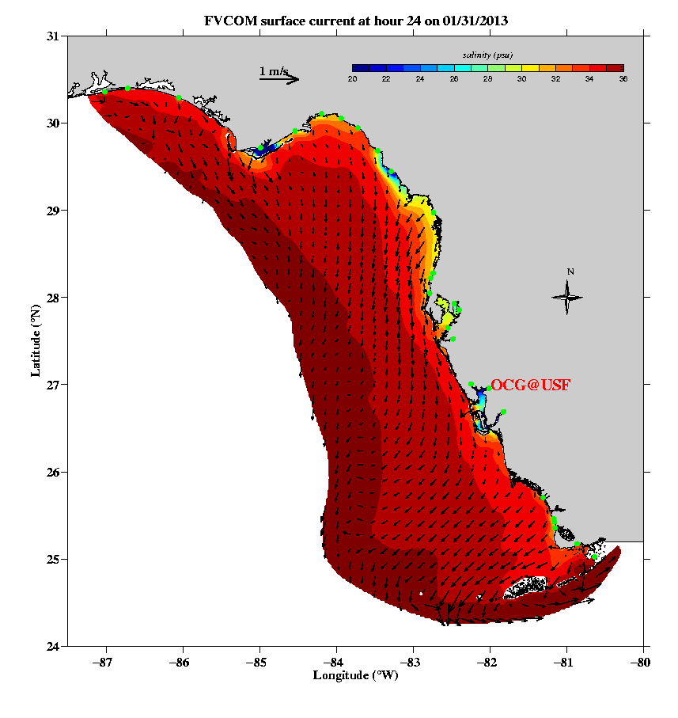
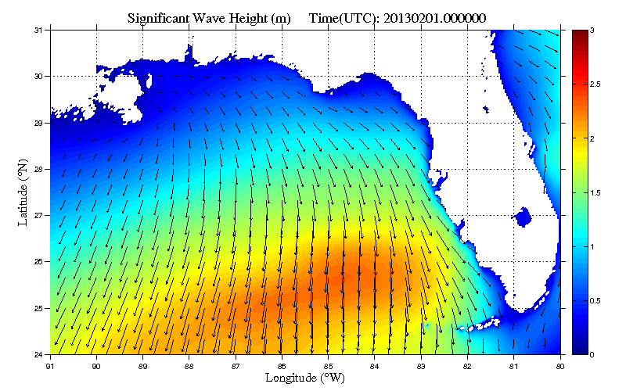

Modeling the Coastal Ocean
Weisberg Group: Daily, Automated Circulation and
Wave Forecasts (http://ocgweb.usf.edu)
Provided as a public service as part of our COMPS Program
Applications include:
Tracking red tide & oil spills
Fisheries resources
Search and rescue
Notes:
Weisberg’s overview for COMPS

Slide 23
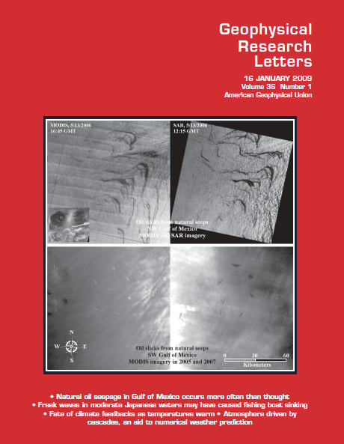
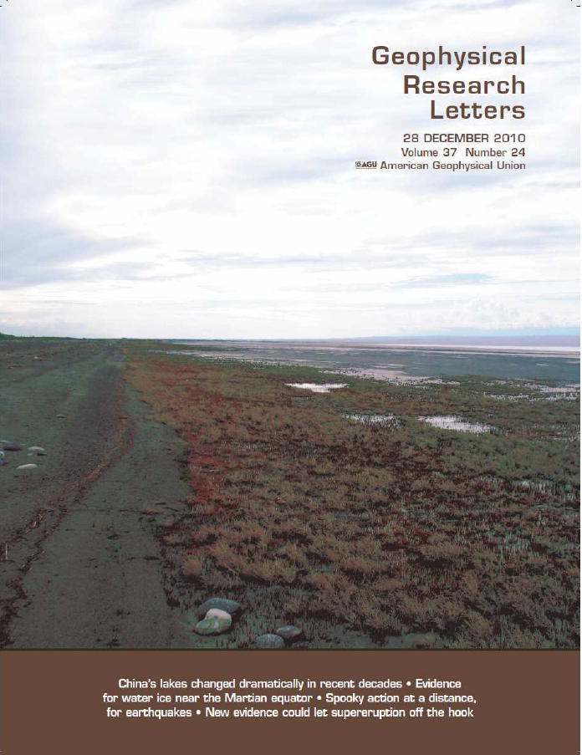
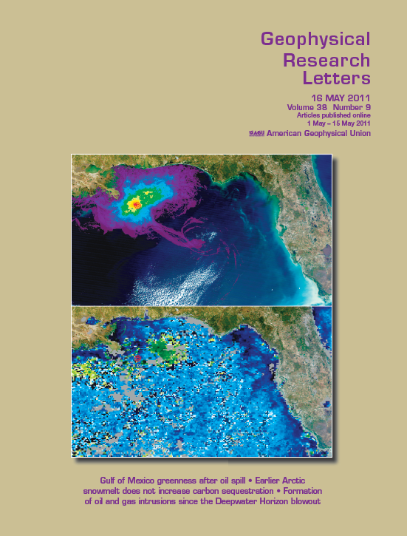
High Impact Publications
Selected Highlights on USF/CMS Research
Hu, Li, Pichel et al. (2009) on Gulf of Mexico oil seeps
Ma, Duan, Hu, et al. (2010) on China’s shrinking lakes
Hu, Weisberg, et al. (2011) on Deepwater Horizon oil spill
Notes:
Another from Chuanmin. This one might work. Three GRL “covers” from CMS researchers shows high impact.

Slide 24
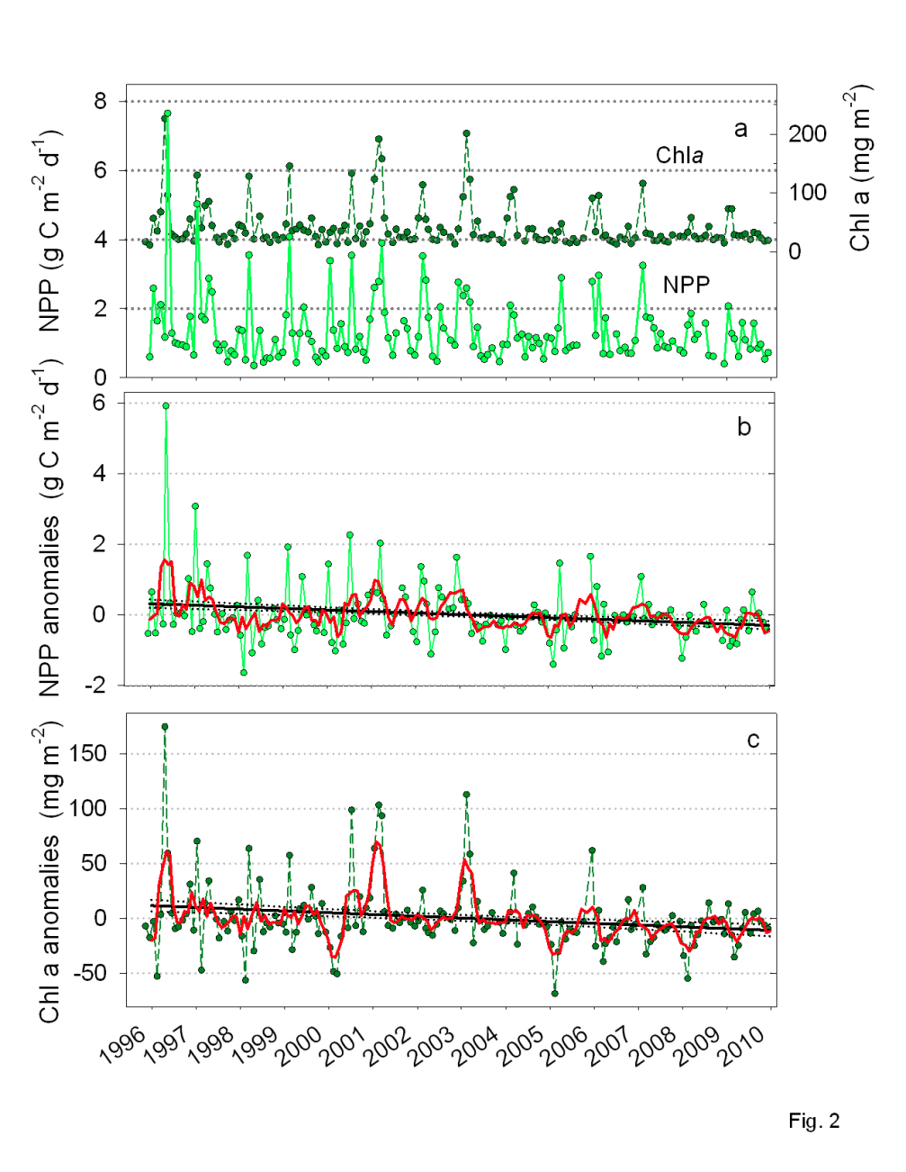
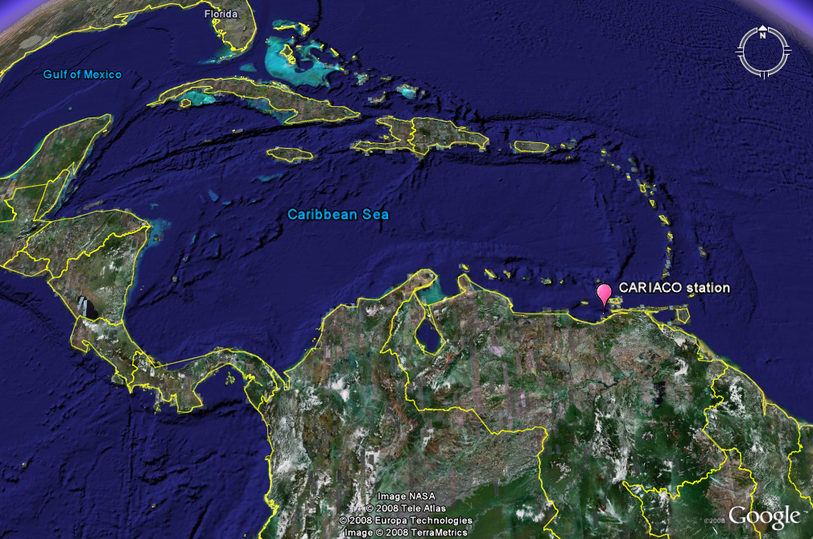

Muller-Karger Group: CARIACO Ocean Time-Series:
Studying linkages between oceanographic conditions and past climate changes
International Collaboration - NSF and Venezuelan Govt funding since 1995
Ocean Observing & Modeling
Long-term decrease in productivity and regional sardine fishery being caused by warming of the tropical Atlantic and Caribbean Sea, which has led to northward shift of Intertropical Convergence Zone
Notes:
From Frank. Punch line is at the bottom right.

Slide 25
Ocean Observing & Modeling/Climate Change/New Sensors
Byrne Group: Ocean Acidification
High precision and high spatial resolution measurements of carbonate saturation states off the California Coast.
Data obtained using novel spectrophotometric procedures developed in our college, plus pH and carbonate data obtained by Ph.D. student Mark Patsavas on a 2011 NOAA cruise.
Notes:
From Bob Byrne, one of the big players in Ocean Acidification, who says, “The figure depicts carbonate saturation states off the California Coast that were obtained using novel spectrophotometric procedures developed in our college, plus pH and carbonate data obtained by doctoral student Mark Patsavas on a 2011 NOAA cruise along the east coast of the United States.”

Slide 26

Climate Change: Southern Ocean warming, Antarctic ice sheet evolution, and global change
Shevenell Group (Paleo Lab)
Warm Southern Ocean waters are melting Antarctic glaciers, with implications for global sea level.
USF CMS paleoceanographers reconstruct past (0-34 Ma) ocean temperatures from fossilized microorganisms found in Southern Ocean marine sediments.
Data, published in Science and Nature, reveal past Antarctic ice sheet retreat occurred during intervals of Southern Ocean warming and elevated atmospheric CO₂.
Ongoing multi-disciplinary oceanographic research is investigating Southern Ocean-glacial ice interactions in East Antarctica.
“Antarctic paleoclimate studies are a research priority” –NRC, in Future Science Opportunities in Antarctica and the Southern Ocean, 2011
Shevenell et al.,
Nature, 2011
In Mulvaney et al.,
Nature,2012
Notes:
Note: Shevenell et al 2011 is paleotemperature data from marine sediments on the western Antarctic peninsula for last 10 Ka
Mulvaney data is paleotemperature data from ice cores on the eastern Antarctic Peninsula over past 10Ka
Similar trends until the last 2 ka, when region started to be more strongly influenced by ENSO.

Slide 27
Monitoring Climate Change from Space
Chambers Group: Gravity Recovery & Climate Experiment (GRACE)

Slide 28
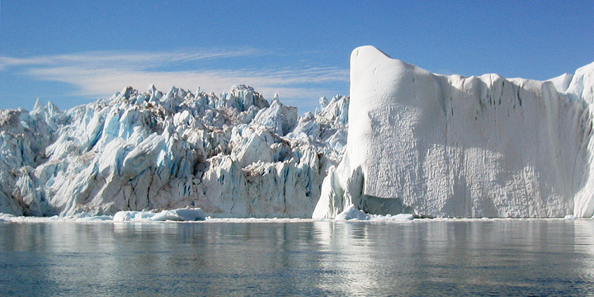
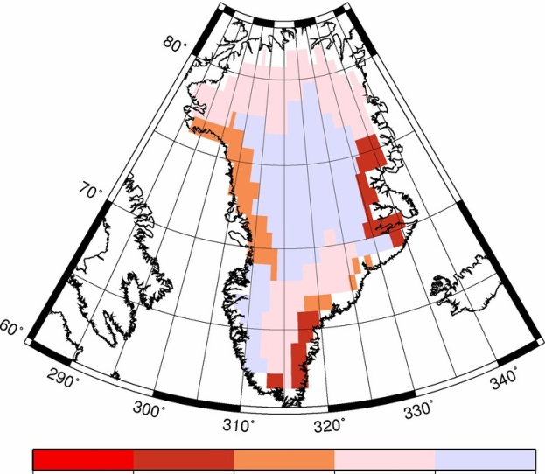
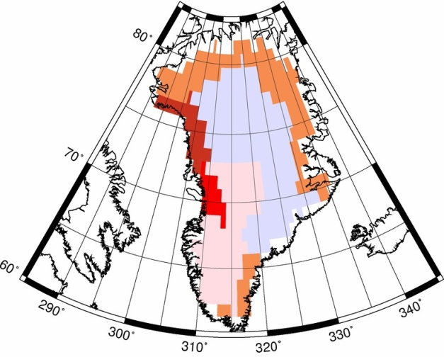
Chambers Group
Total mass lost from
June 2002 to – Dec 2006
Total mass lost from
Jan 2007 to –Jun 2011
1
1
Total
8
8
7
7
km³ of water
5
5
-4
-3
-1
0
Year
-2
1
meters of water
NASA-funded research: Advanced techniques have been developed to measure the contribution from individual drainage basins. Future work will combine GRACE with GPS measurements of vertical land motion to determine the mass loss of individual glaciers within the larger drainage basin.
km³ of water
Individual basins
Year
Bonin, J., and D. P. Chambers (2013), Uncertainty Estimates of GRACE Inversion Modeling Technique Over Greenland Using a Simulation, Geophys. J. Int., in review
Notes:
From Don Chambers. Key point is that we’re involved in global climate change research.

Slide 29
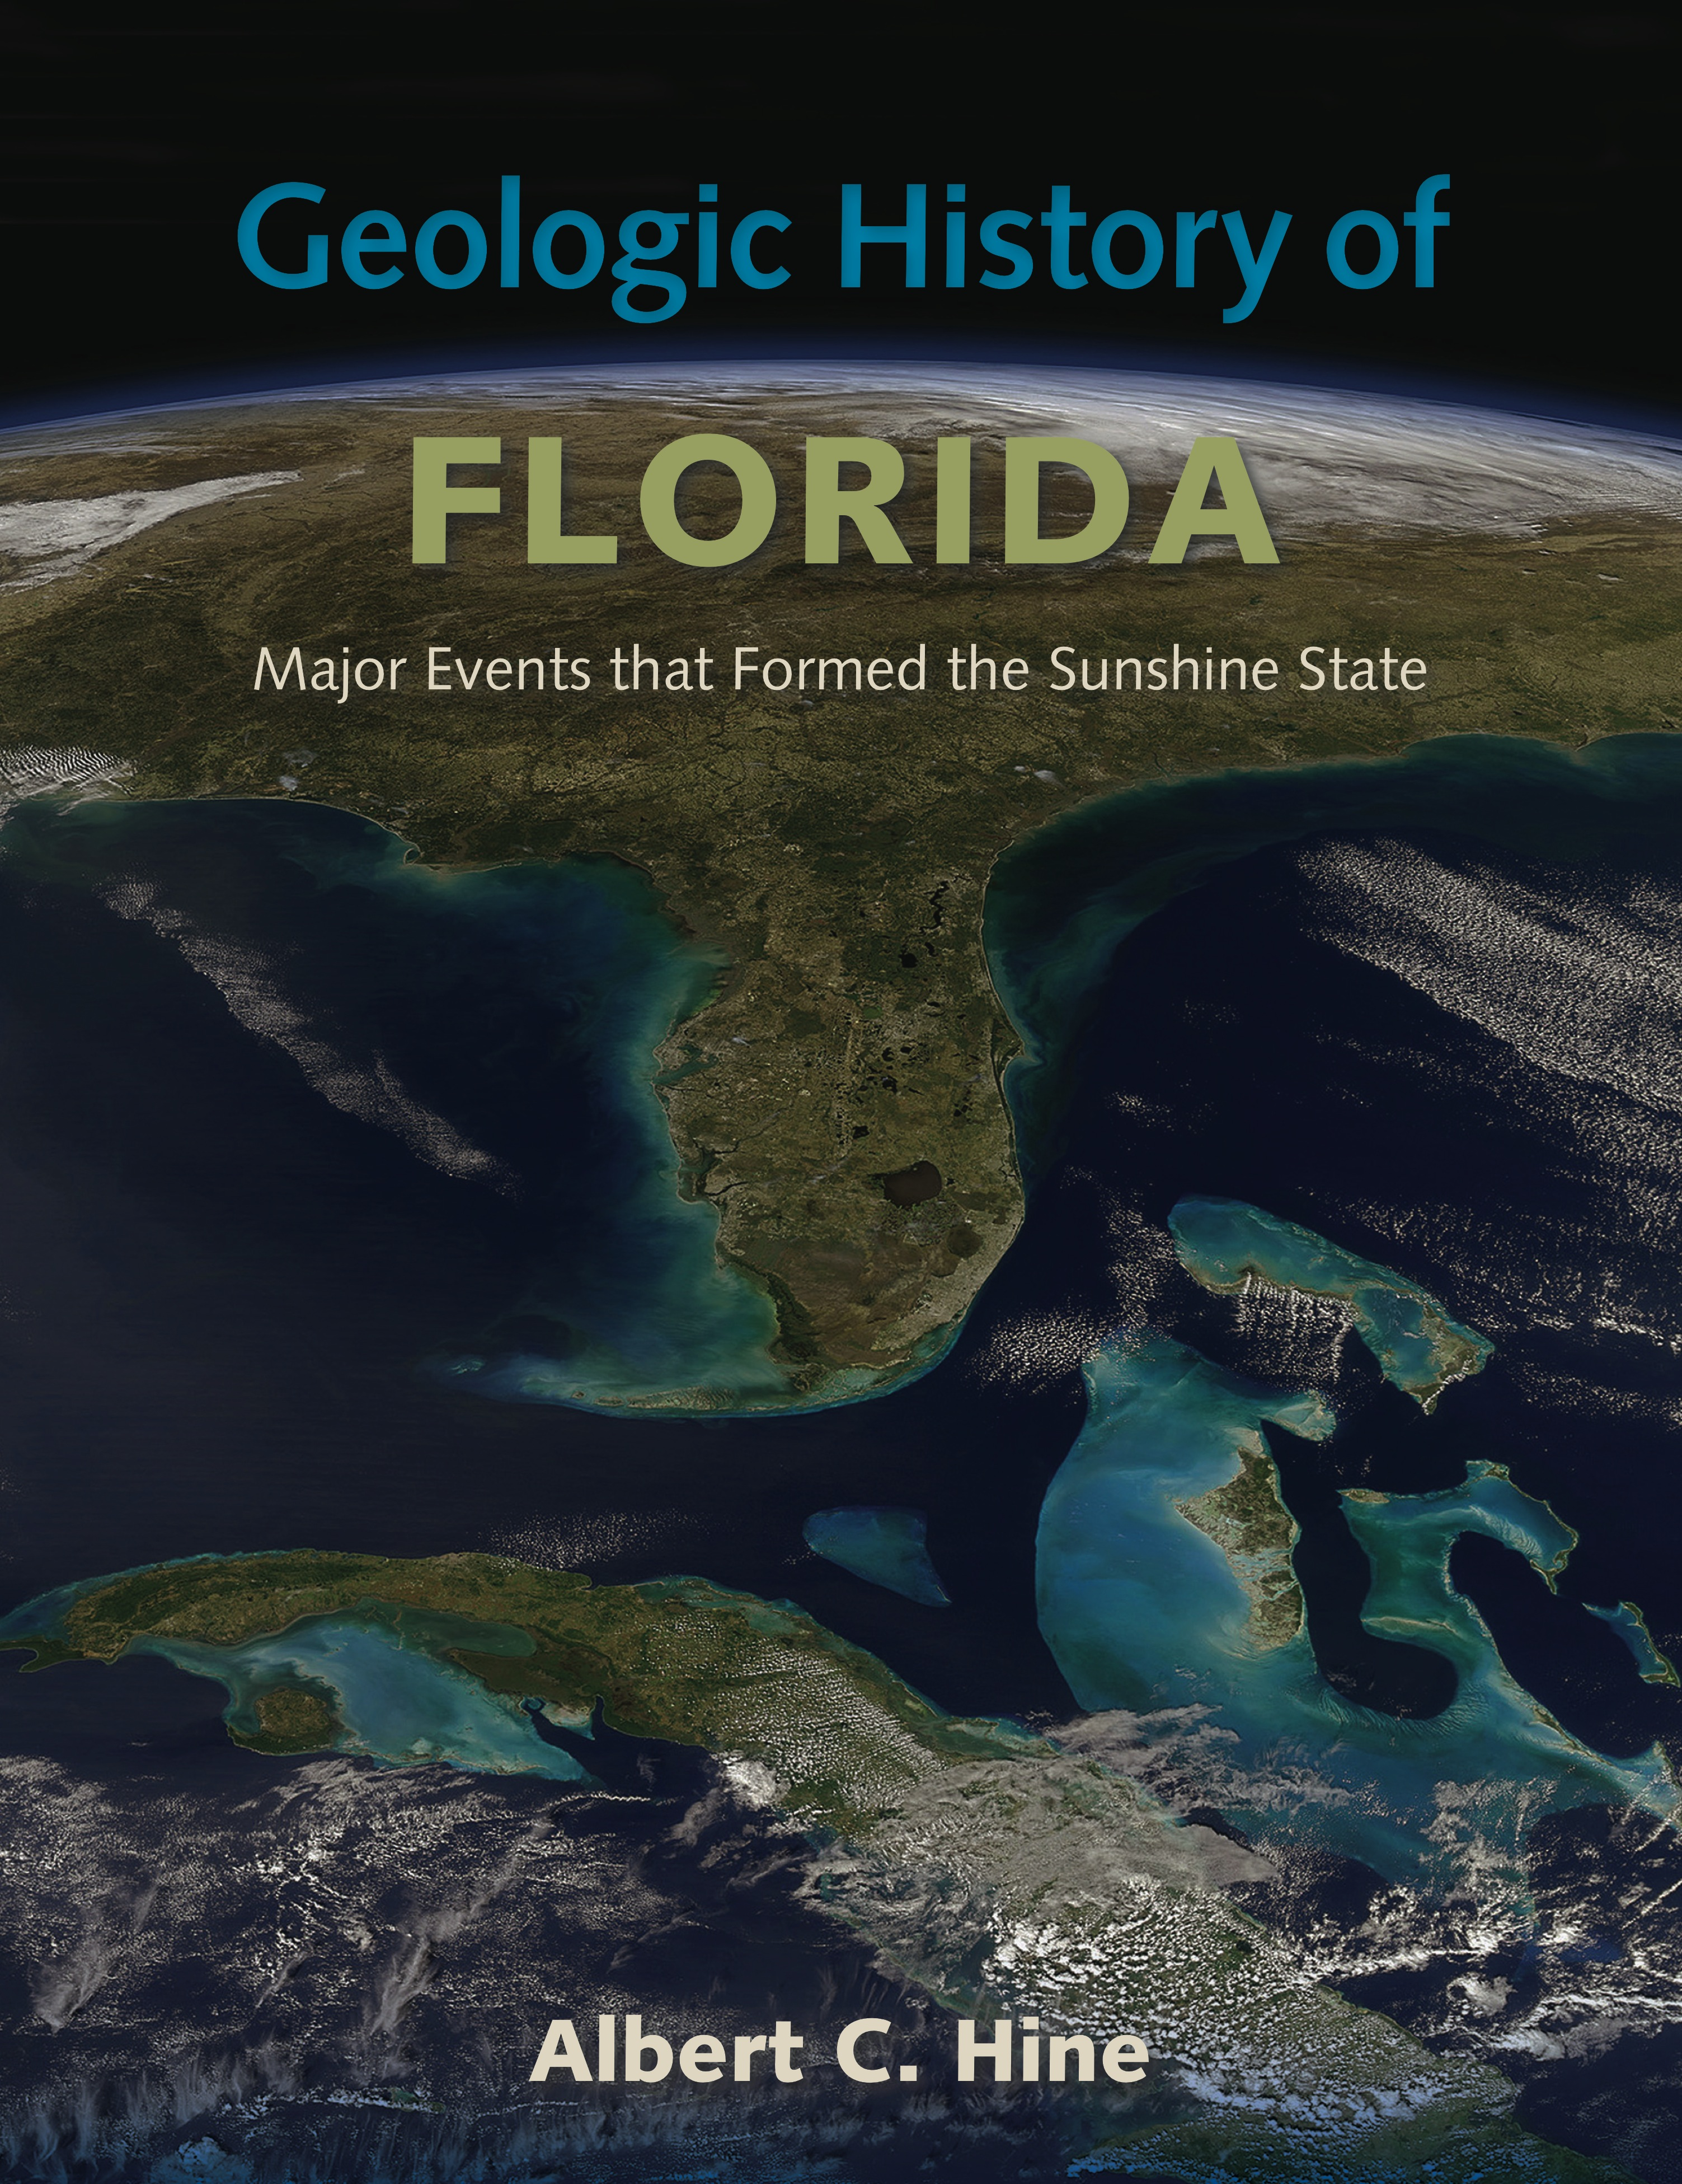
Online course coming soon!!

Slide 30
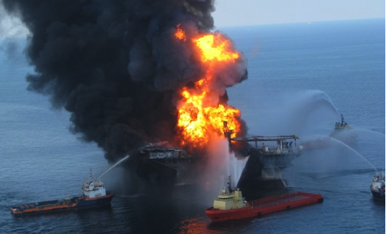
On April 20, 2010
Explosion and Fire on Transocean Ltd’s Drilling Rig - Deepwater Horizon Explosion

Slide 31
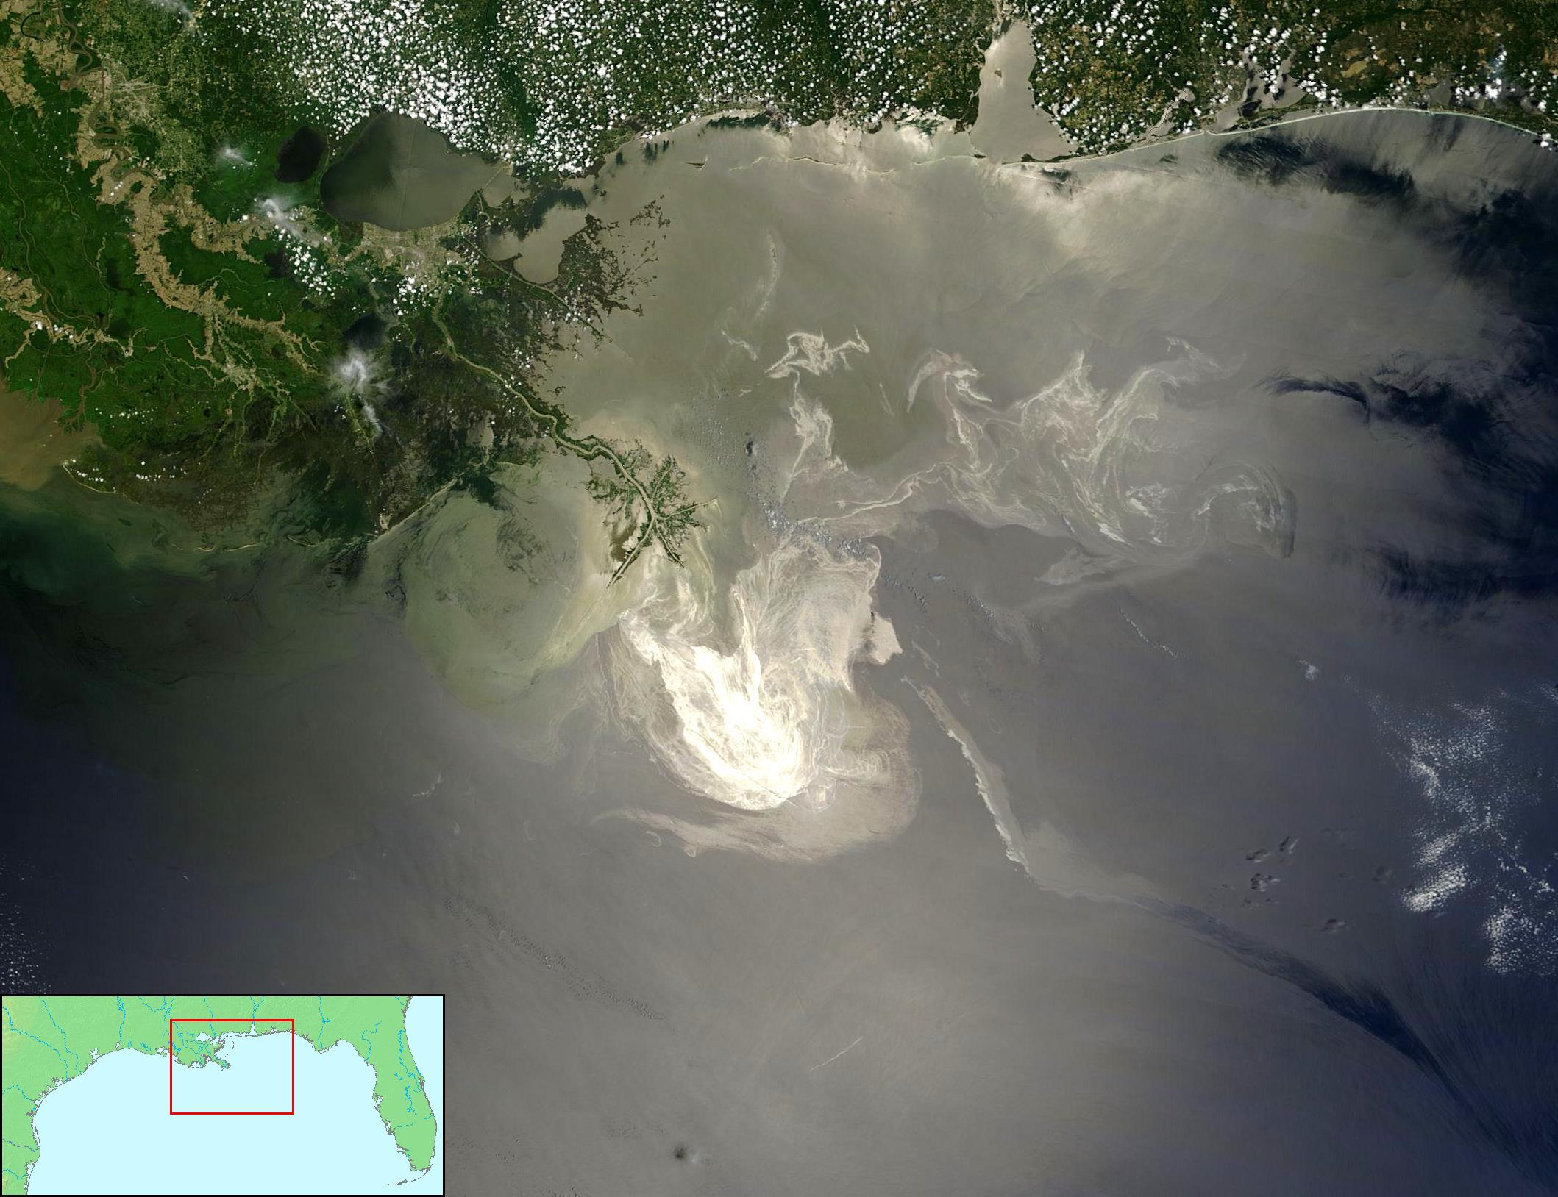
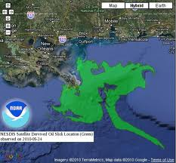
Oil Spill from Space—May 24, 2010
A 2-Dimensional Disaster

Slide 32
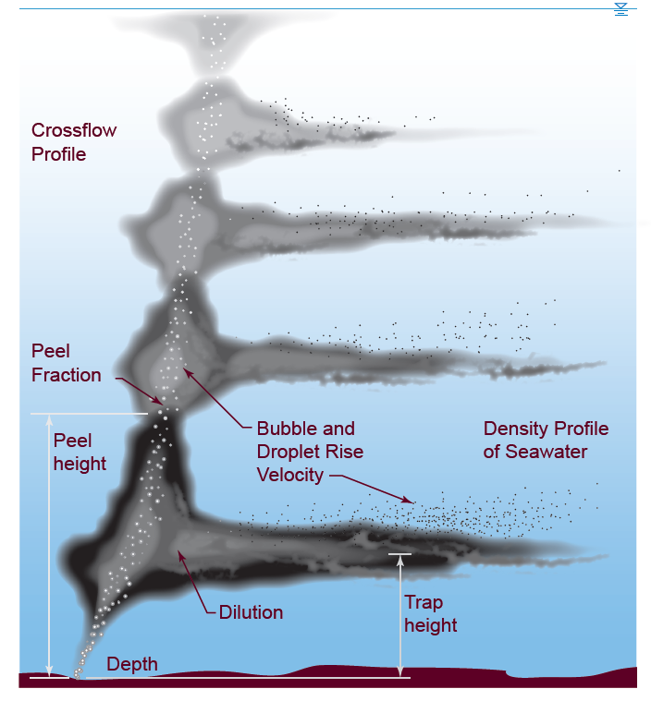
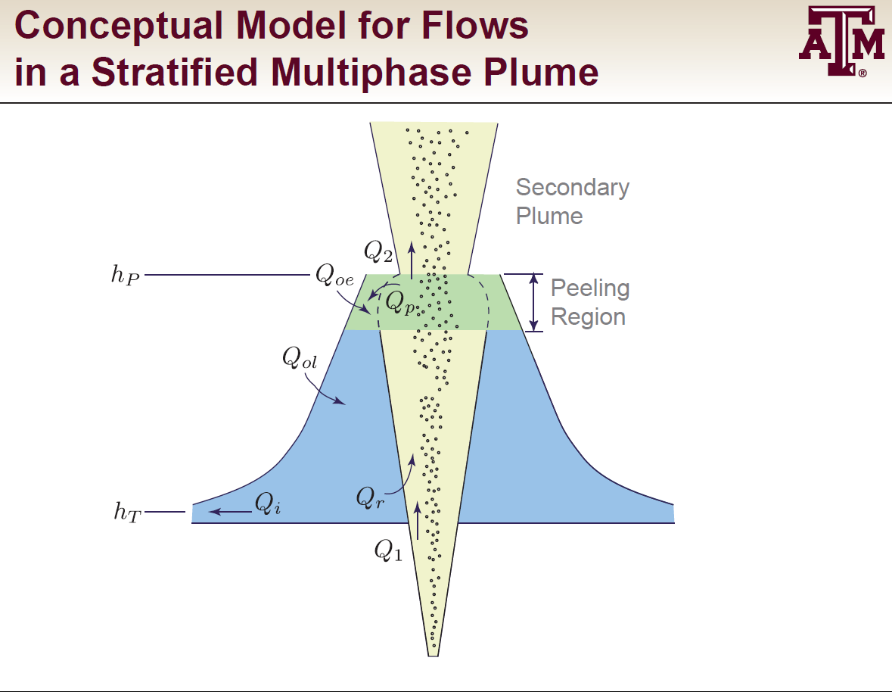

But it is a 4-D problem
• Model multiphase plume flow
• Coupled to GoM circulation
models
• Improve near-field modeling
w/better constraints behavior
of oil/gas/seawater mixture at
high-pressure
Socolofsky, TAMU; Paris, UM-RSMAS

Slide 33
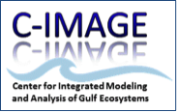
C-IMAGE Consortium Partners: assembling the world’s experts
University of South Florida – Lead, IT, education, various science
Florida Institute of Oceanography – Research vessels
Hamburg Technical University – High-P lab studies, velocity
Texas A&M University – Oil physics and chemistry
University of Calgary – HMW environmental exposure, partitioning
Wageningen University & NHL – Netherlands – Decision support tool
Eckerd College - Benthic stratigraphic studies
University of West Florida - Microbial studies
Pennsylvania State University – Degrading enzymes, ¹³C, ¹⁴C studies
University of Miami – Modeling oil distribution & concentration
University of South Alabama – Fish community analyses
Mote Marine Laboratory - Biomarkers -vertebrate exposure
Scripps Institution of Oceanography – Marine mammals

Slide 34
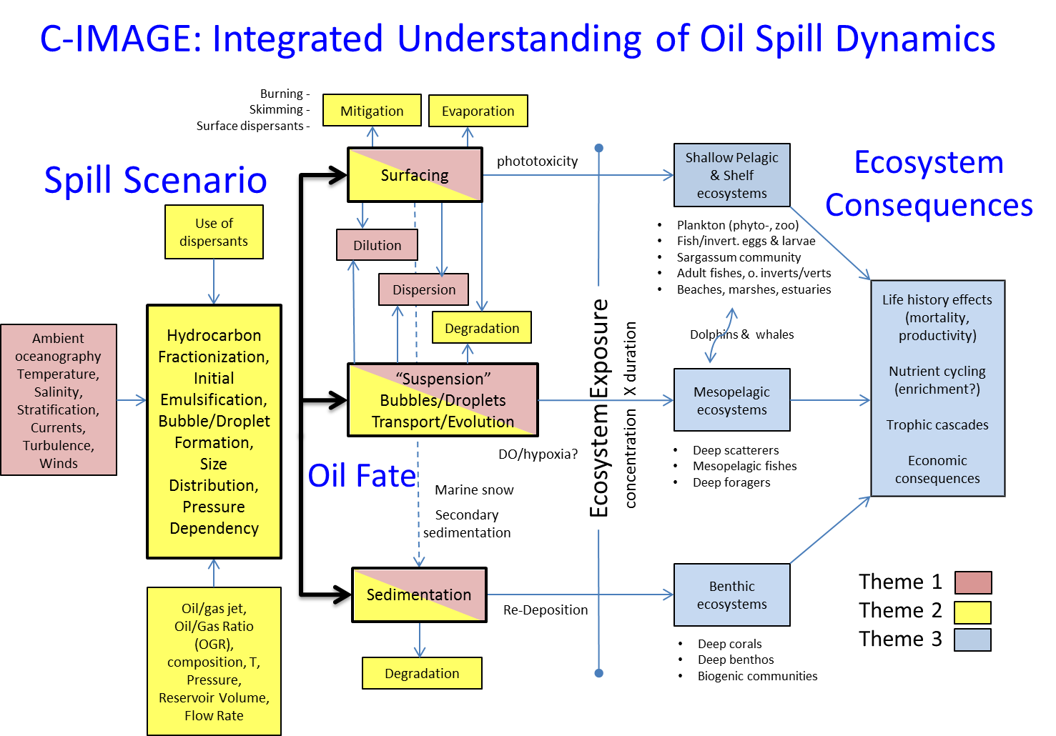
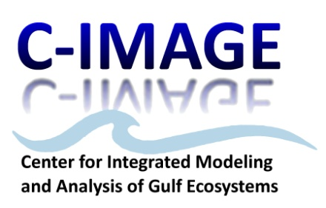
USF, Scripps, SAlabama, WFla
USF, Mote
TAMU
UMiami
TUHH
UCalgary
USF
USF, Calgary, Eckerd, PSU, Wageningen,WFla

Slide 35
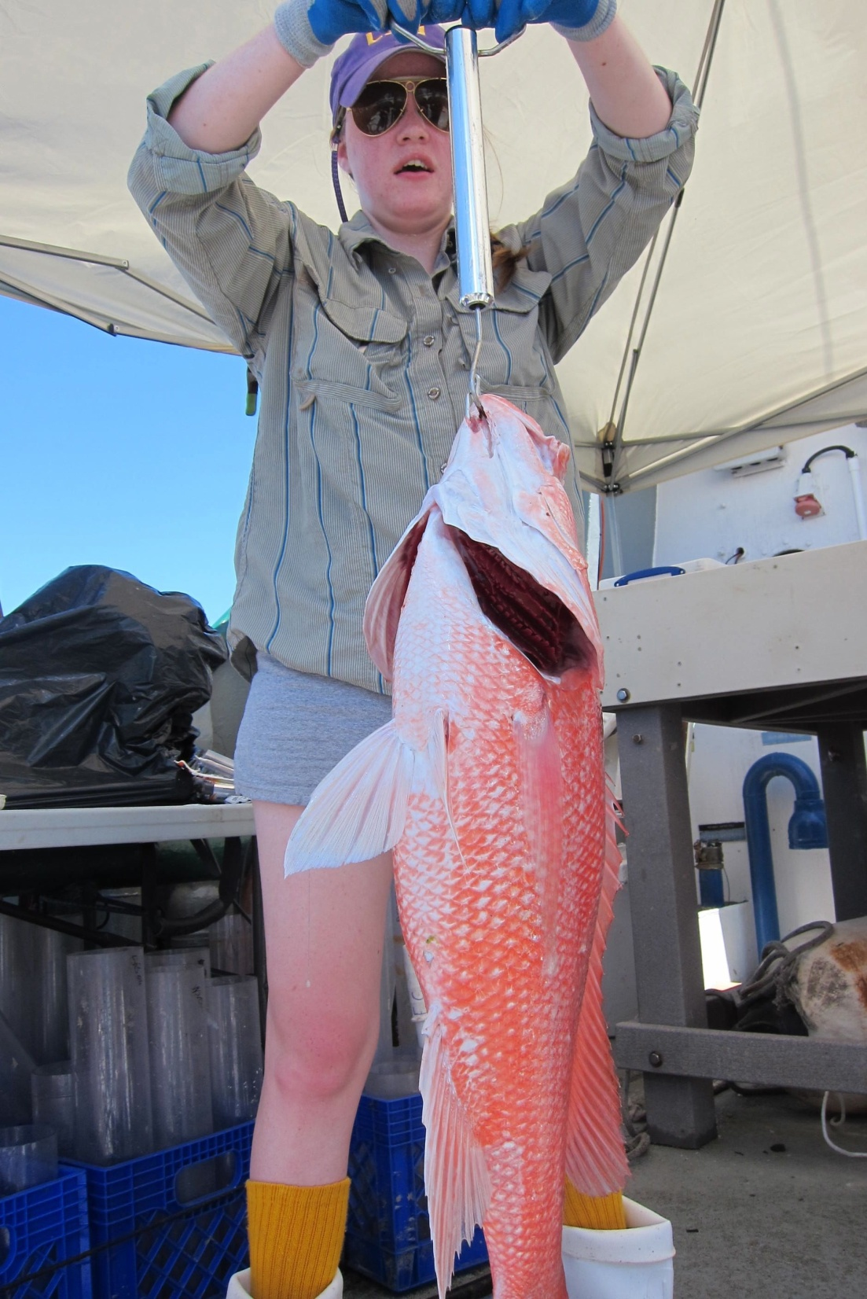
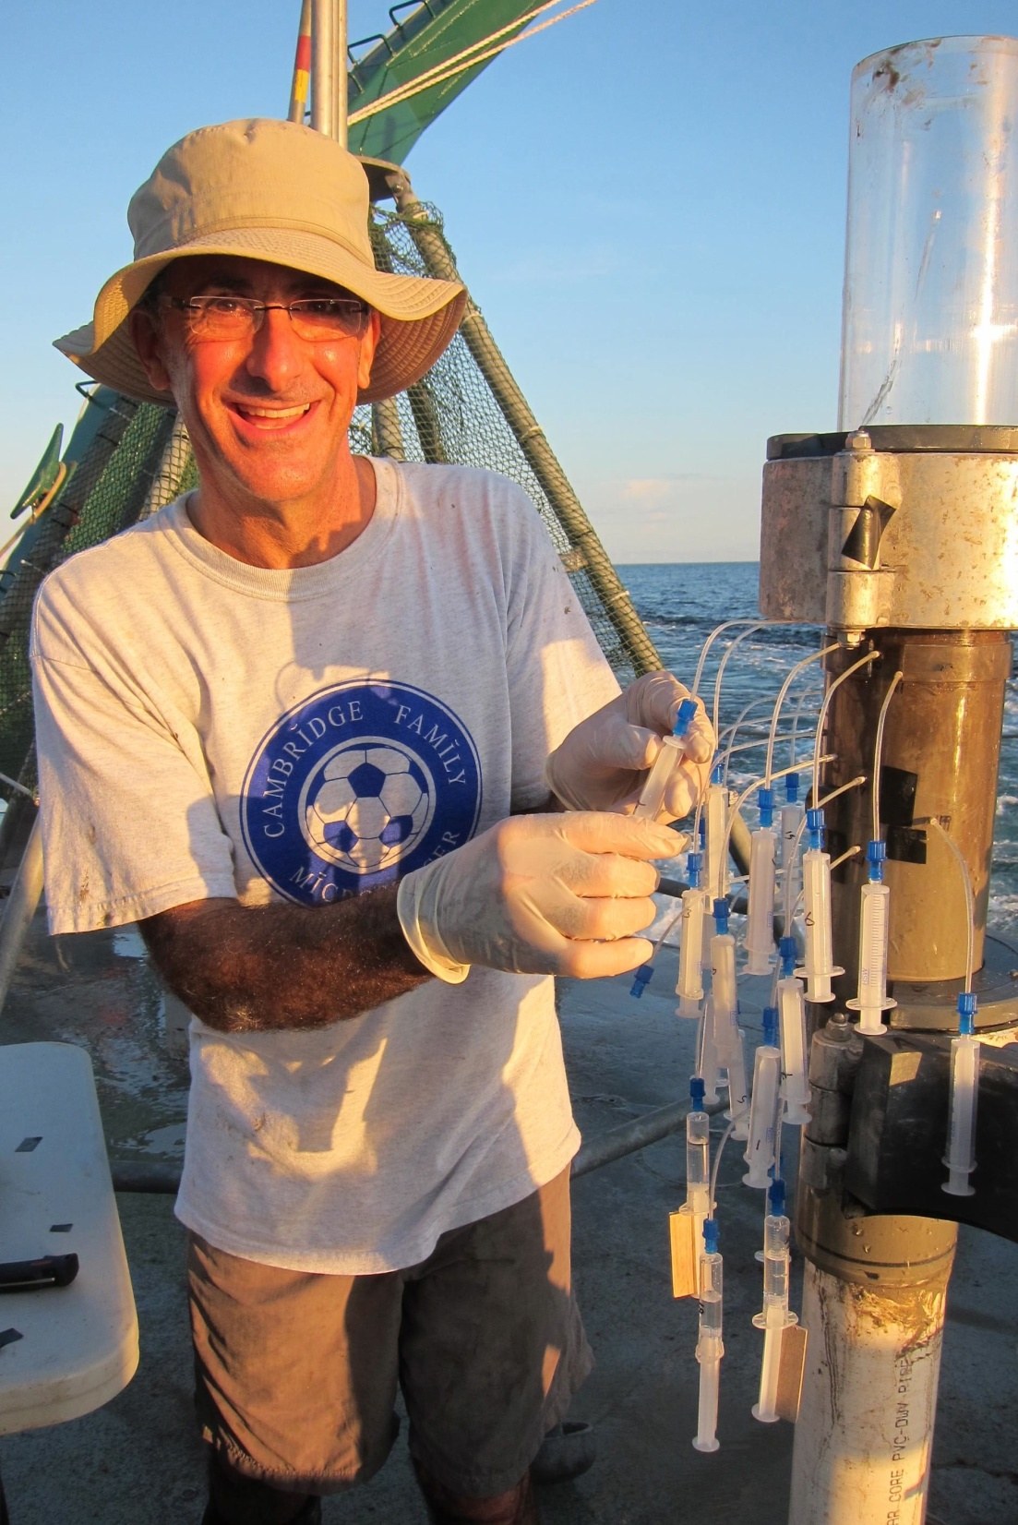
Integrated sediment & fish sampling
R/V Weatherbird II - 2012

Slide 36



Communication & Outreach
Teacher @Sea Research Program
RESULTS
2 HS & 1 MS Teacher sailed (Aug & Nov 2012 cruises)
26 Blog posts, feat. 6 scientists, 2 postdocs, 7 G students
> 10,000 Re-tweets (source, USF Mass Comm.)
10 Schools direct participation via Skype broadcasts
~700 students remotely participated in the expeditions
146 student questions answered LIVE or via email
Notes:
CIMAGE Teachers at Sea, 3 teachers completed onboard research & served as ship to shore communicators via 25 Blogs, >10,000 Tweets/Re-tweets, and 21 LIVE Skype video conferences (630 K-12 & college students, 11 schools). Began tracking metrics during 3-day November cruise-

Slide 37

Communication & Outreach
Communication: Engaging the Public
Public Media WUSF
2 CIMAGE podcasts, the Loop, (300K) featuring Murawski & Hollander
Science Festival (12K)
- 2 CIMAGE Exhibits
Public Lectures (~200)
- Florida Marine Science
Educators

Slide 38

Development
Through the generosity of many friends and alumni, the USF Foundation provided over $300,000 in support of the 2012-2012 College of Marine Science Fellows.

Slide 39
CMS Development FY13 >$10,000 gifts
Guy Harvey Ocean Foundation - $30,000 in support of Detection of Planktonic Grouper Larvae research
Mary and William Hogarth - $20,000 in support of The William T. Hogarth Fellowship in Marine Mammals
Progress Energy Florida - $10,000 in support of the Oceanography Camp for Girls.
This year the number of College of Marine Science donors represents a 47.17% increase from the previous year.

Slide 40
Looking Forward
Challenges
  Continuing reduction in federal investments in research
  Funding for facilities and equipment maintenance and improvement
  Sponsored Programs: Matches & overhead return
Opportunities
  Expansion of undergraduate involvement
  Restore Act funding

Slide 41




Questions
&
Comments…
Notes:
First I would like to thank all the donors and especially those present today.
18 fellowship will be awarded
Total amount to be awarded $200,000
We are just into the 08-09 Academic year and have much to be proud of
110 students
Hiring 4 new faculty members
Evaluating new research vessel
Looking at new curriculum

