Slide 1
Weekly Schedule
This Week @USFCMS
Seminars
Weekly
Brown bag
Defenses
List
Academic deadlines
List
MSAC Activities
List

Slide 2
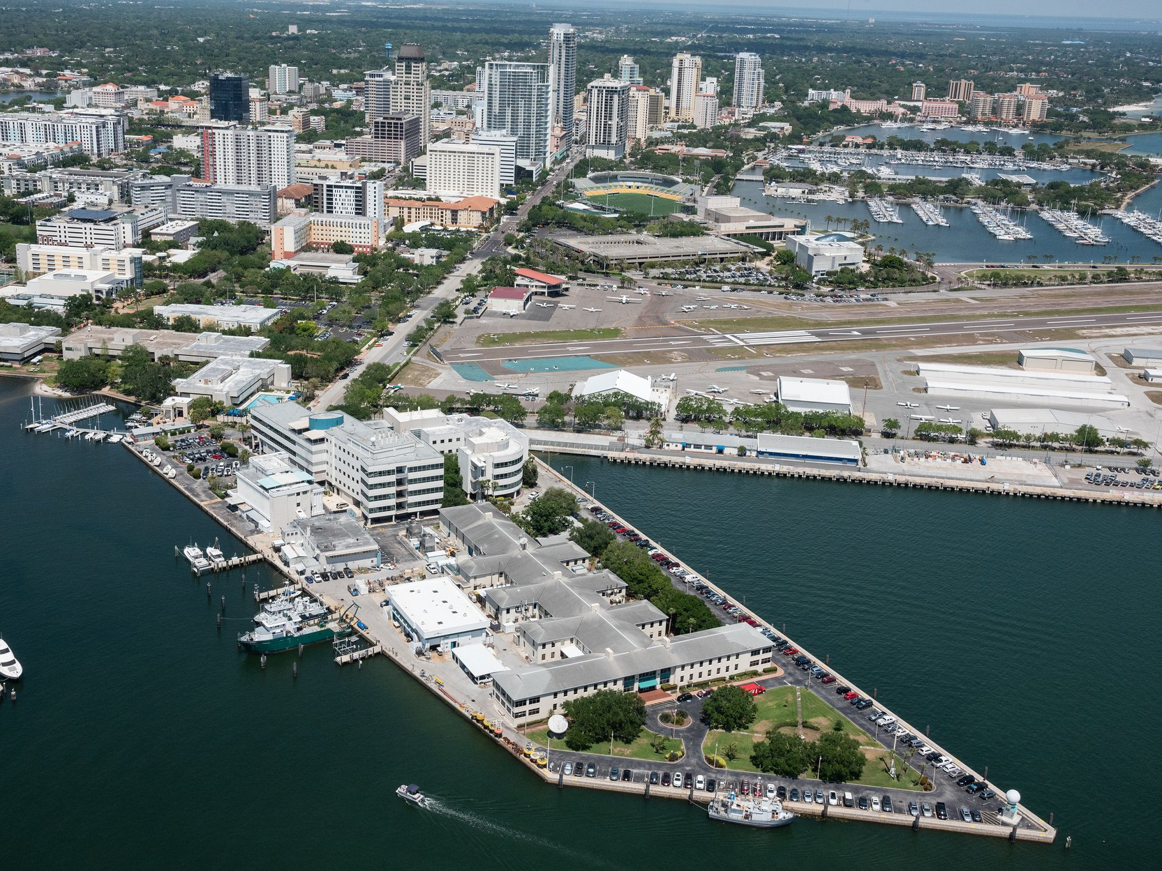
CMS Facility

Slide 3
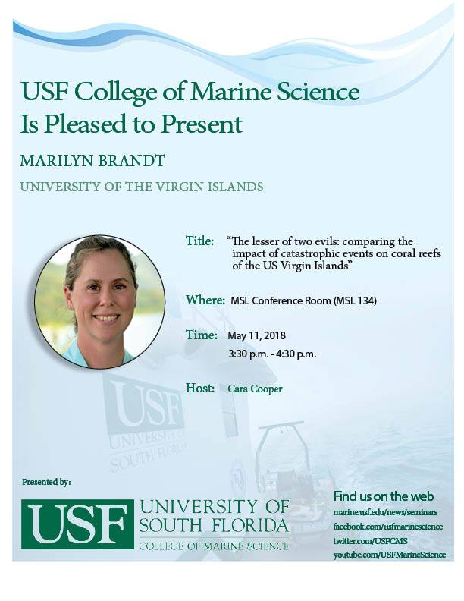
Weekly Seminar Flyer

Slide 4
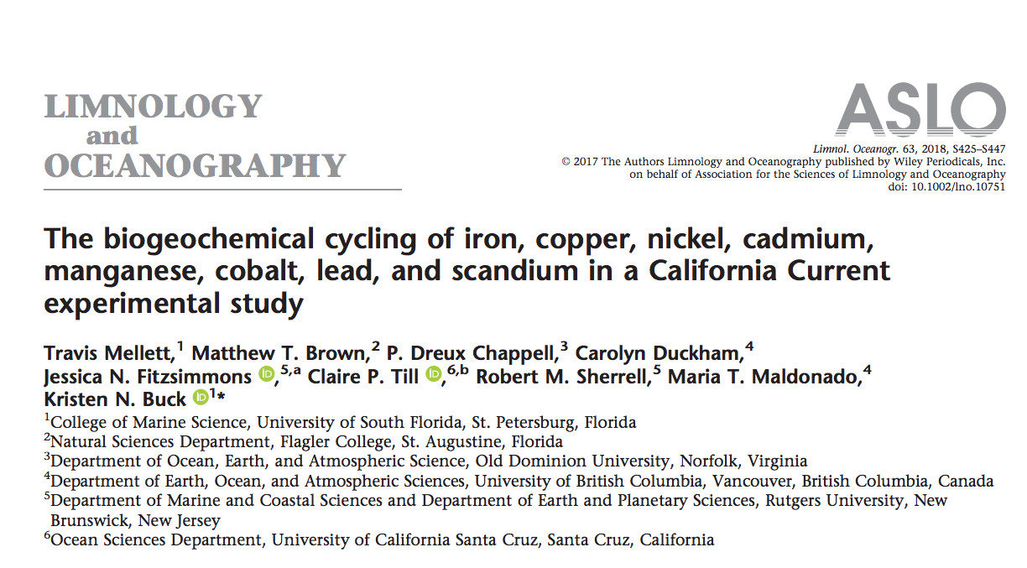
CMS Publication
2018 USF CMS Student and Faculty Publication

Slide 5
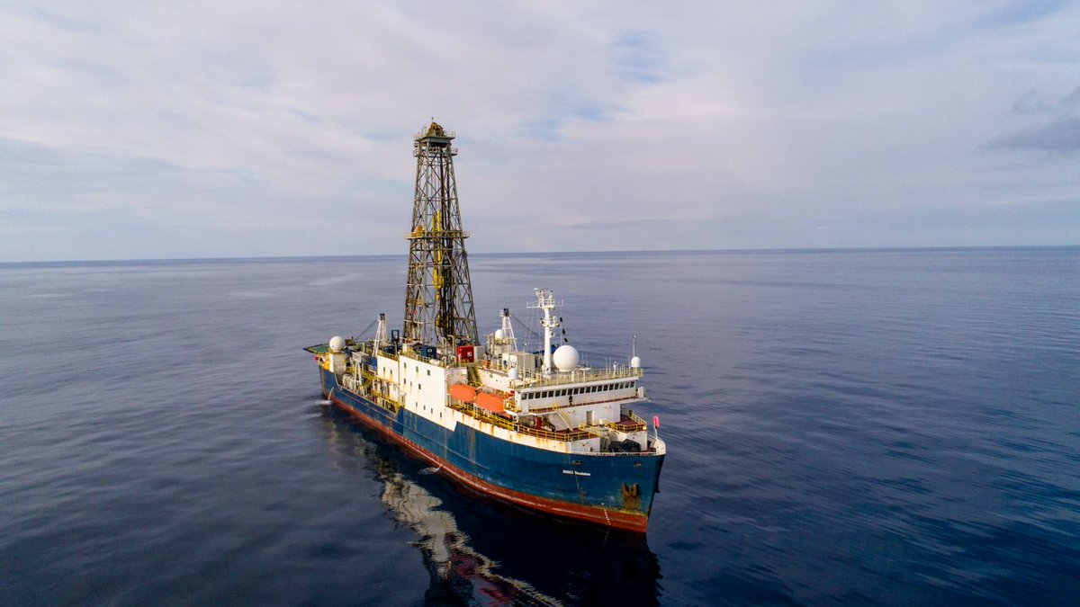
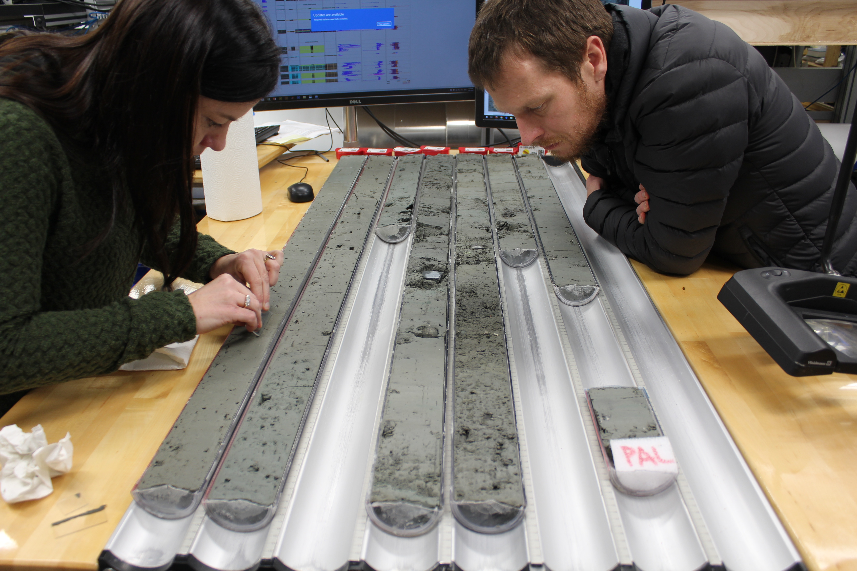
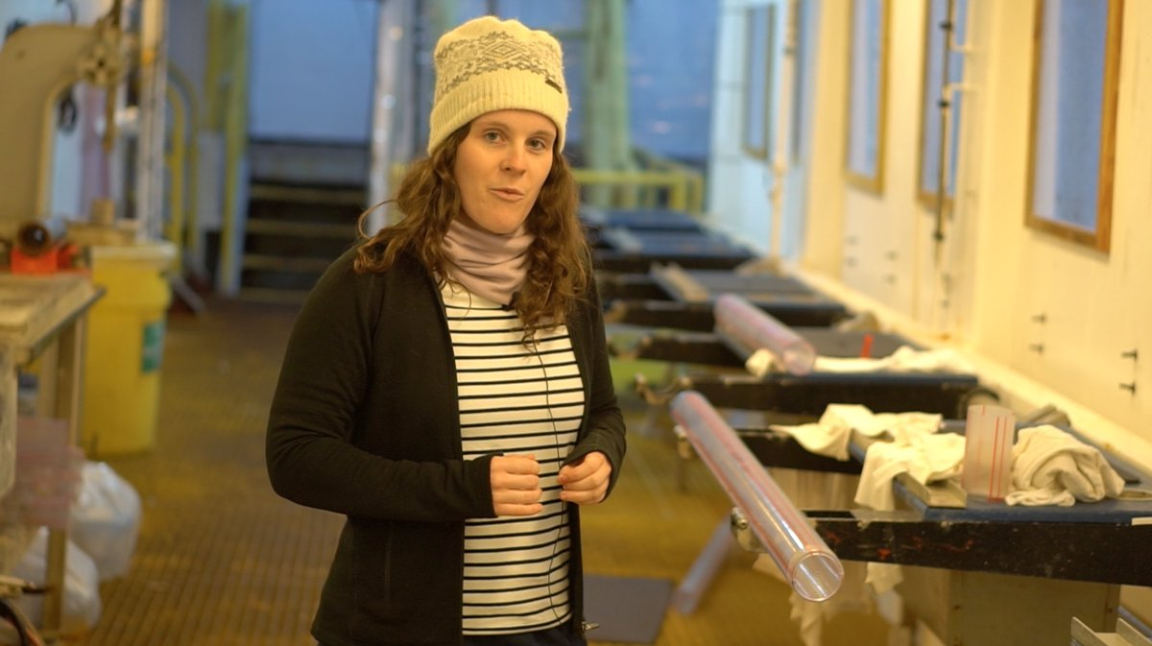
CMS Research Highlight
CMS faculty, Amelia Shevenell, and PhD student, Imogen Browne, sail on IODP Expedition 374 to the Ross Sea, Antarctica to understand 20 million years of Antarctic ice sheet evolution

Slide 6
CMS Publication
2018 USF CMS student and faculty publication

Slide 7
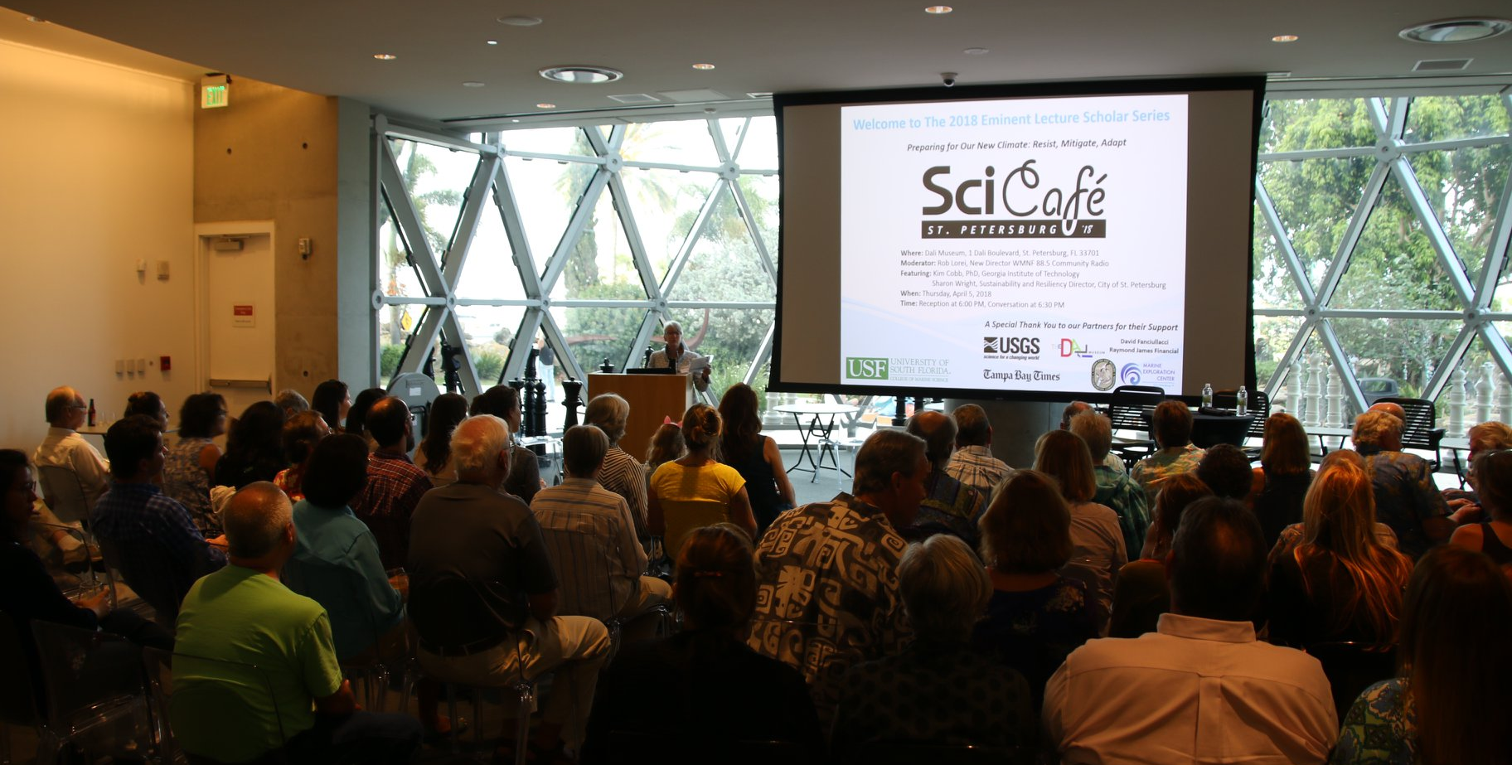
CMS Outreach
April 2018 USF CMS Sci Café with Dr. Kimberly Cobb,
a paleoceanographer from GA Tech

Slide 8
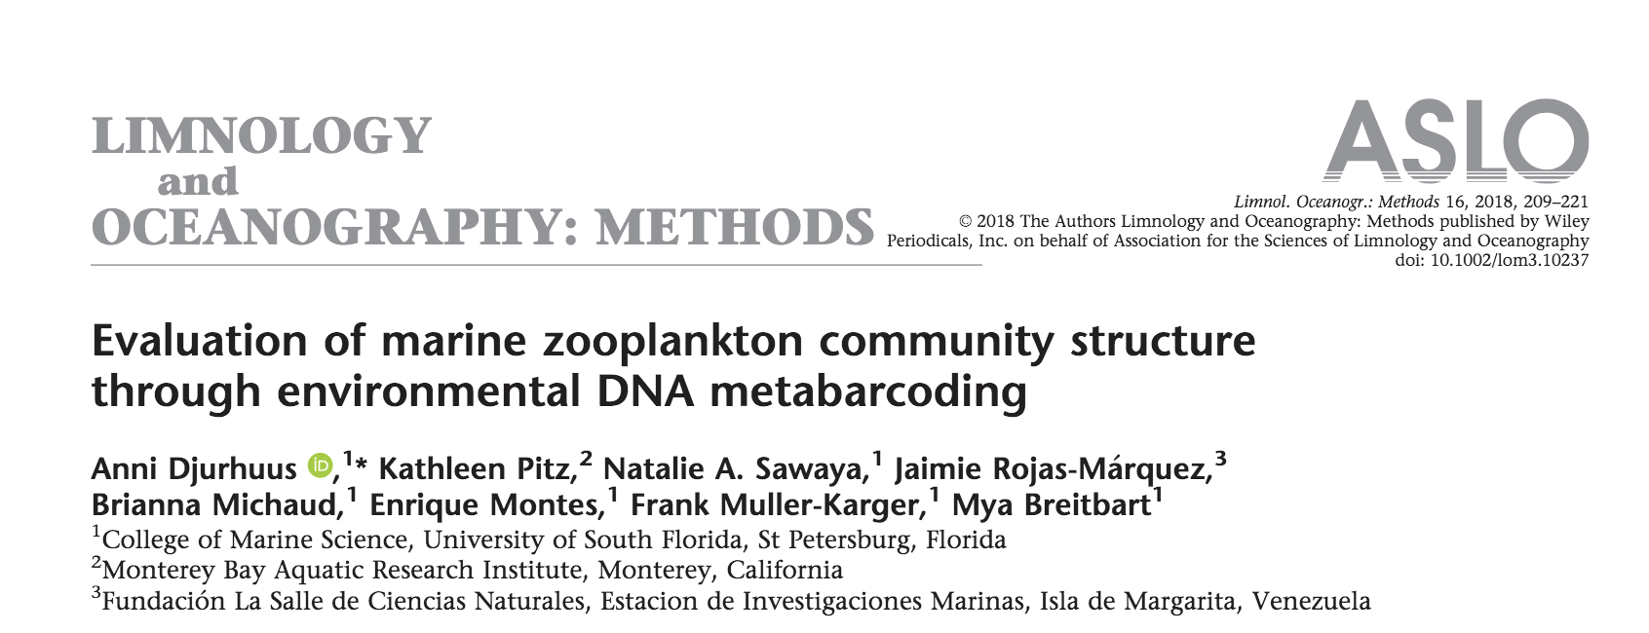
CMS Publication
2018 USF CMS student and faculty publication

Slide 9
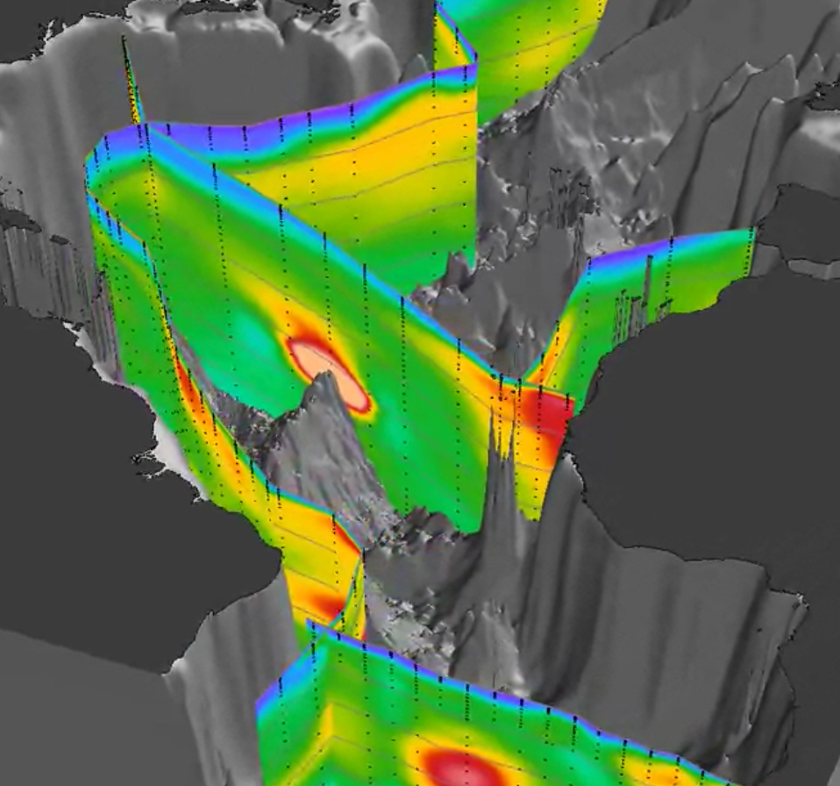
CMS Research Highlight
USF CMS faculty, Kristen Buck and Tim Conway, co-author
the GEOTRACES Intermedate Data Product 2017
Schlitzer et al. Chemical Geology. (accepted)

Slide 10
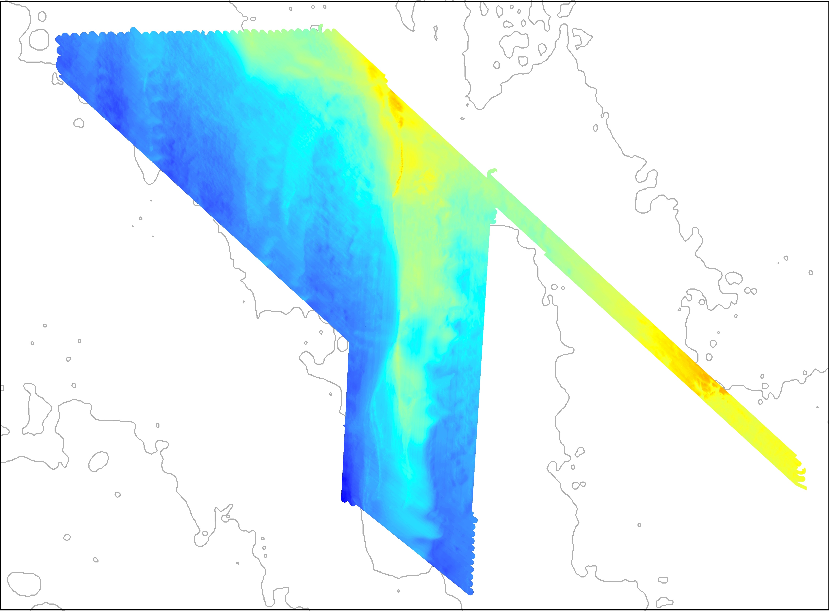
CMS News Flash
USF C-SCAMP researchers present West Florida Shelf geophysical and benthic habitat data at GEOHAB 2018, Santa Barbara, CA

Slide 11
Weekly Schedule
This Week @USFCMS
Seminars
Weekly
Brown bag
Defenses
List
Academic deadlines
List
MSAC Activities
List

Slide 12
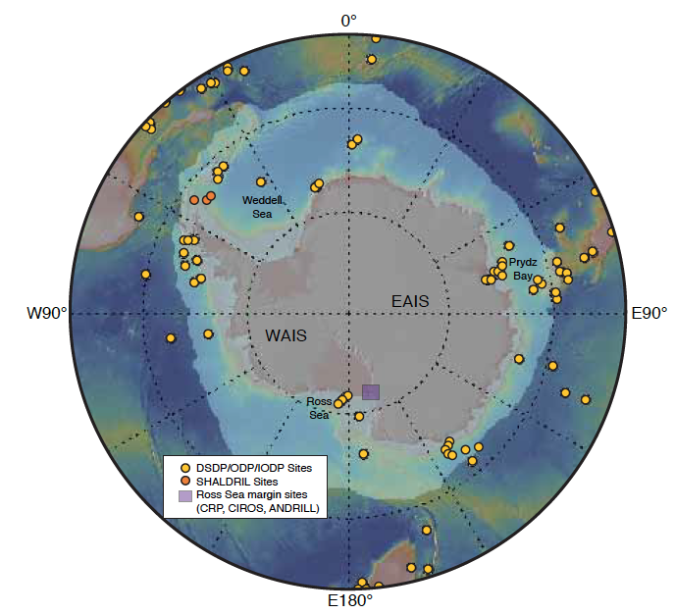
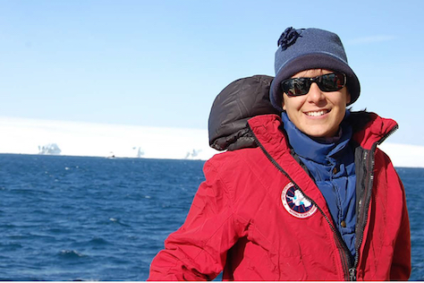
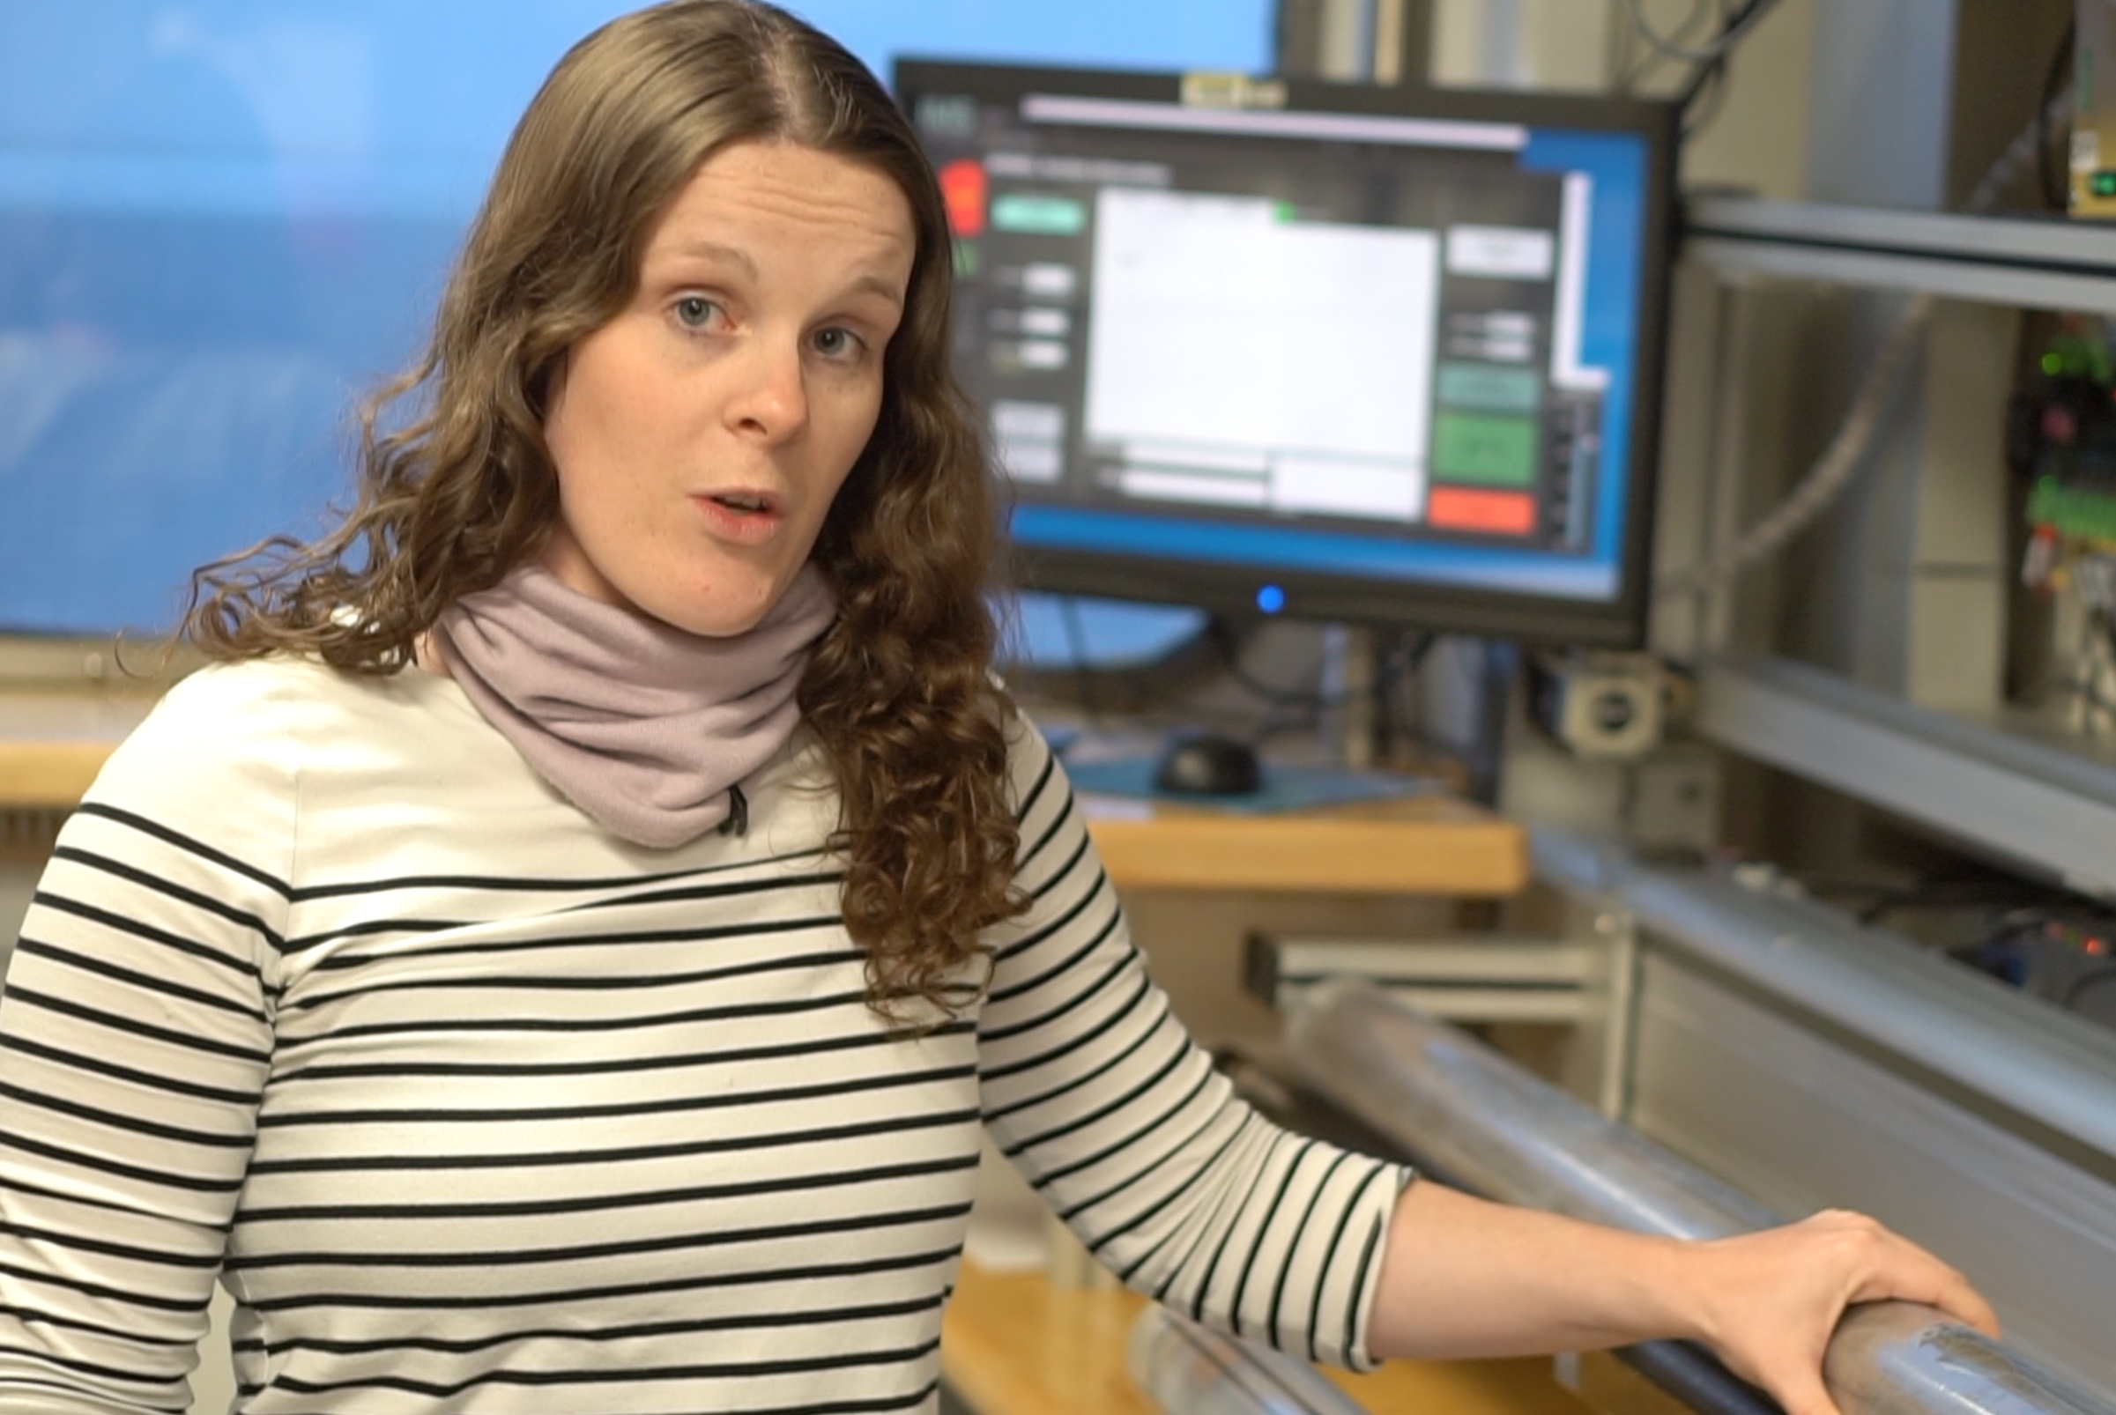
CMS Student Success
USF CMS Faculty, Amelia Shevenell, and PhD students, Imogen Browne, Theresa King, and Michelle Guitard, selected to sail on 2018-2019 IODP Expeditions to Antarctica

Slide 13
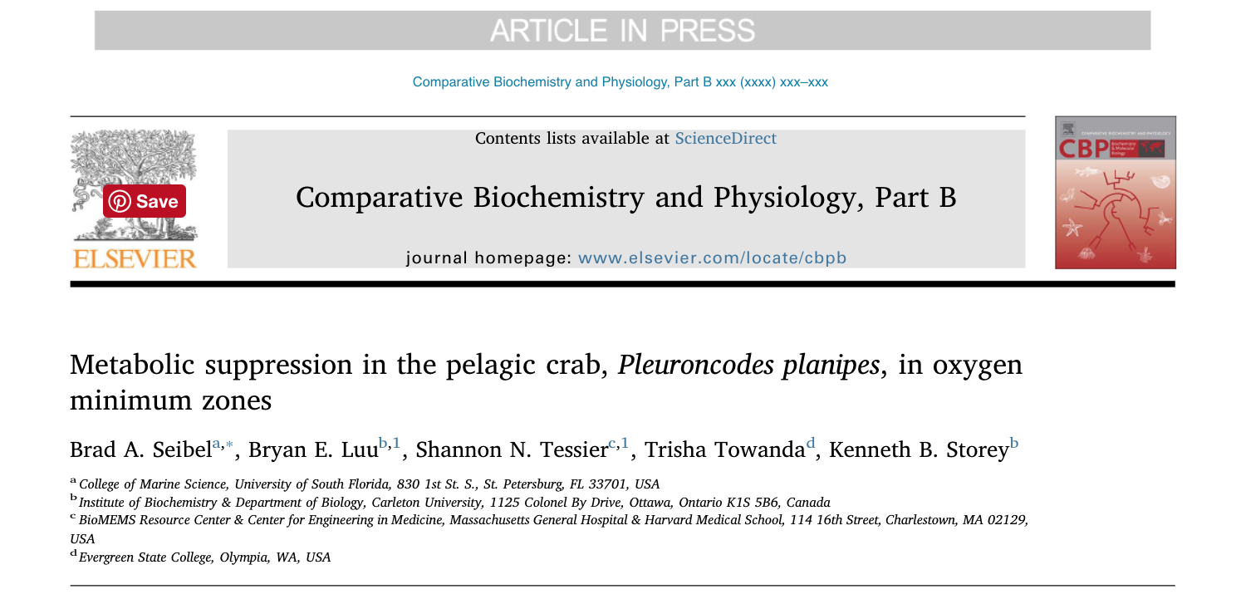
CMS Publication
2018 USF CMS faculty publication

Slide 14
CMS Facility

Slide 15
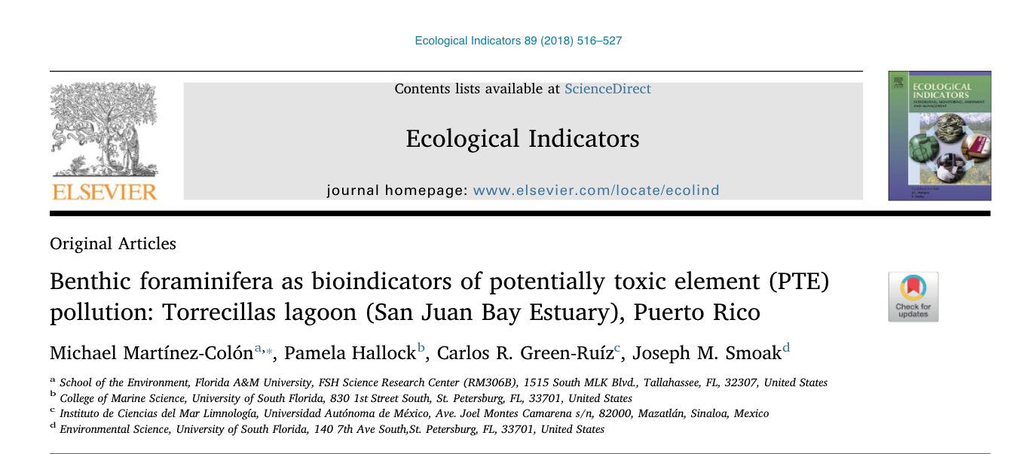
CMS Publication
2018 USF CMS and USFSP publication

Slide 16
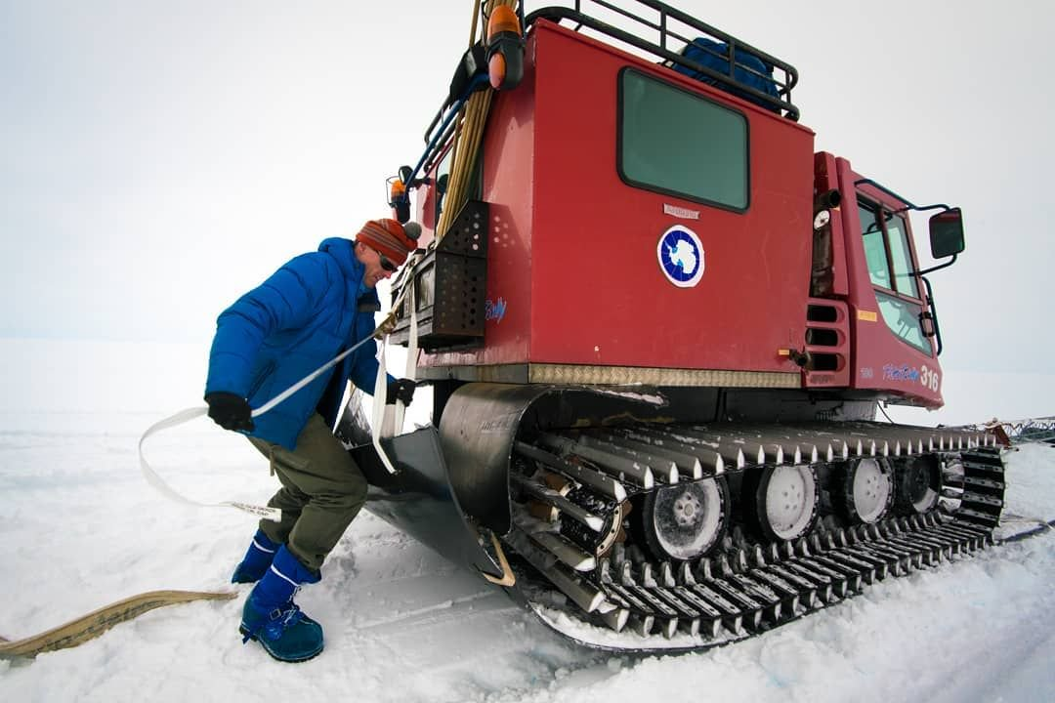
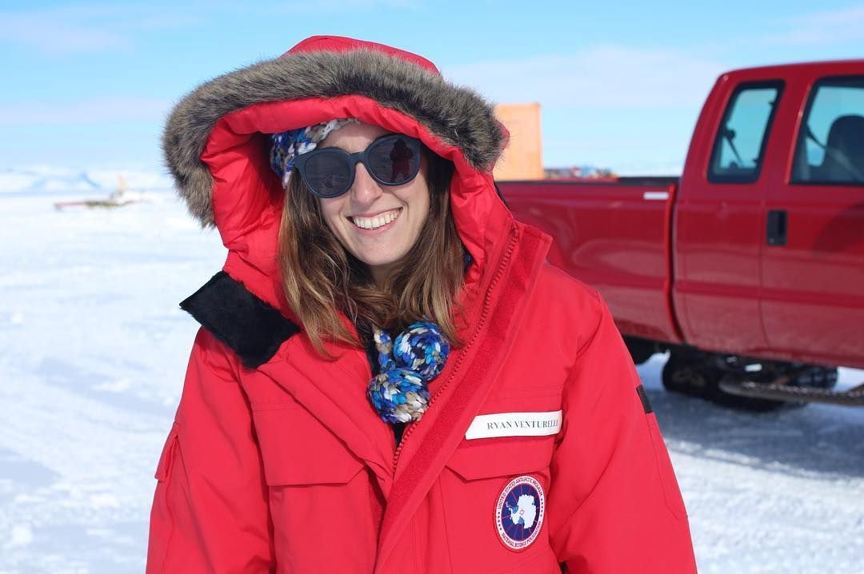
CMS Research Highlight
2018 USF CMS PhD student, Ryan Venturelli, faculty,
Brad Rosenheim, and their collaborators prepare to drill into subglacial Lake Mercer, West Antarctica

Slide 17
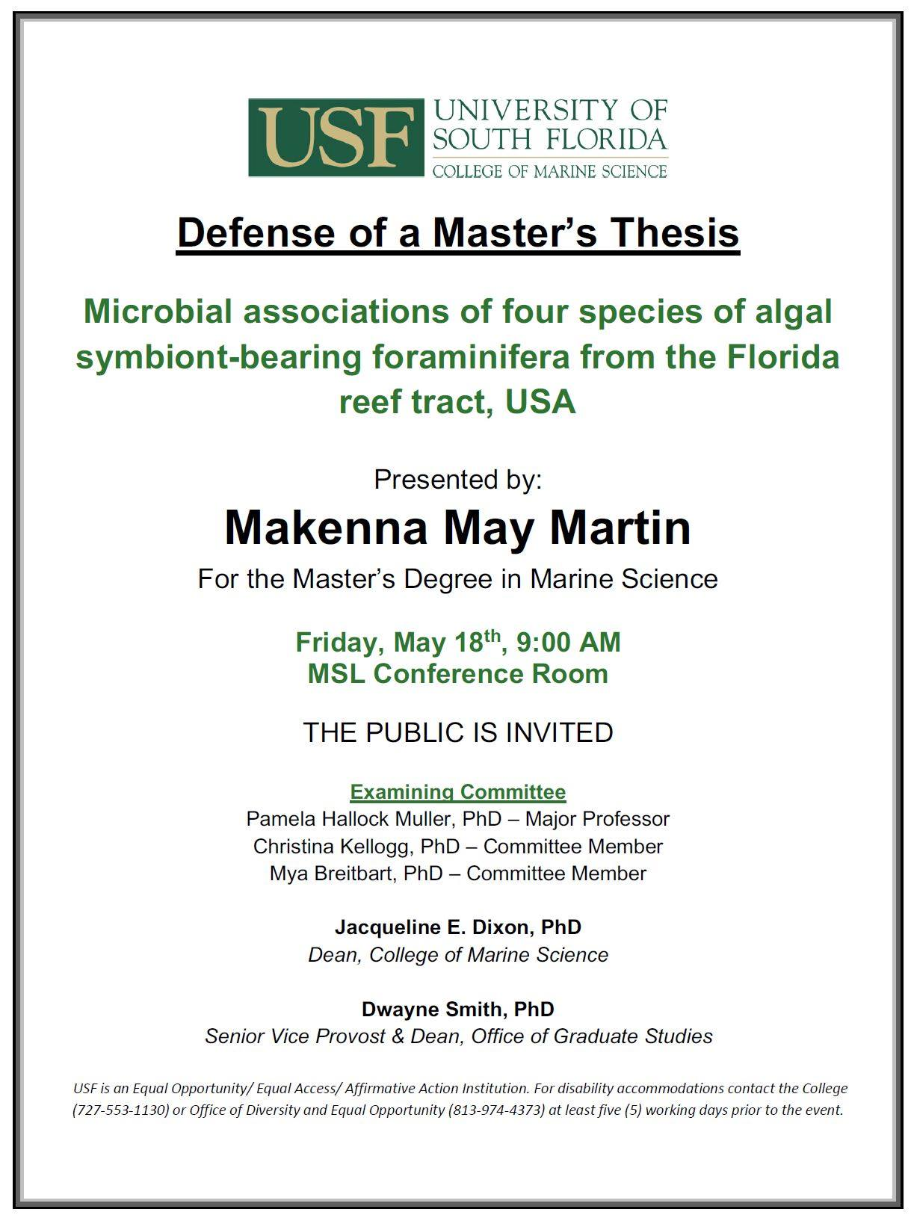
Defense Flyer

Slide 18
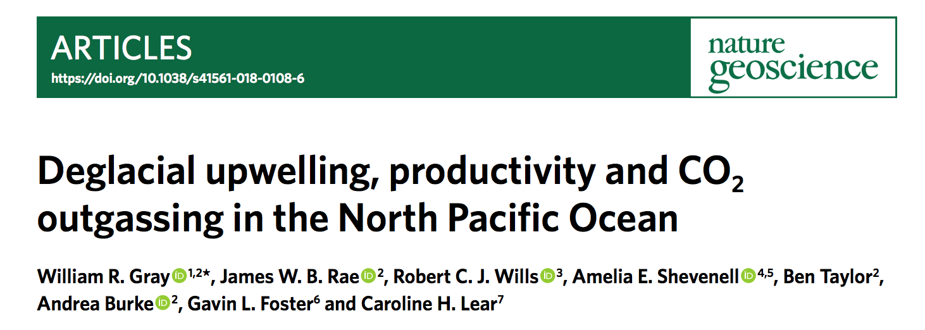
CMS Publication
2018 USF CMS faculty publication

Slide 19
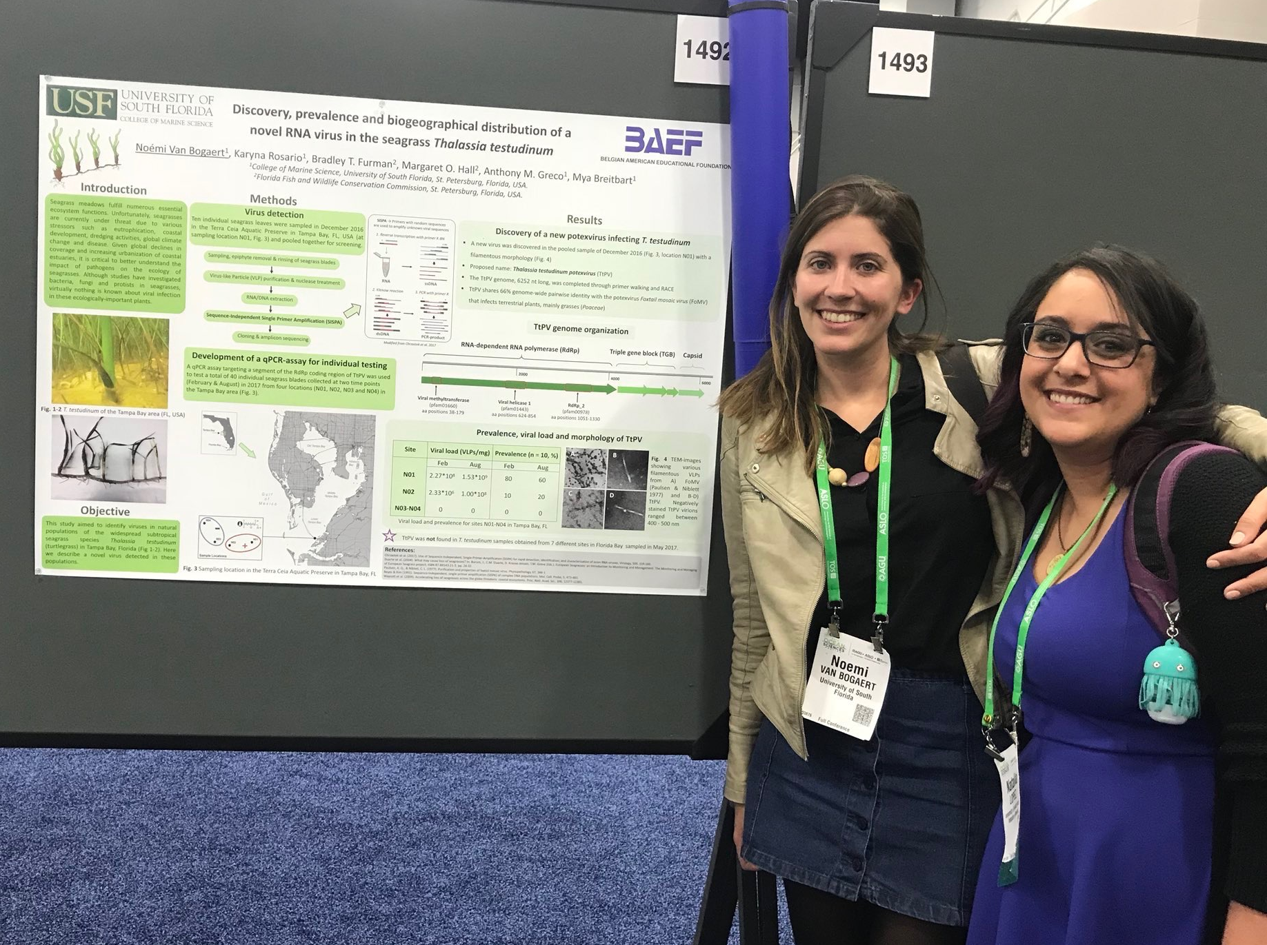
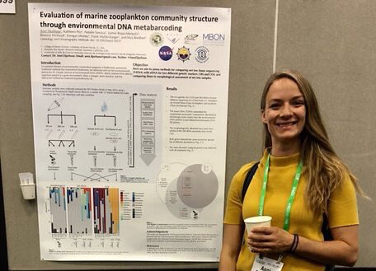
CMS Student Success
USF CMS students present research at XXX

Slide 20
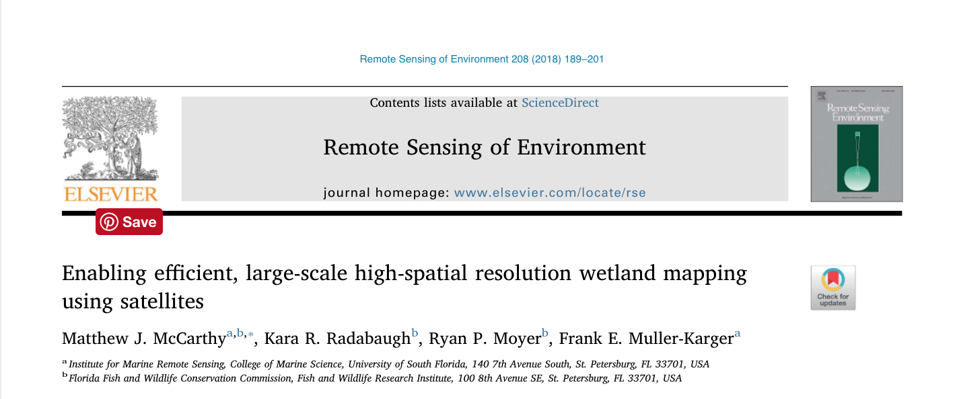
CMS Publication
2018 USF CMS student and faculty publication

Slide 21
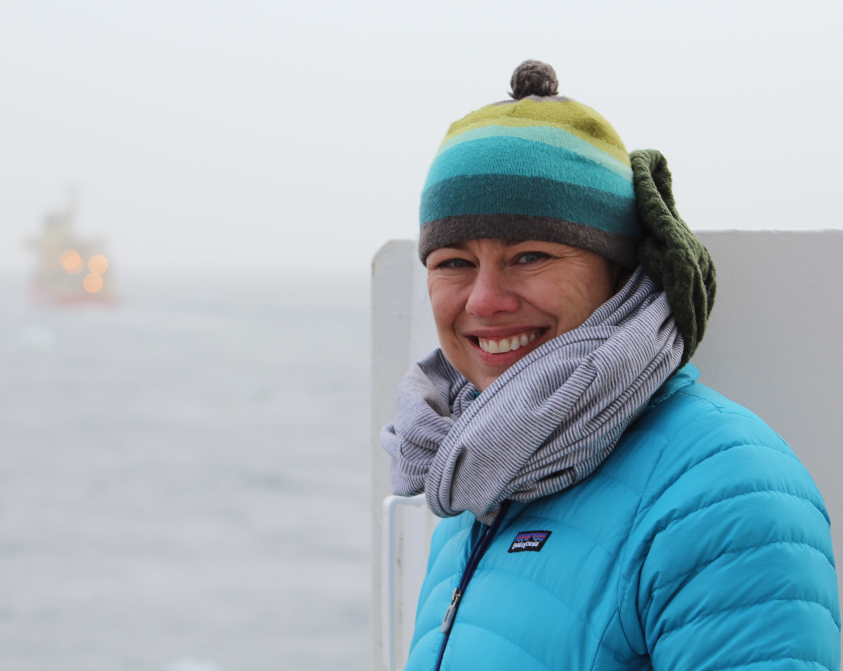
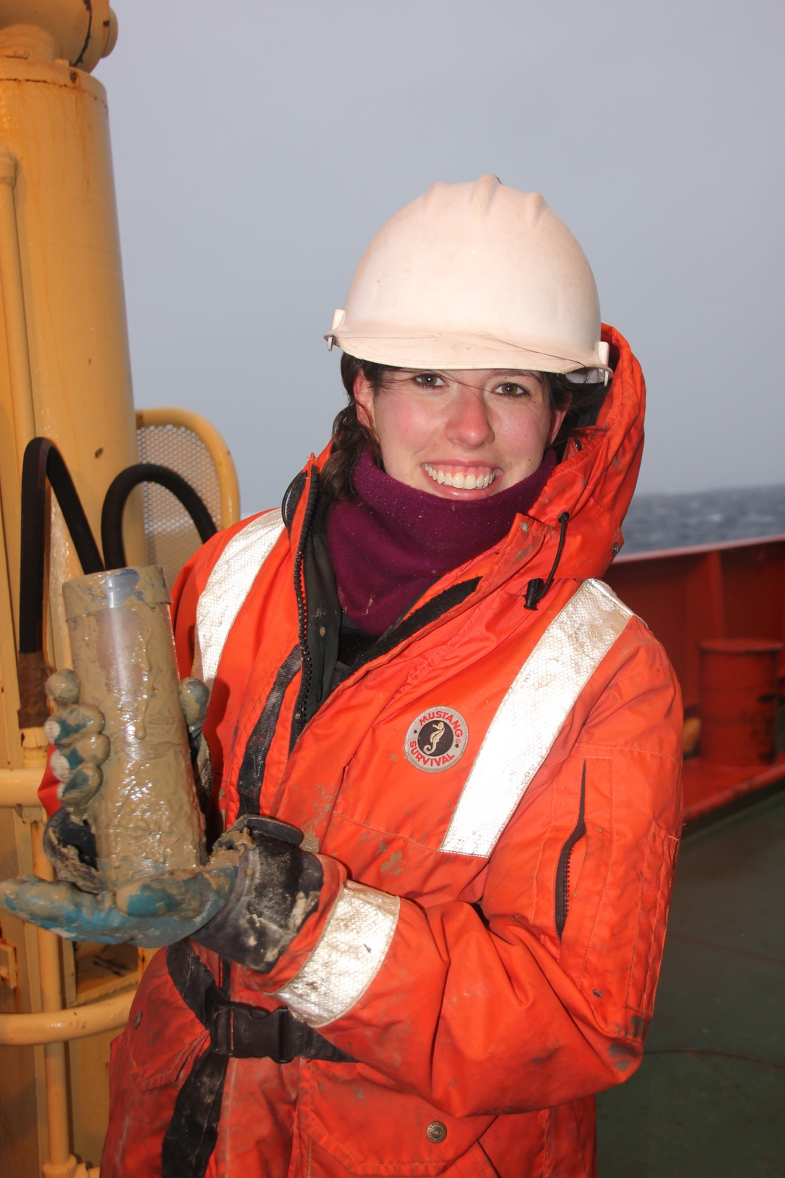
CMS Research Highlight
USF CMS faculty and student publication

Slide 22
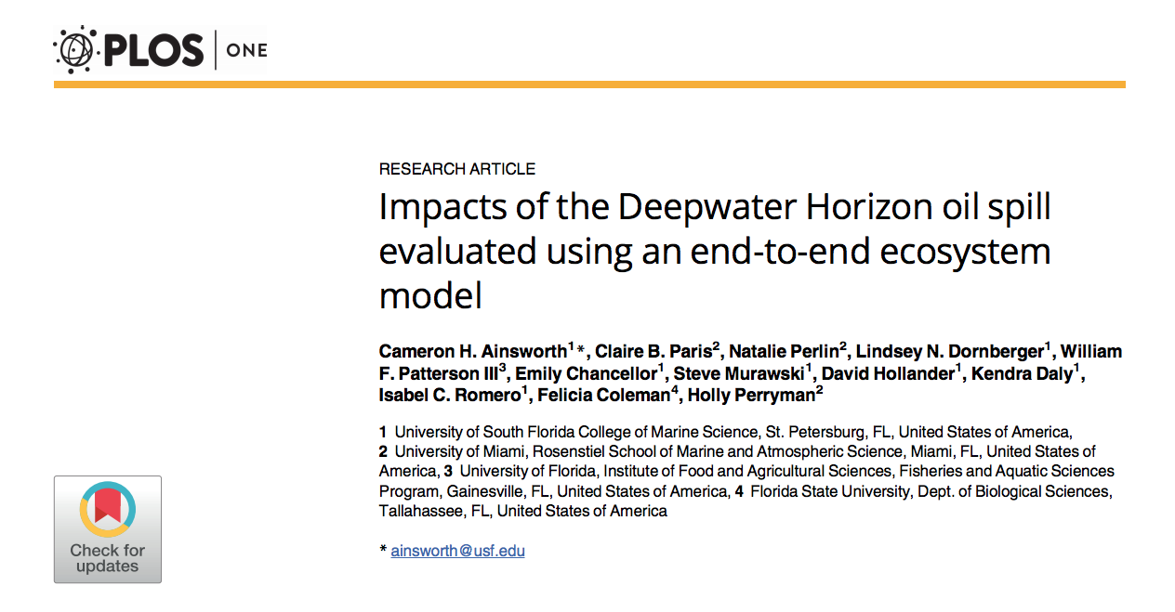
CMS Publication
2018 USF CMS student and faculty publication

Slide 23
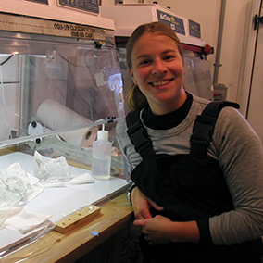
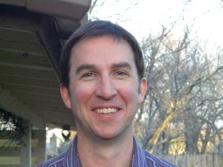
CMS Award
Congratulations to USF CMS faculty, Kristen Buck and Don Chambers
Don Chambers promoted to Professor
Kristen Buck awarded tenure and promoted to Associate Professor

Slide 24
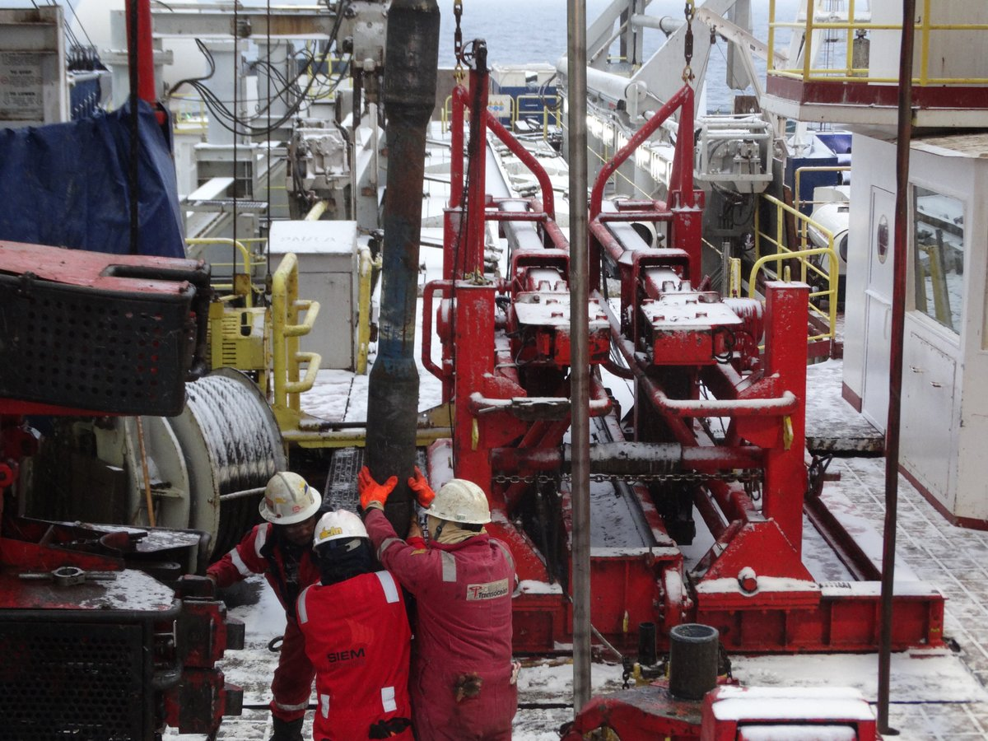
Research Photo

Slide 25
Weekly Schedule
This Week @USFCMS
Seminars
Weekly
Brown bag
Defenses
List
Academic deadlines
List
MSAC Activities
List

Slide 26
CMS Facility
USF CMS Plasma Analytical Facility

Slide 27
CMS Publication
2018 USF CMS faculty publication

Slide 28
CMS Outreach

Slide 29
MSAC EVENT
Vembu Cup and MSAC Festival 2018
When: May 19, 2018, 8 am-6pm
Golf Tournament: 8 am at the Mangrove Bay Golf Course, 875 62nd Ave NE, St. Pete
MSAC Festival: 1 pm at the Marine Exploration Center (Port of St. Petersburg).

Slide 30
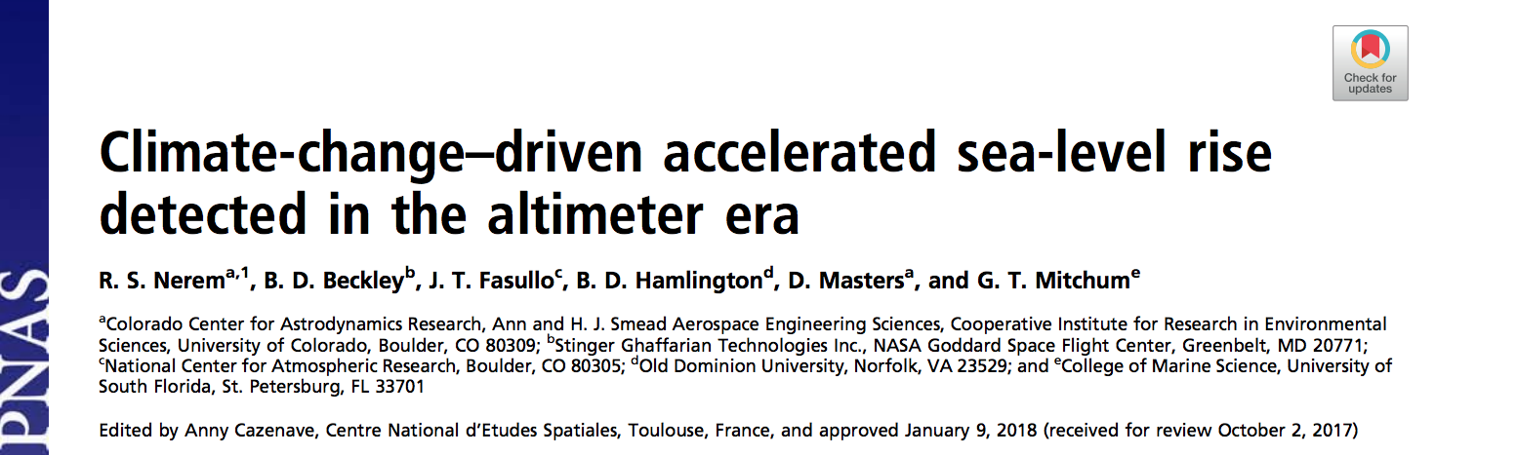
CMS Publication
2018 USF CMS faculty publication

Slide 31
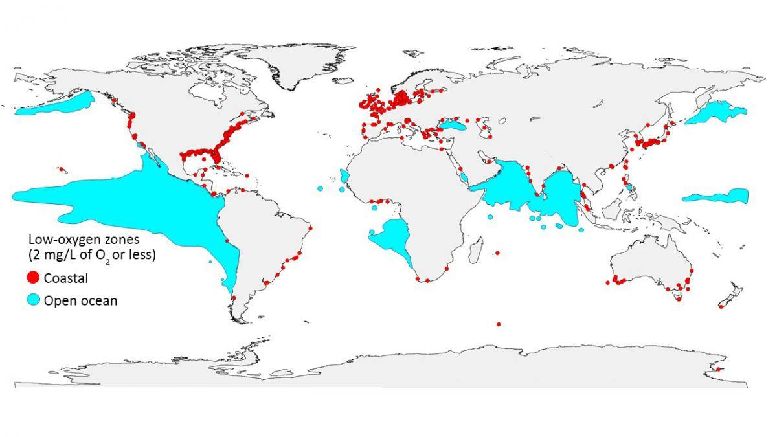
CMS Research Highlight
USF CMS faculty publication

Slide 32
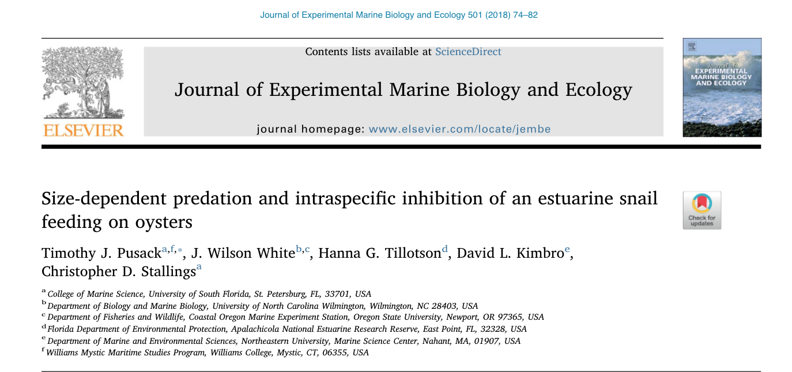
CMS Publication
2018 USF CMS student and faculty publication

Slide 33
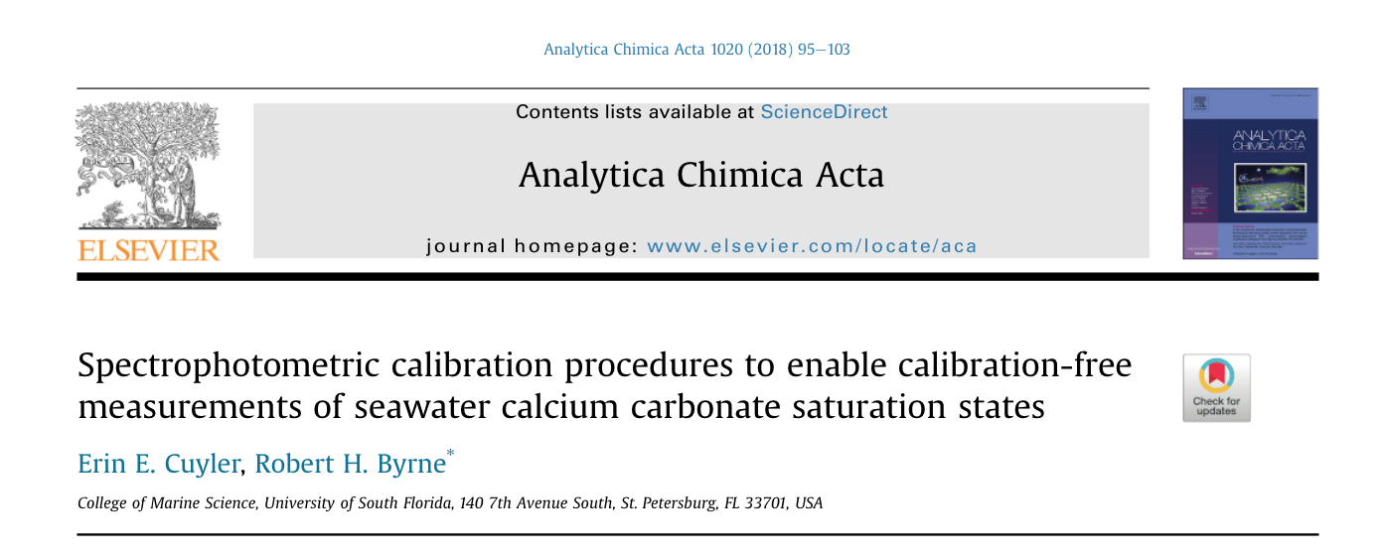
CMS Publication
2018 USF CMS student and faculty publication

Slide 34
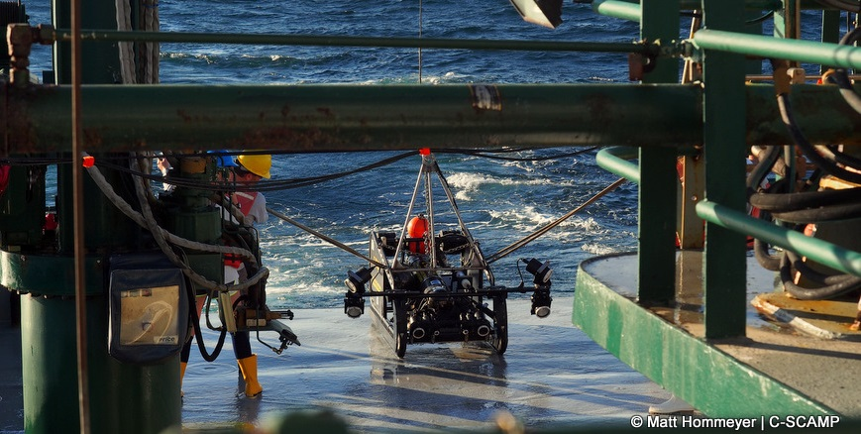
Research Photo

Slide 35
Weekly Schedule
This Week @USFCMS
Seminars
Weekly
Brown bag
Defenses
List
Academic deadlines
List
MSAC Activities
List

Slide 36
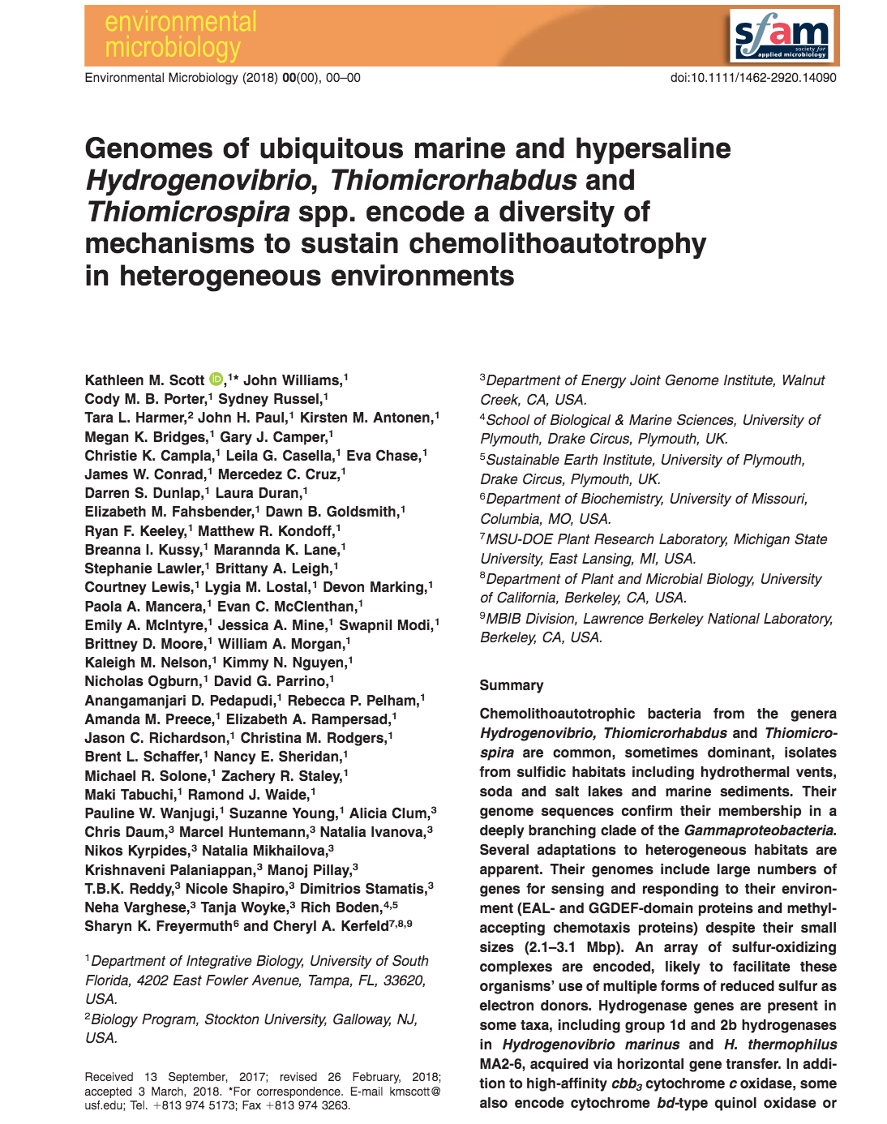
CMS Publication
2018 USF CMS faculty and student publication

Slide 37
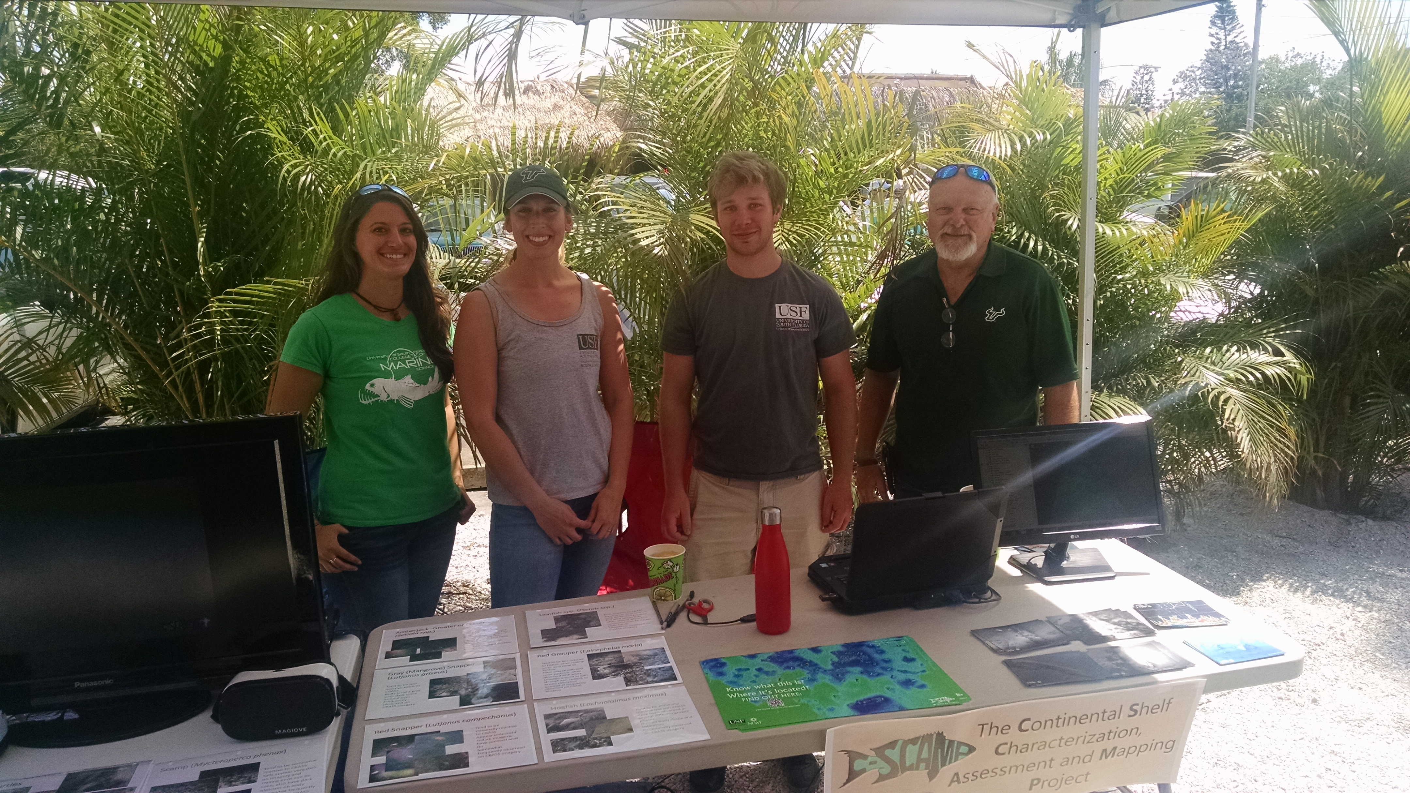
CMS Outreach

Slide 38
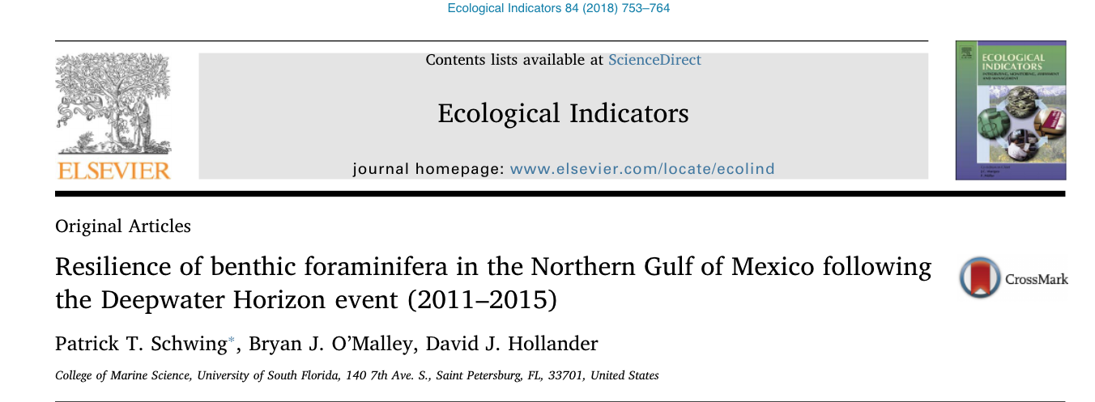
CMS Publication
2018 USF CMS publication

