Slide 1





Exploring the morphodynamics of river deltas and barrier islands. What can we learn from simple models?
Jorge Lorenzo Trueba
2/12/2015
with help from Vaughan Voller, Chris Paola, Robert Twilley, Andrew Ashton, and Giulio Mariotti

Slide 2
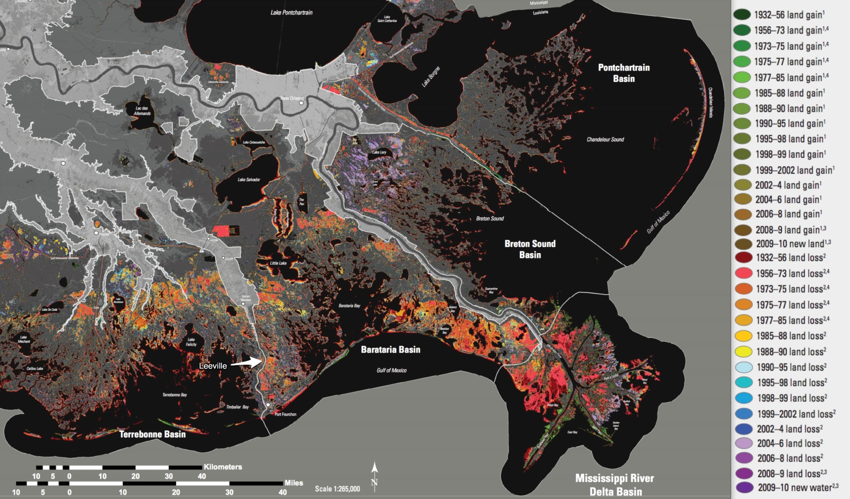
Deltas are among the most vulnerable coastal environments
A USGS map from 2011 shows changes in the extent of land area in coastal Louisiana between 1932 and 2010.
2
Land loss between 1932 and 2010= 1,833 Km (Half of Rhode Island)

Slide 3
Why is Miss delta sinking?
PLANT MATTER
ACCUMULATION
River Sediment
SEA LEVEL RISE
SUBSIDENCE
TECTONICS
Kim et al. 2009
Notes:
The point sketch on the left depicts the deltaic processes that aim at keeping pace with sea-level. Due to the abrupt reduction in river sediment supply, there are several regions on the deltaic plain that are keeping up with sea-level and subsidence only due to the plant matter accumulation.
The leading delta restoration plan on the table involves opening the levees at controlled locations downstream of new Orleans to reestablish the connettion between the river and the wetland ecosystems.

Slide 4
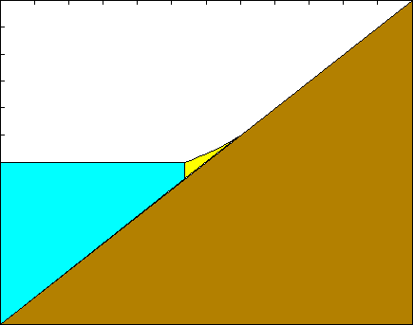
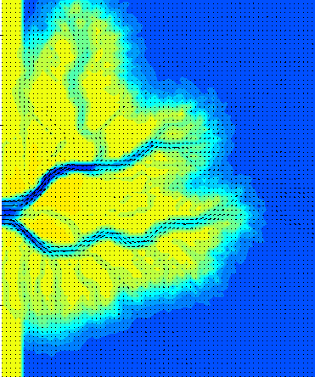
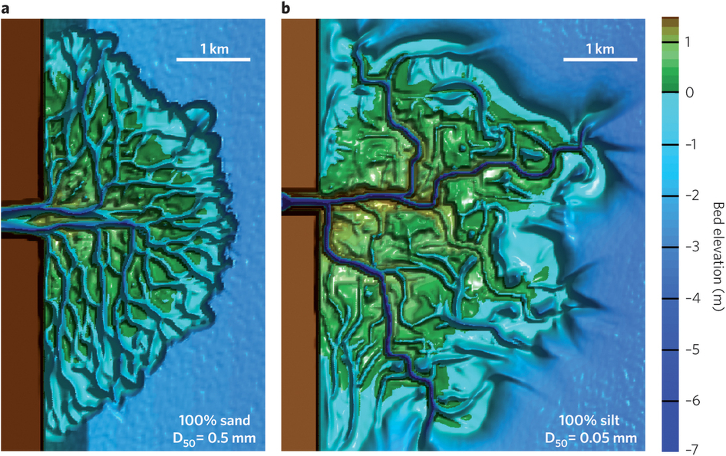
Numerical Modeling of River Deltas
Lorenzo-Trueba et al. 2012
Rule-based Cellular Delta Model
(Man Liang et al., CSDMS spotlight 2012)
Delft 3D - Edmonds 2012
Key Ingredients:
Mass conservation
Maintain geometric shape
Complexity

Slide 5
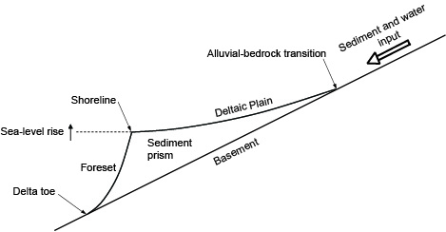
Modeling Framework
Key Ingredients:
Mass conservation
Maintain geometric shape

Slide 6
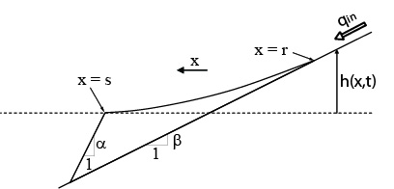
Modeling Framework
Local slope
Mass balance for
Lorenzo-Trueba et al. 2009
Boundary conditions

Slide 7
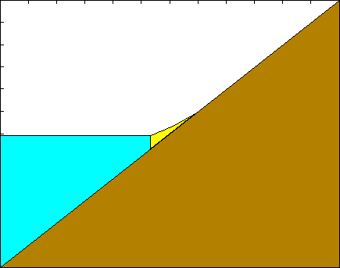
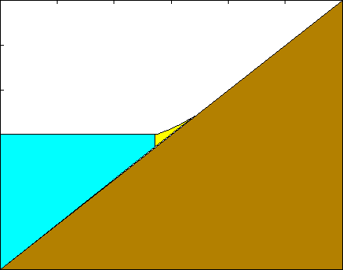
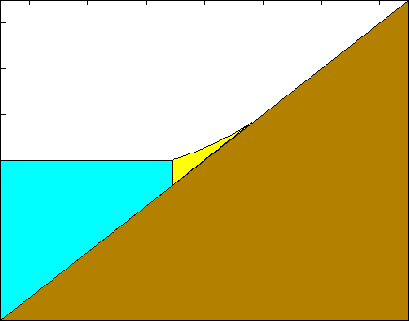
Response of fluvial deltas to sea-level change
Constant sea level
Constant sea-level fall
Constant sea-level rise
Sea-level cycle

Slide 8
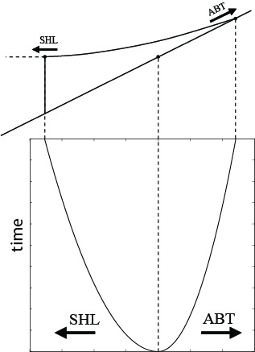
Constant sediment supply and constant sea level
Lorenzo-Trueba et al. 2009

Slide 9
Constant sediment supply and constant sea level
Flume experiments by Wonsuck Kim and Tetsuji Muto.
Lorenzo-Trueba et al. 2009

Slide 10
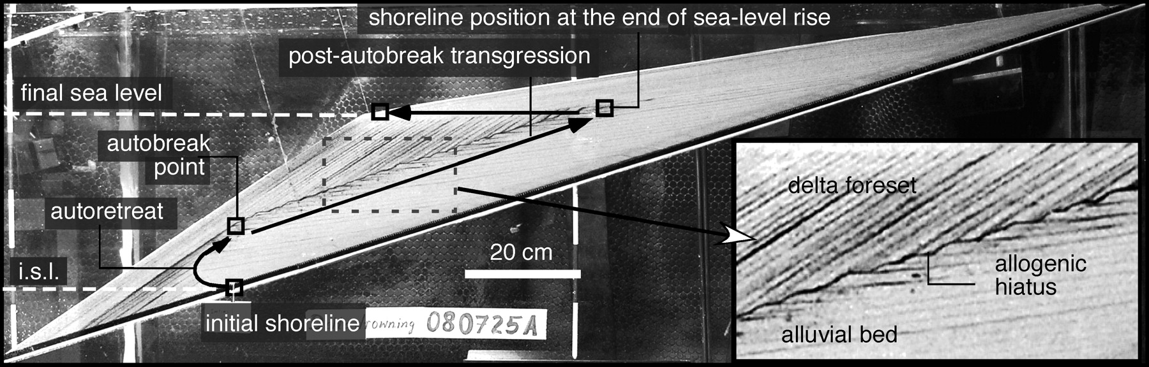
Constant sea-level rise rate
Autobreak, Tetsuji Muto and Ron Steel 2001
Arti Tomer et al. 2011
Parker and Muto 2008

Slide 11
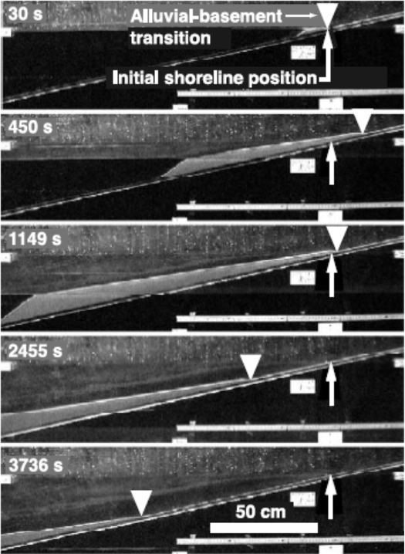
River incision during sea-level rise?
Muto and Swenson 2005
Lorenzo-Trueba et al. 2012

Slide 12
River incision during sea-level rise?
Lorenzo-Trueba et al. 2012

Slide 13
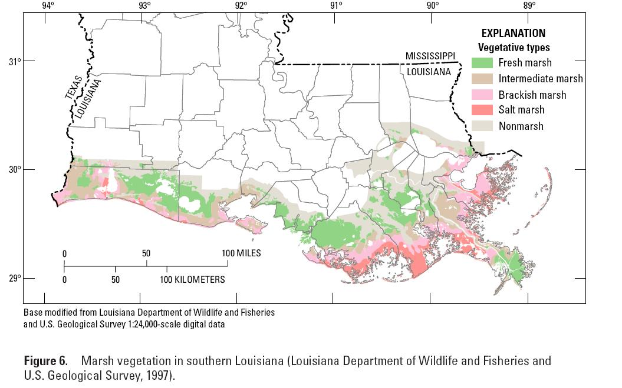
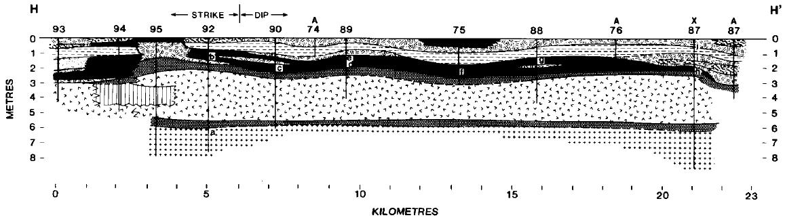
Organic sediment dynamics
Above-ground biomass
Below-ground biomass
Peat
Kosters et al. 1987

Slide 14
Organic sediment dynamics
Peat excess removed from the system (aerobic decomposition)
[Morris et al. 2002, Mudd et al. 2009]
Space left is filled by inorganic sediments.
Insufficient inorganic sediments → shoreline retreat
ACCOMMODATION

Slide 15
Organic sediment dynamics
[Kosters et al. 1987,
Staub & Esterle 1994,
Portnoy and Giblin 1997,
Ibañez et al.2010]
Anaerobic decomposition
Sulfate reduction (salt marshes)
Methanogenesis (fresh marshes)

Slide 16
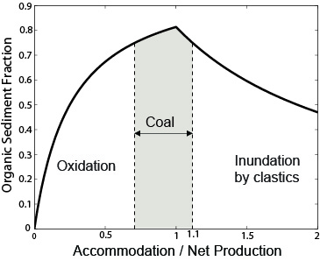
Organic sediment dynamics
Central observation from Coal Geology
Upper limit for potential coal accumulation predicted by Bohacs and Suter 1997. Diessel 2000.
Lorenzo-Trueba et al.2012

Slide 17
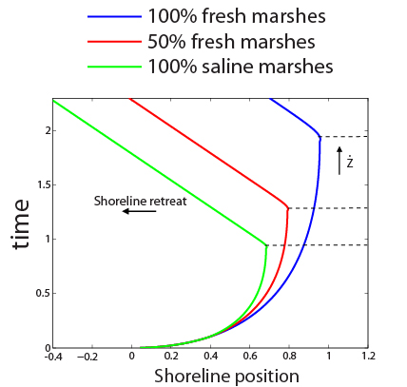
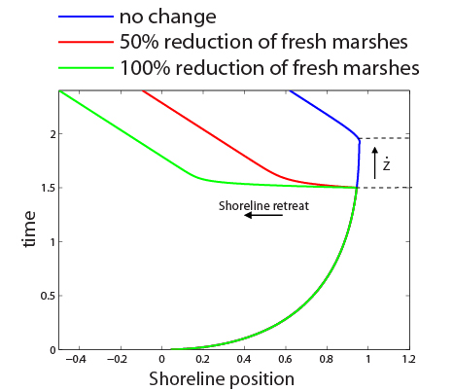
Exploring the role of the boundary between fresh and salt marshes

Slide 18
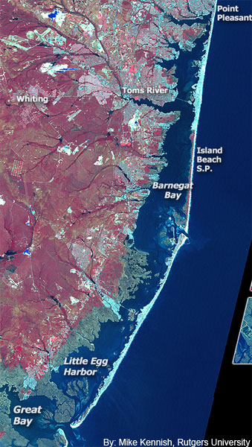
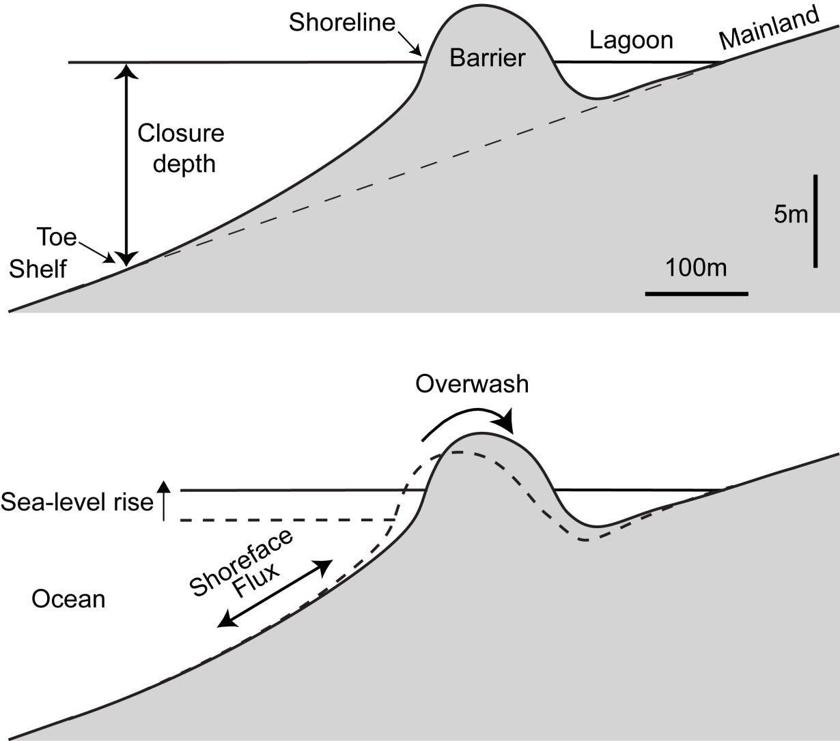
Background
Cross-section view
Lorenzo-Trueba and Ashton, 2014

Slide 19
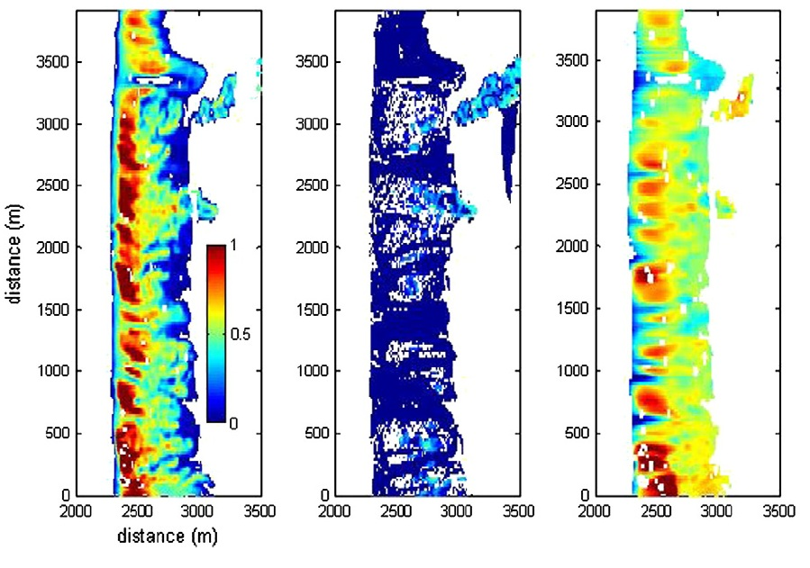
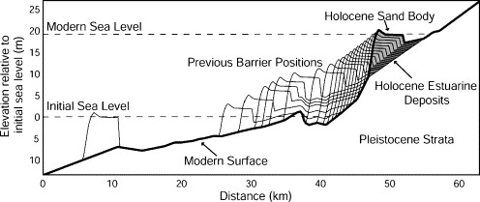
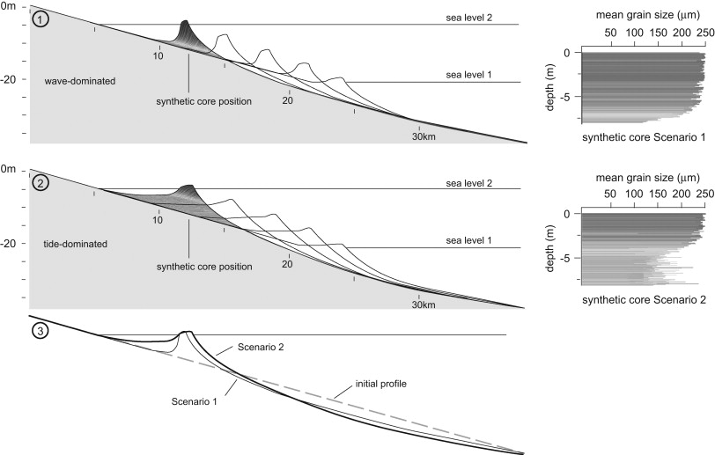
Background
X-Beach (Roelvink et al. 2009)
GEOMBEST (Stolper et al. 2005, Moore et al. 2010)
BARSIM (Storms et al. 2002)
Complexity

Slide 20
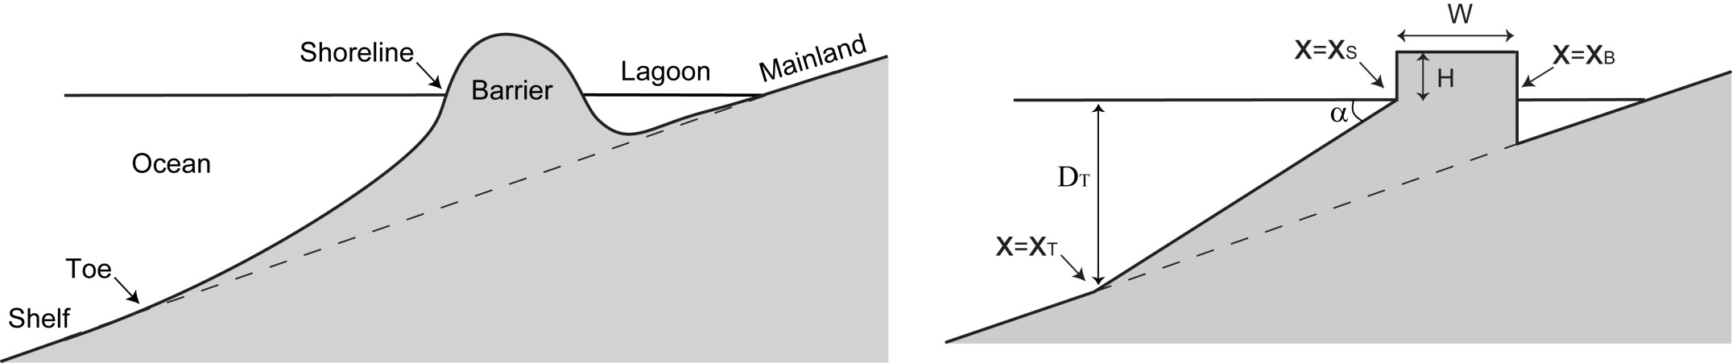
Modeling Framework
A morphodynamic model that:
is simple enough to rapidly explore barrier behavior for a wide range of input parameter values.
focuses on the interplay between shoreface evolution, overwash deposition, and sea-level rise.
Simplifying the geometry
Lorenzo-Trueba and Ashton, 2014

Slide 21
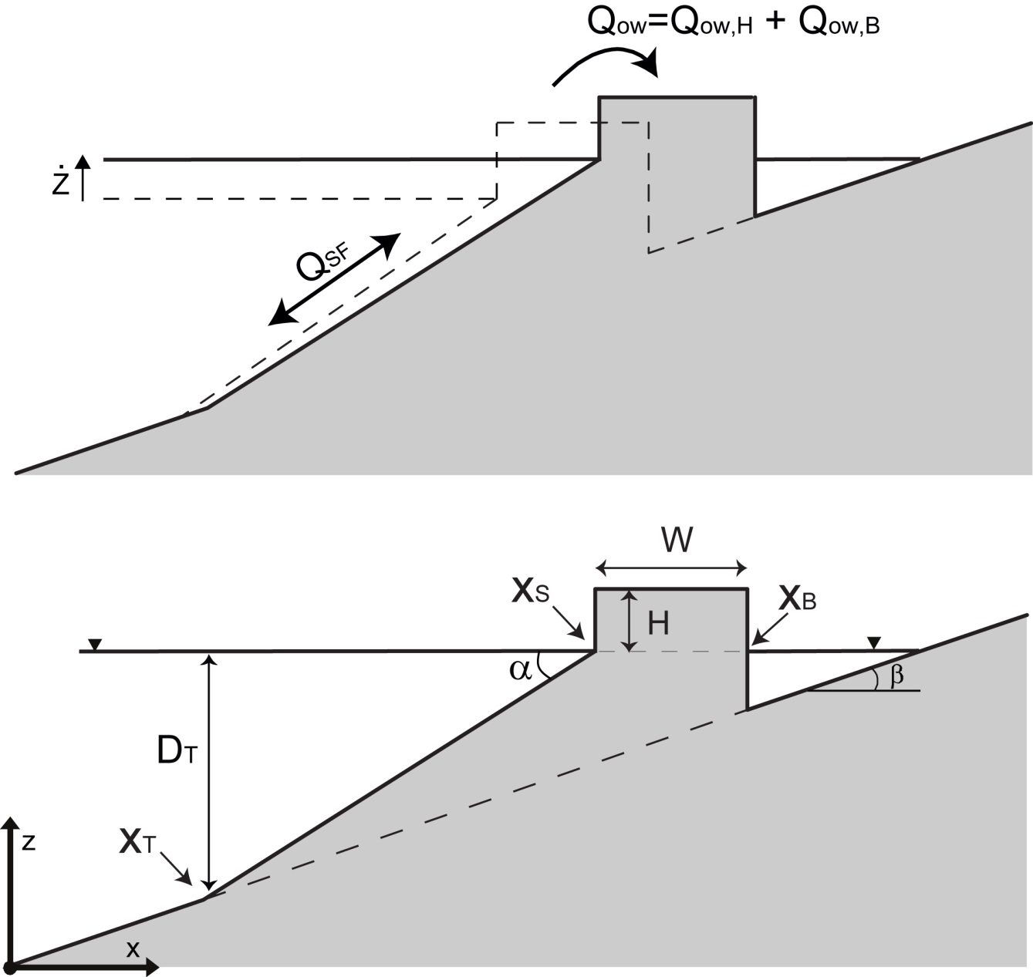
Modeling Framework
Lorenzo-Trueba and Ashton, 2014

Slide 22
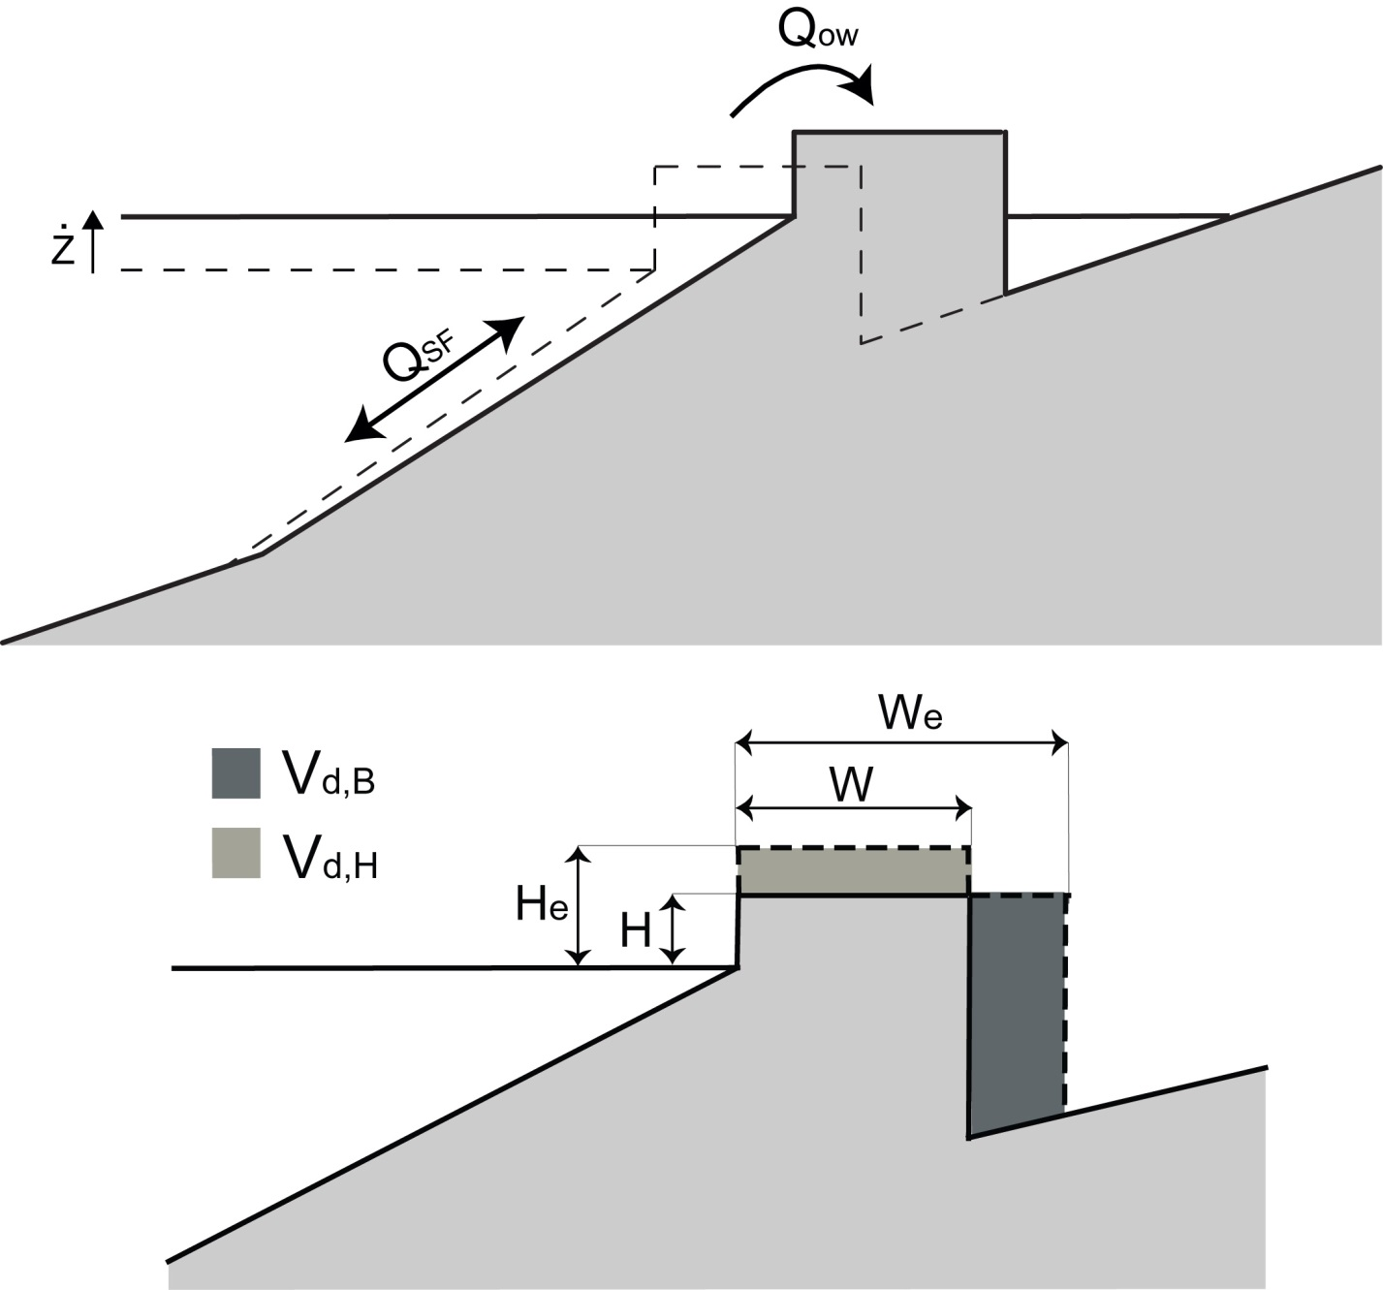
Storm Overwash

Slide 23
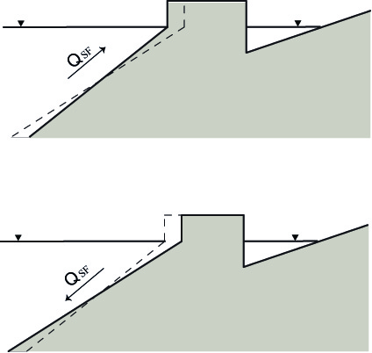
Shoreface Response
Assuming linear Airy wave theory :
Lorenzo-Trueba and Ashton, 2014
Alejandra Ortiz et al.

Slide 24
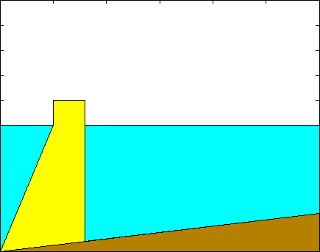
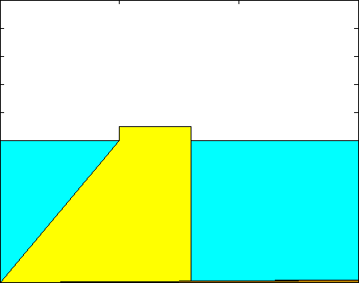
Coastal Barrier Response to Constant Sea-level Rise
Dynamic Equilibrium
Width drowning
Discontinuos Retreat
Height Drowning

Slide 25
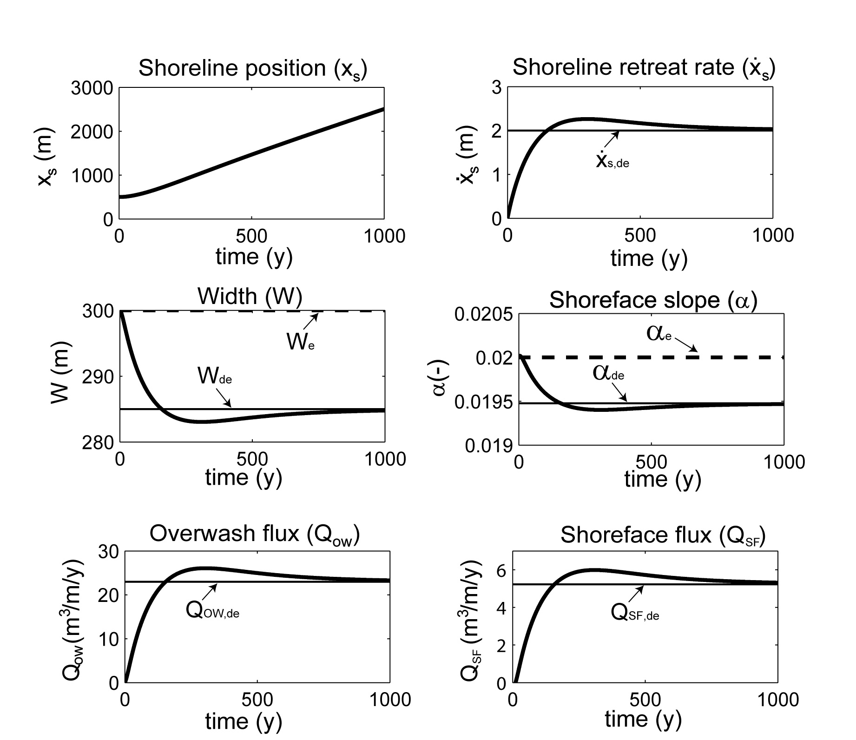

Coastal Barrier Response to Constant Sea-level Rise
Dynamic Equilibrium
20
Elevation (m)
10
0
1.0
2.0
3.0
Horizontal distance (Km)
Sand
Shelf

Slide 26
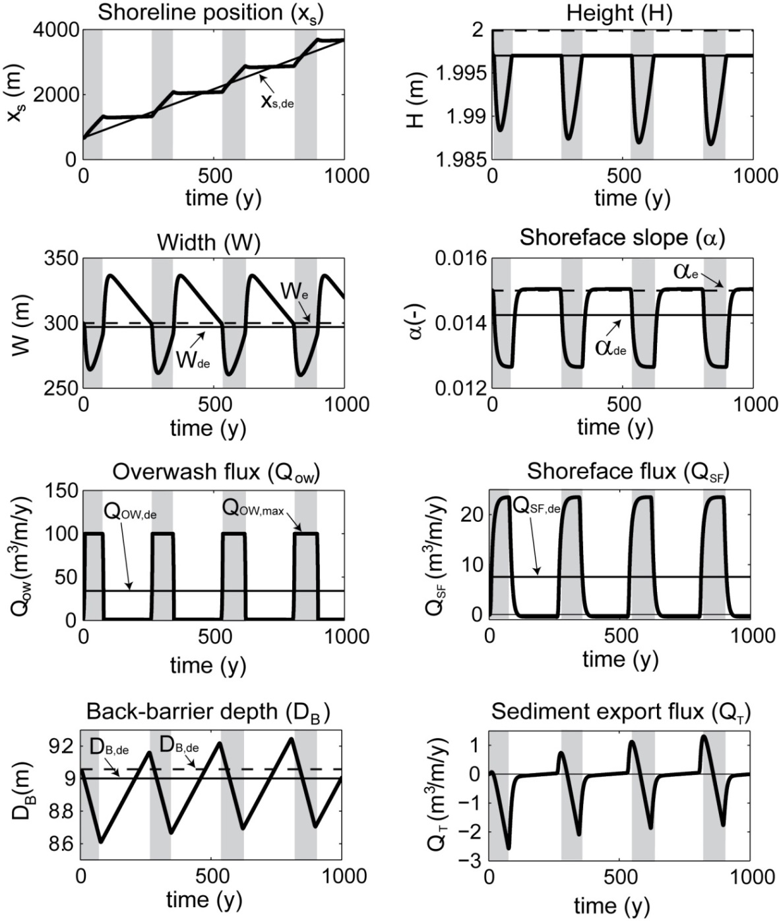
Coastal Barrier Response to Constant Sea-level Rise
Periodic retreat
20
10
0
1.0
2.0
3.0
Horizontal distance (Km)
Sand
Shelf

Slide 27
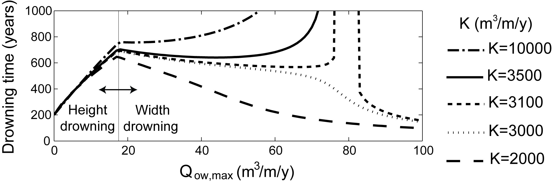
Coastal Barrier Response to Constant Sea-level Rise
Height Drowning
Width drowning

Slide 28
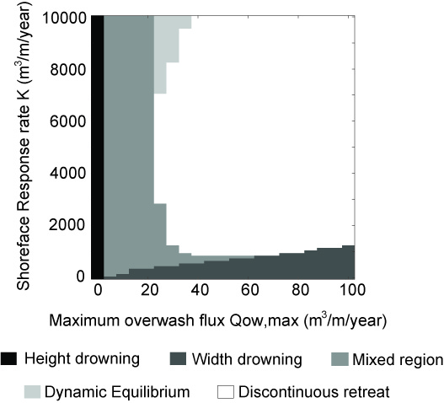
Regime Diagrams

Slide 29
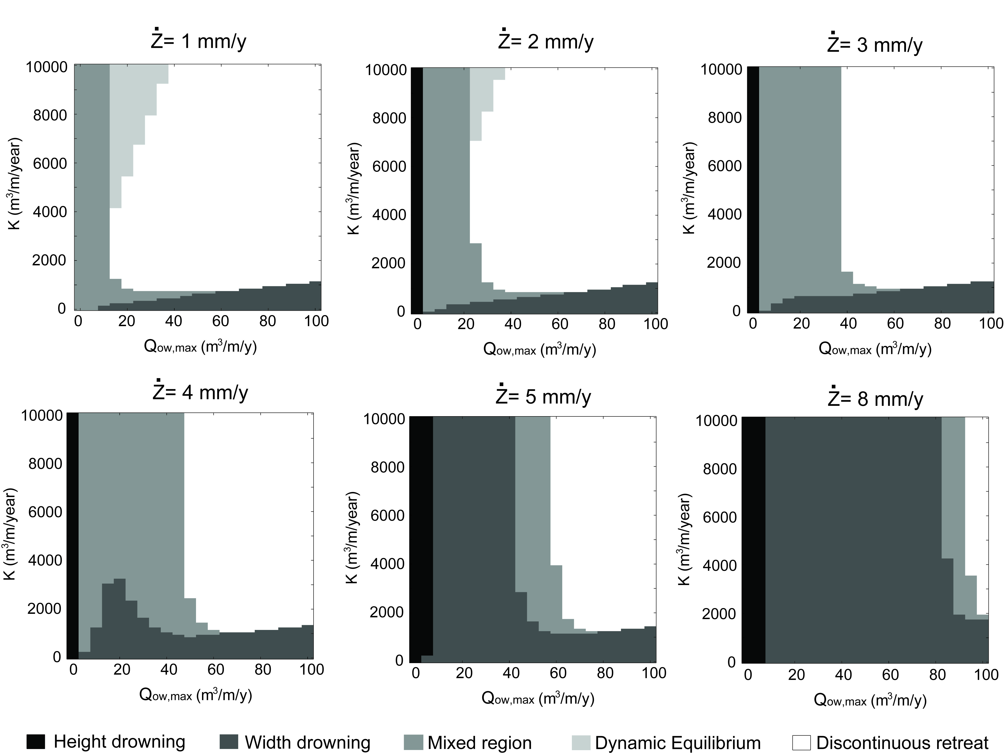
Sensitivity to sea-level changes

Slide 30
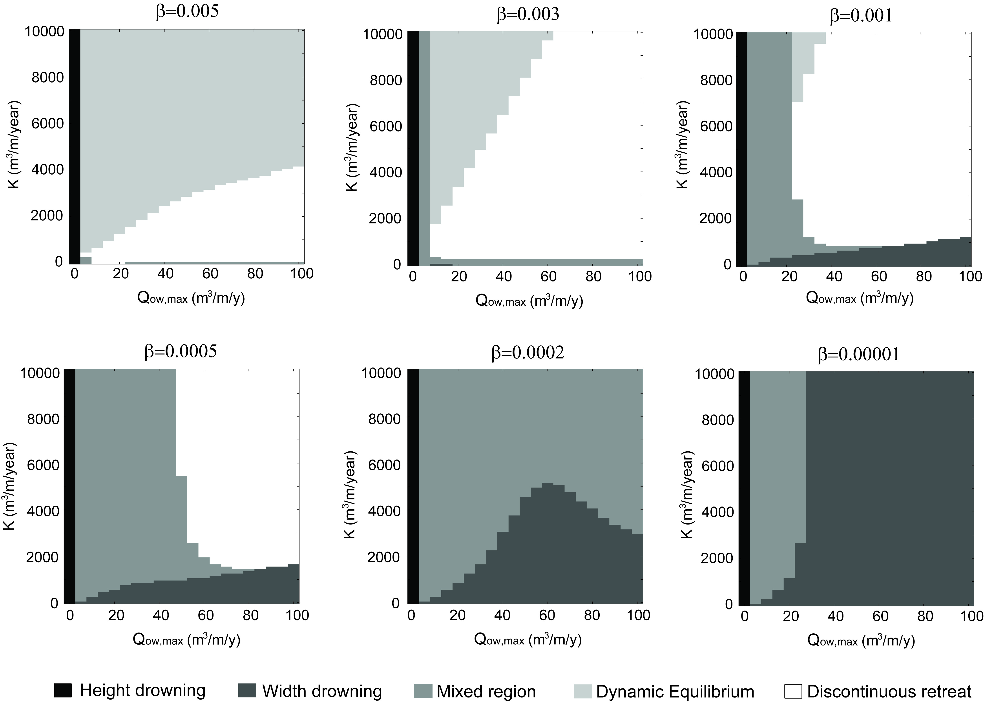
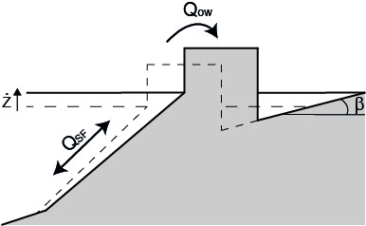
Sensitivity to mainlad slope (β)

Slide 31
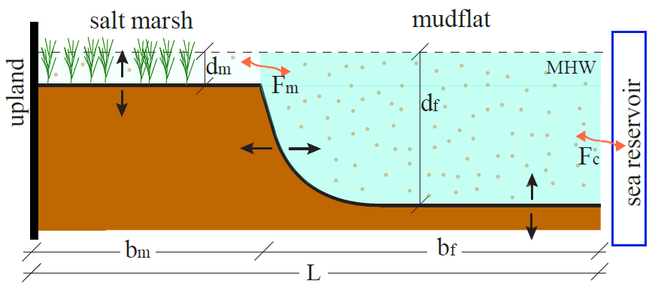
Marsh – Lagoon Model
Mariotti and Carr 2014
O = Organic mater accumulation
Fm = Sediment exchange between the marshes and the lagoon
E = Marsh net erosion driven by wind waves in the lagoon
Fc = Sediment exchange between the lagoon and the open ocean

Slide 32
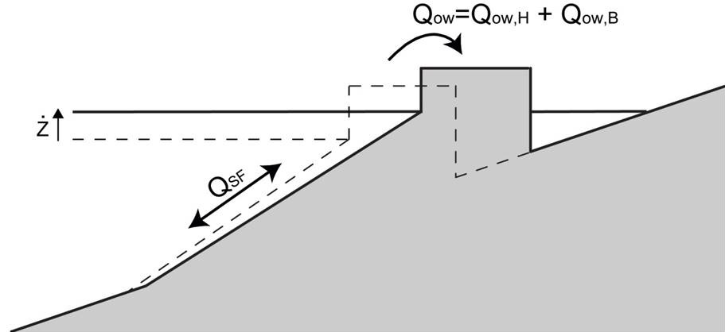
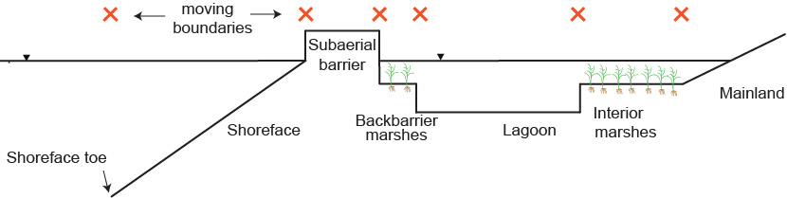
Coupled Barrier-Marsh-Lagoon system
+
Lorenzo-Trueba and Ashton, 2014
=
Mariotti and Carr 2014
Lorenzo-Trueba and Mariotti, 2014

Slide 33
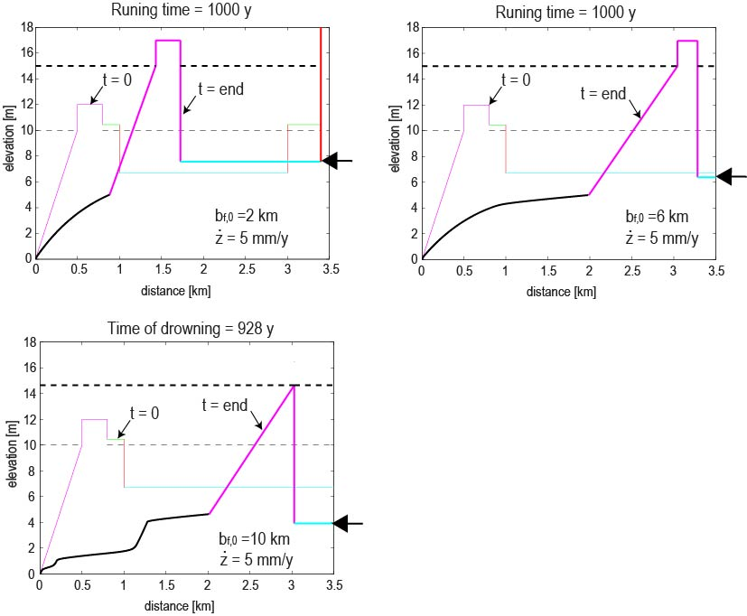
Lorenzo-Trueba and Mariotti, 2014
Barrier response strongly depends on lagoon geometry.
The arrows on the side of the plot point at the bottom of the lagoon at the end of the run to highlight the change in lagoon depth in each case.

Slide 34
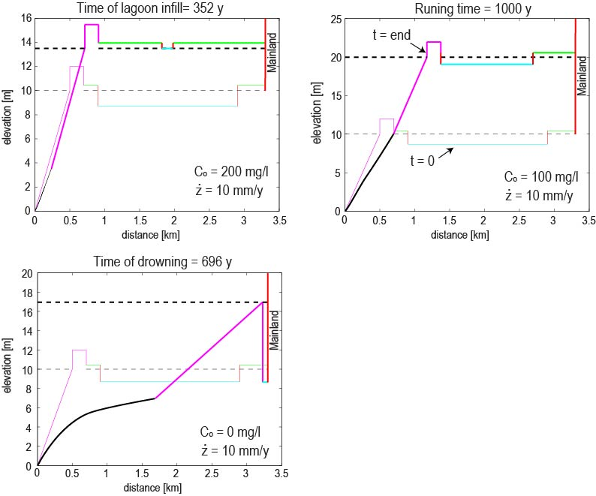
Barrier response strongly depends on the rates of sediment exchange with the open sea.
The arrows on the side of the plot point at the bottom of the lagoon at the end of the run to highlight the change in lagoon depth in each case.

Slide 35
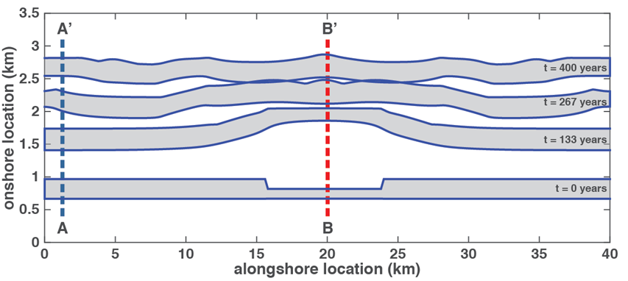
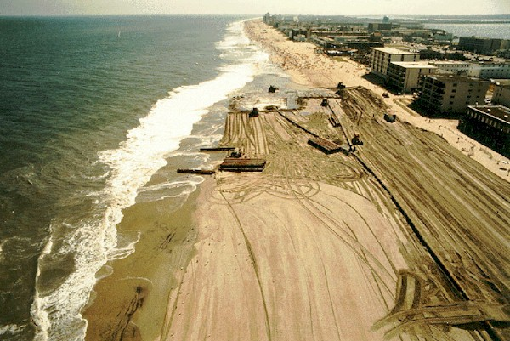
Future Work
Future model extensions:
Coupling Along- and Cross-shore components
Incorporate human activities such as beach nourishment practices
Allow for changes in the intensity and frequency of storms
etc.
Ocean City, NJ 2007
Ashton and Lorenzo-Trueba 2015

Slide 36
Thanks for listening
Questions?

Slide 37
Conclusions
These results do not aim at specifically reproducing the evolution of any particular barrier/deltaic system.
Simple models as tools for thinking clearly and rigorously

Slide 38
Extra

Slide 39
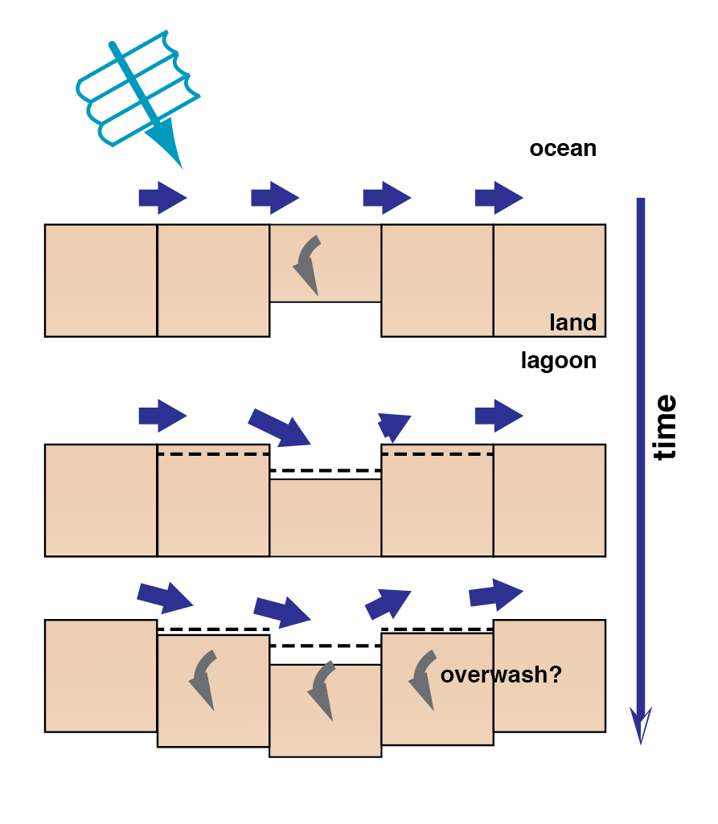
Coupling Along- and Cross-shore
Local overwash distorts the shoreline
Alongshore transport gradients fill the hole
Neighboring shoreline erodes
Neighboring shoreline begins overwashing?

Slide 40
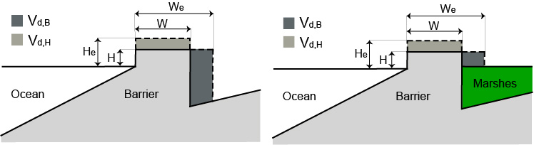
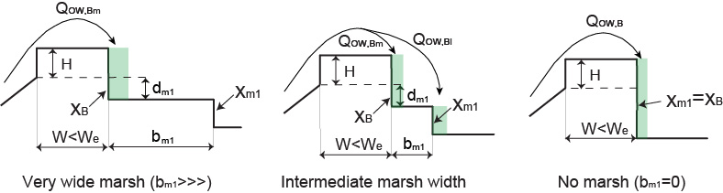
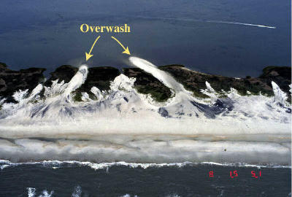

Slide 41
Shoreface Response
Assuming shallow water :
H = representative wave height
T = representative wave period
L = representative wave length
Ws = settling velocity
Assuming linear Airy wave theory :

Slide 42
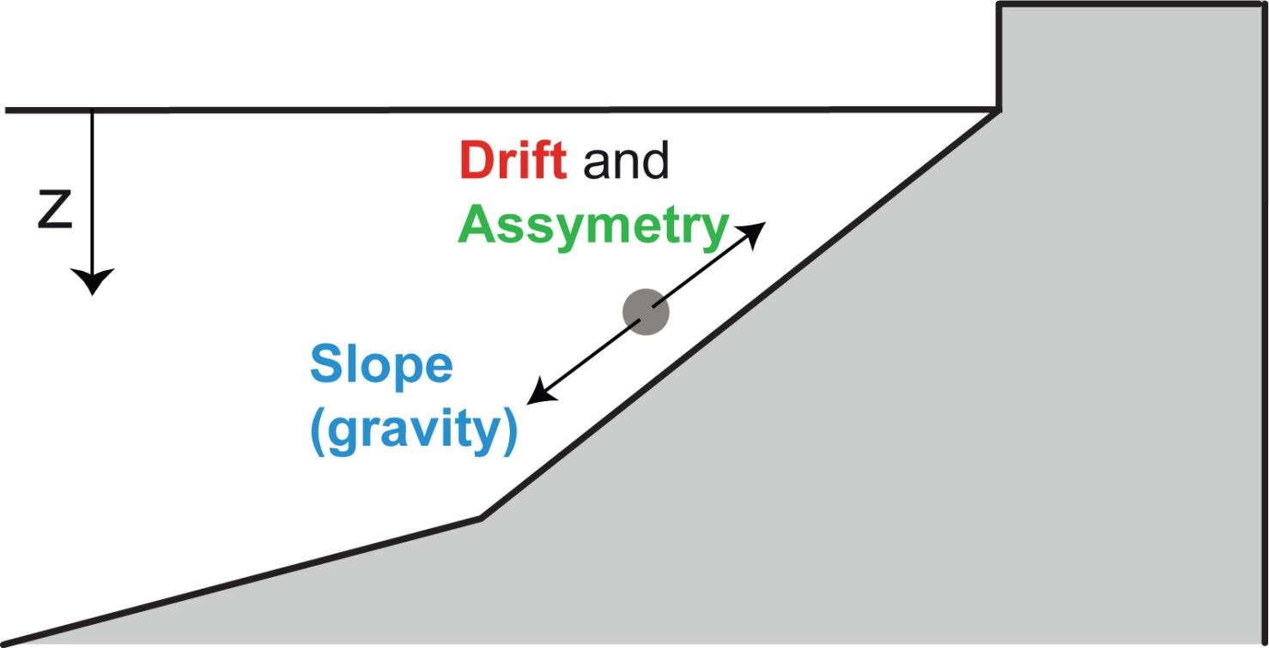
Shoreface Response
Energetics formulation for cross-shore suspended sediment transport (Ortiz and Ashton, submitted):
Drift
Asymmetry
Slope
  u₀ = wave orbital velocity (m/s)
  w_{s} = sediment settling velocity (m/s)
  β = bed slope
far from surf zone!

Slide 43
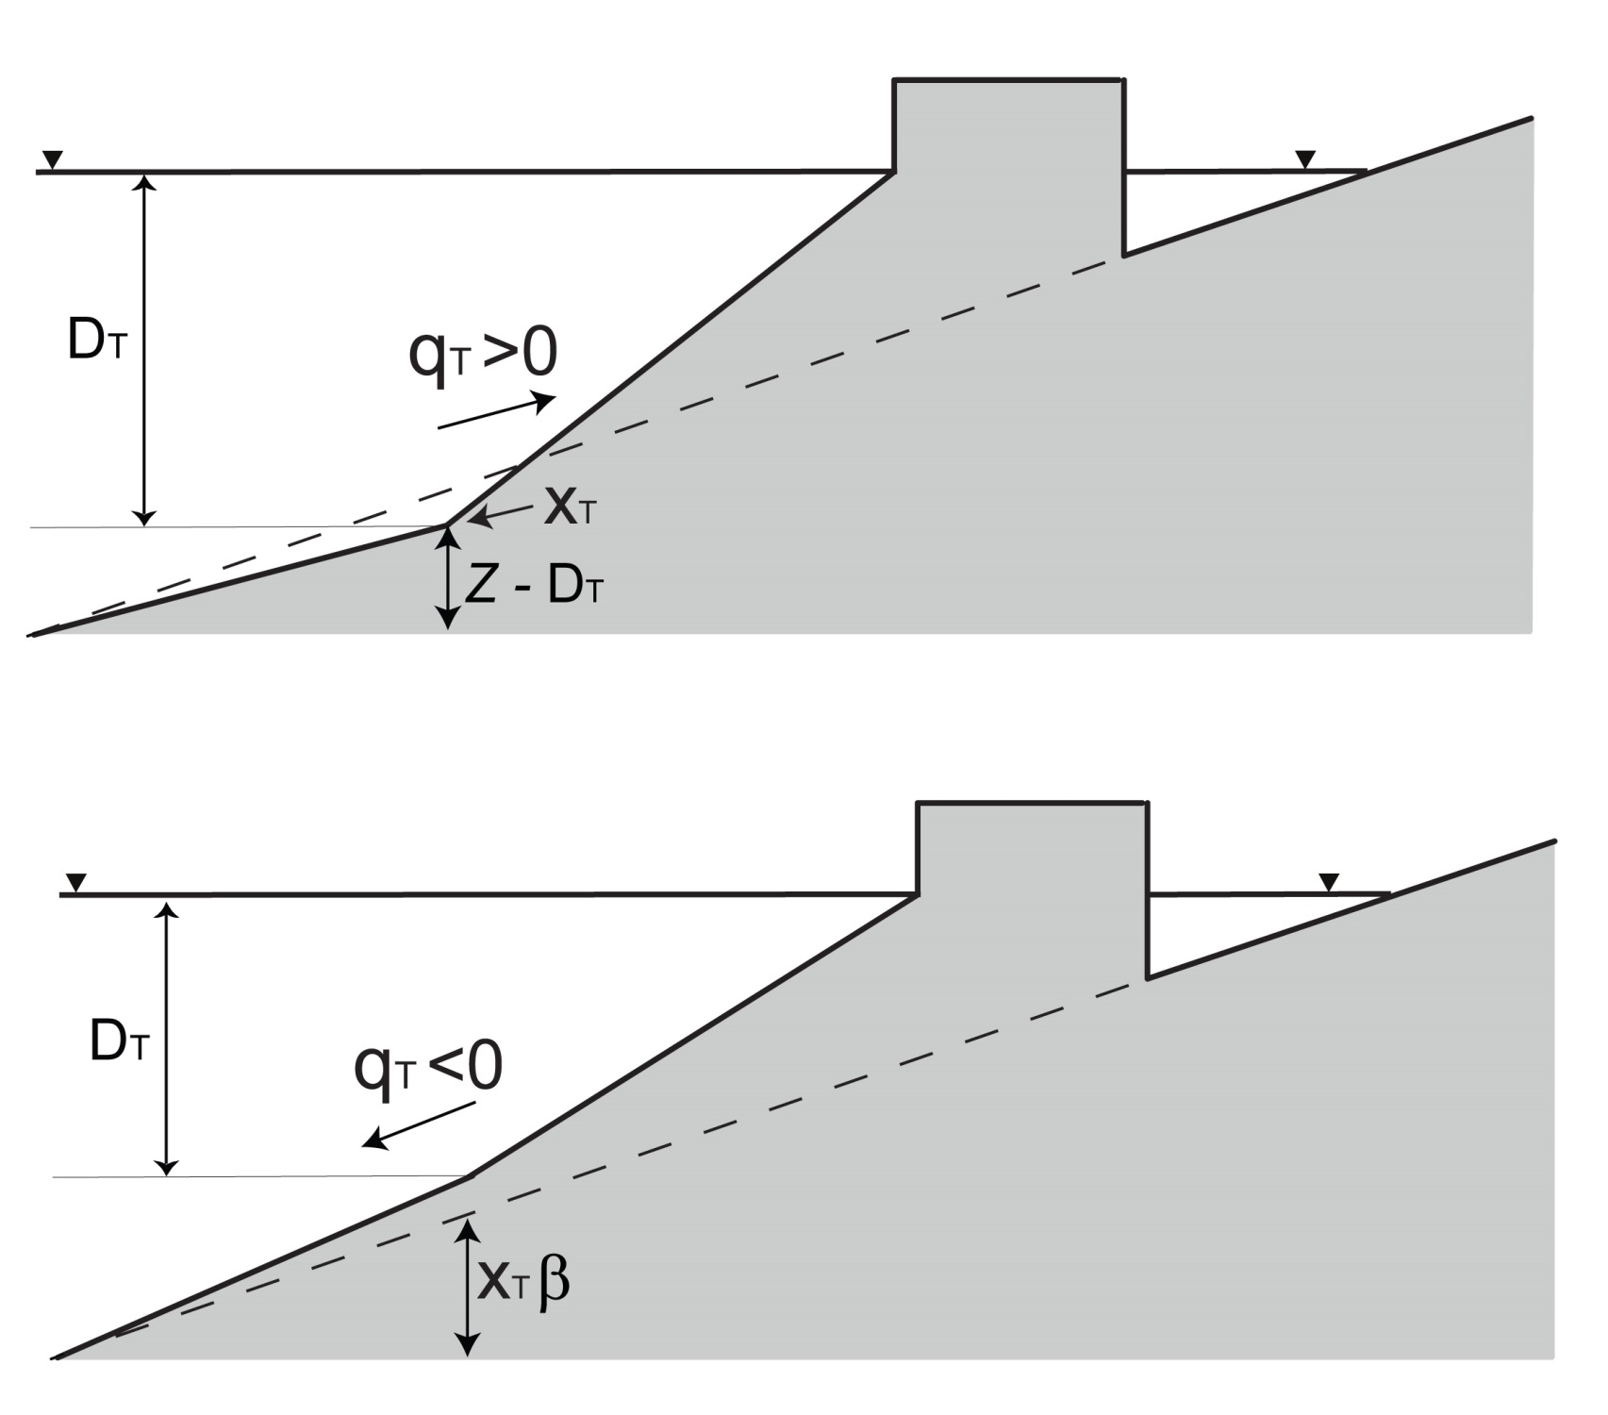
Sediment exchange barrier/shelf
Barrier incision into the substrate
Barrier loss of sediments

Slide 44
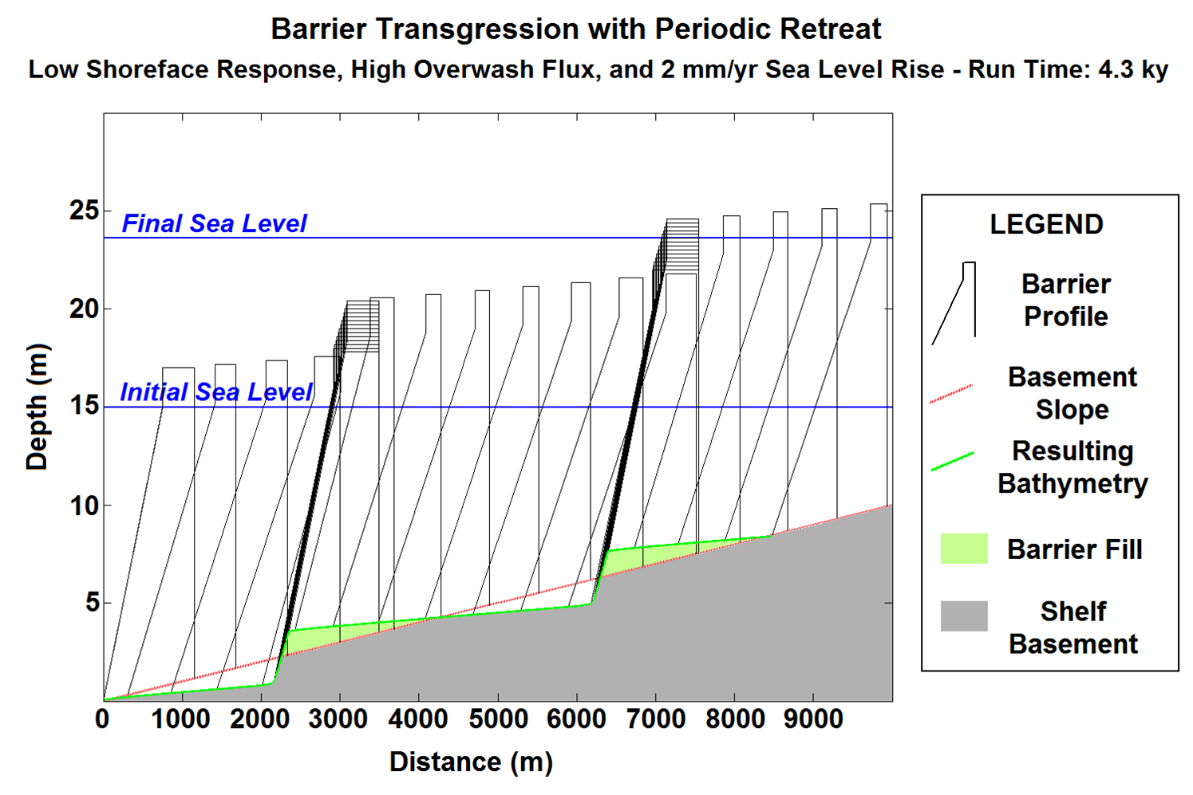
Relict barrier sediment on the shelf
Dan Ciarletta – PhD student at MSU

Slide 45
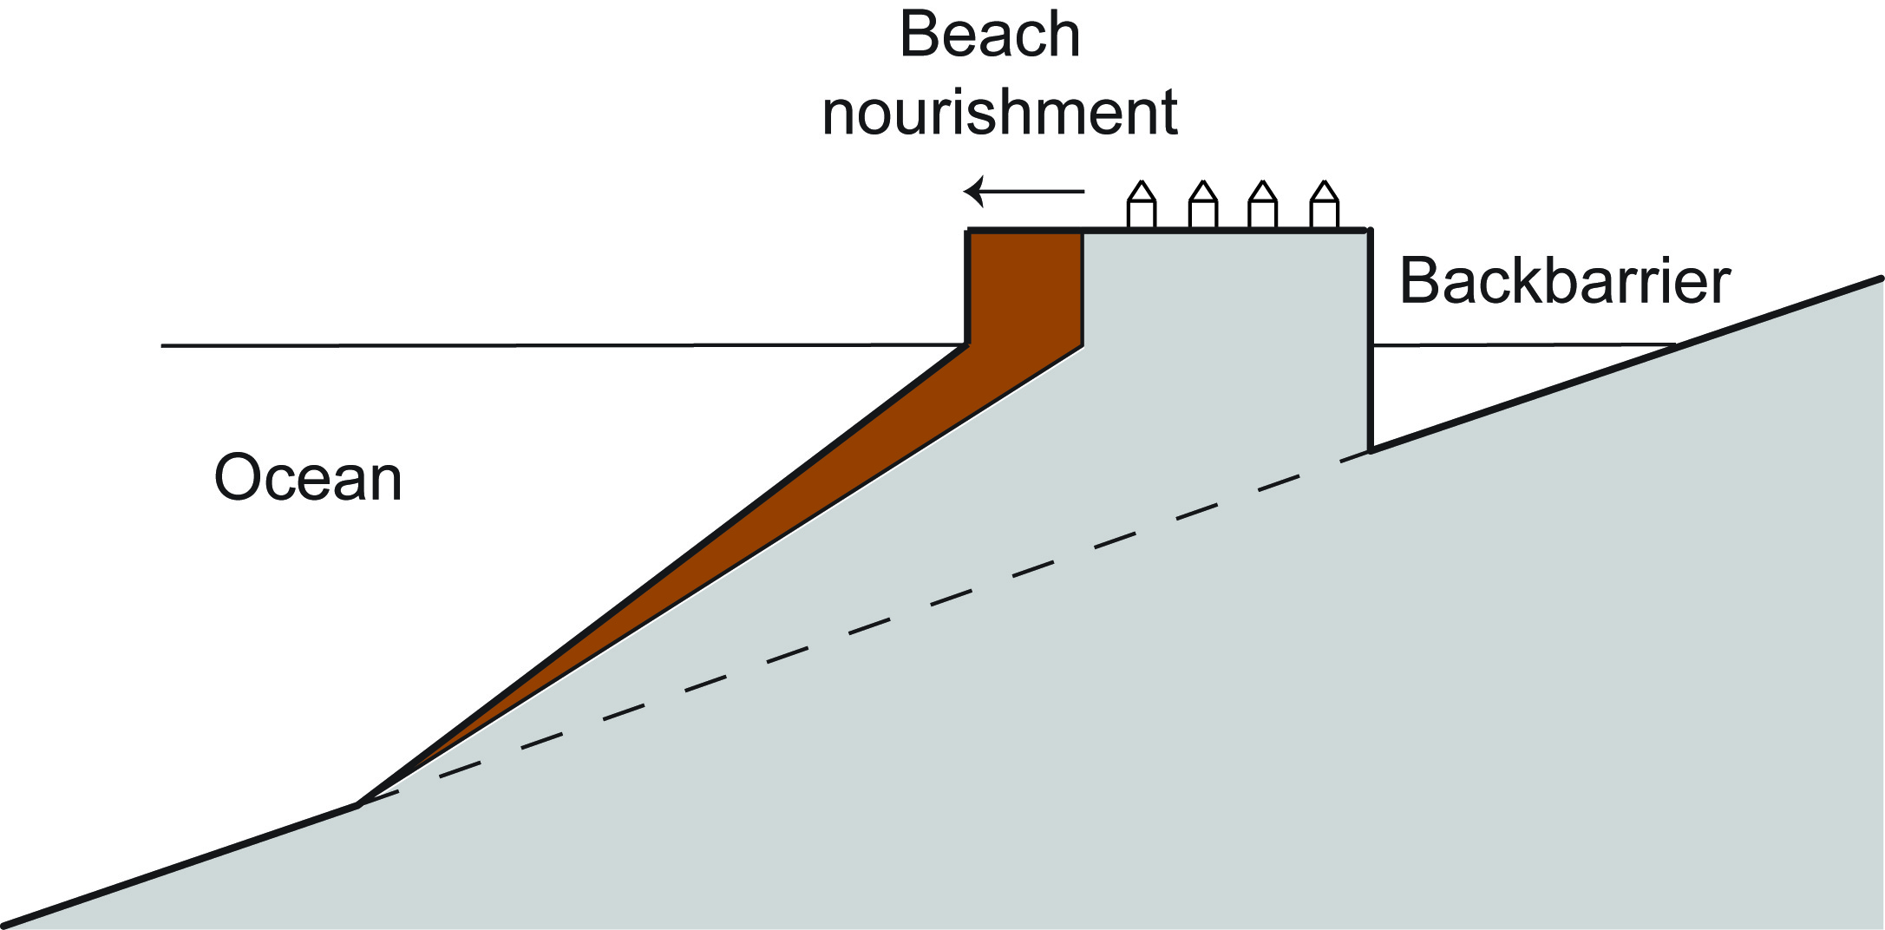

Coupling beach nourishment activities
and barrier evolution
Ocean City, NJ 2007
Lorenzo-Trueba et al. (in prep)
NJDEP

Slide 46

Sensitivity Analysis

