Slide 1
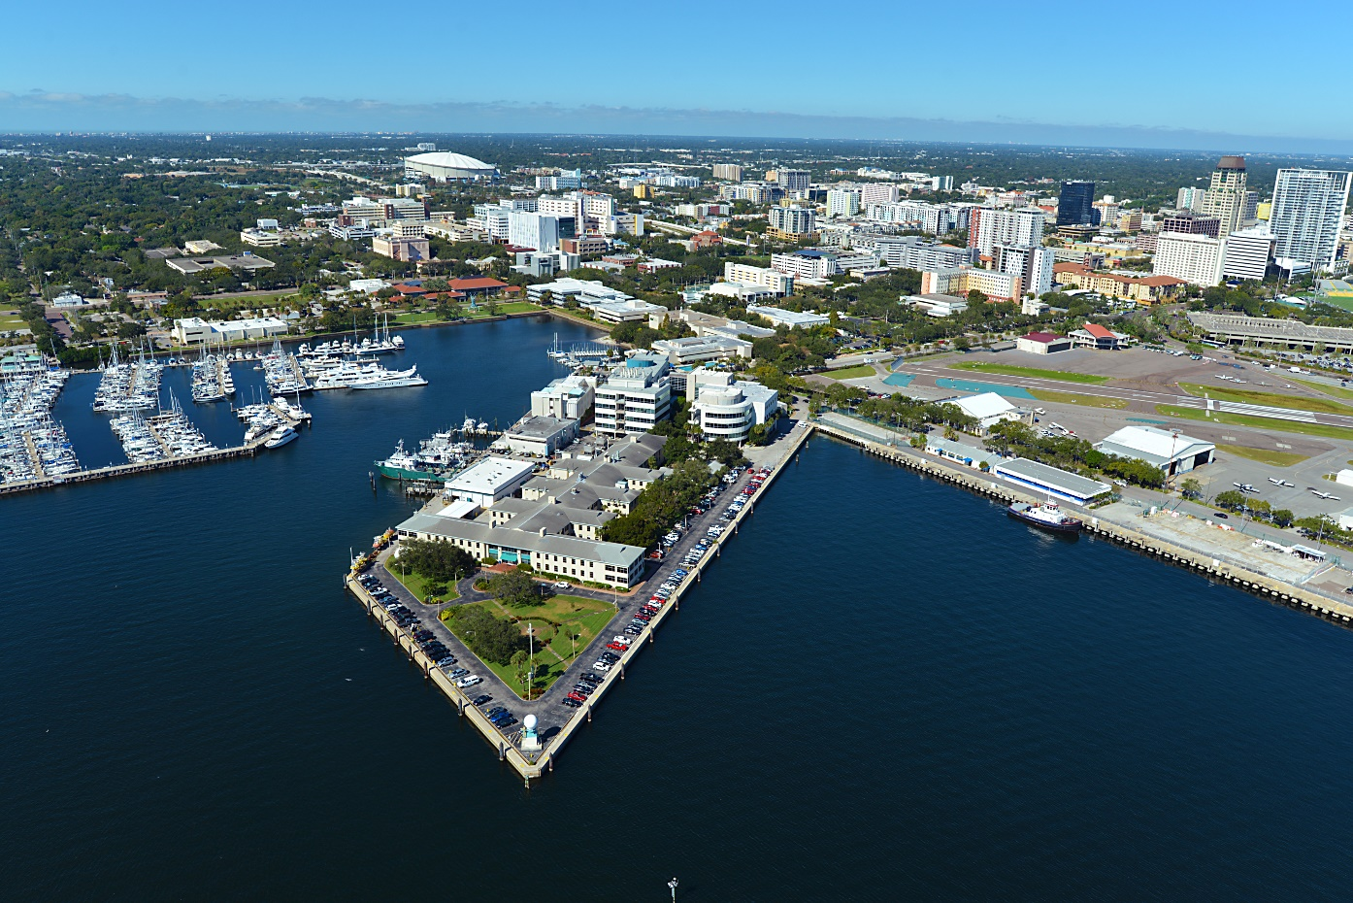
COLLEGE OF MARINE SCIENCE
2023 FALL ASSEMBLY

